Slide 1
Week 11
Quantum Statistics

Slide 2
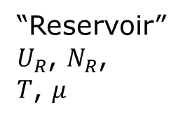
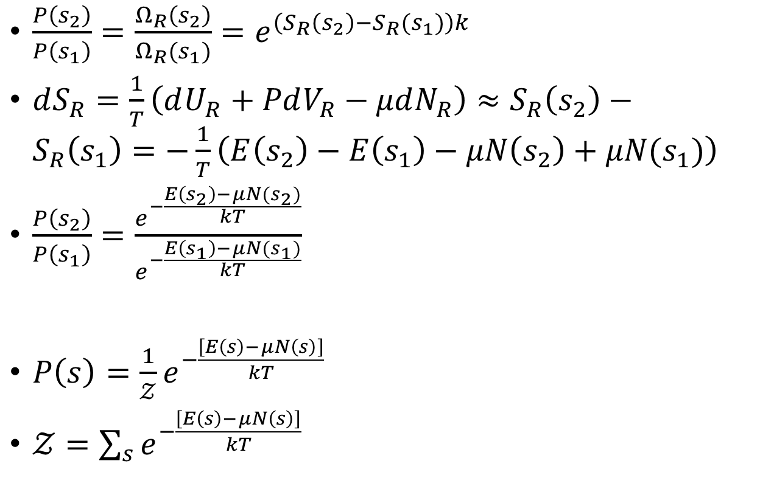

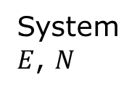
Gibbs factor/grand canonical ensemble
$\frac{P\left(s_{2}\right)}{P\left(s_{1}\right)}=\frac{Ω_{R}\left(s_{2}\right)}{Ω_{R}(s_{1})}=e^{\left(S_{R}\left(s_{2}\right)−S_{R}(s_{1})\right)k}$
$dS_{R}=\frac{1}{T}\left(dU_{R}+PdV_{R}−μdN_{R}\right)≈S_{R}\left(s_{2}\right)−S_{R}\left(s_{1}\right)=−\frac{1}{T}\left(E\left(s_{2}\right)−E\left(s_{1}\right)−μN\left(s_{2}\right)+μN(s_{1})\right)$
$\frac{P\left(s_{2}\right)}{P\left(s_{1}\right)}=\frac{e^{−\frac{E\left(s_{2}\right)−μN(s_{2})}{kT}}}{e^{−\frac{E\left(s_{1}\right)−μN(s_{1})}{kT}}}$
$P\left(s\right)=\frac{1}{𝒵}e^{−\frac{\left[E\left(s\right)−μN\left(s\right)\right]}{kT}}$
$𝒵=\sum_{s}{e^{−\frac{\left[E\left(s\right)−μN\left(s\right)\right]}{kT}}}$
“Reservoir” $U_{R}$, $N_{R}$,
$T$, $μ$
System
$E$, $N$
$U_{R}+E=const$, $N_{R}+N=const$

Slide 3
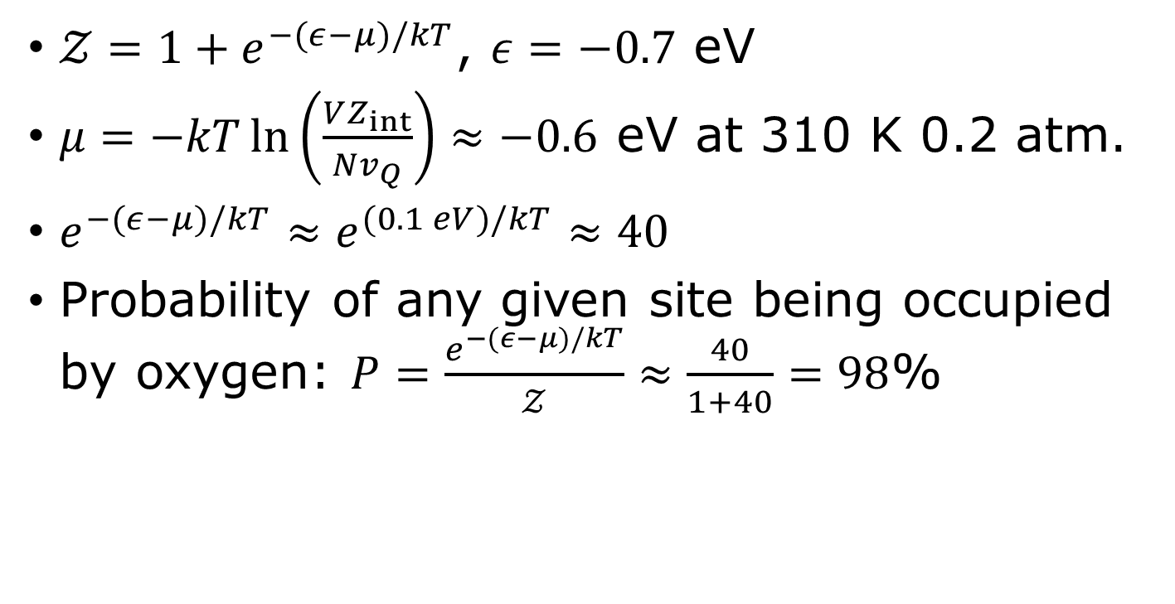


Hemoglobin with O₂
$$N=0$$
$$N=1$$
$𝒵=1+e^{−(ε−μ)/kT}$, $ε=−0.7$ eV
$μ=−kT\ln\left(\frac{VZ_{int}}{Nv_{Q}}\right)≈−0.6$ eV at 310 K 0.2 atm.
$e^{−(ε−μ)/kT}≈e^{(0.1 eV)/kT}≈40$
Probability of any given site being occupied by oxygen: $P=\frac{e^{−(ε−μ)/kT}}{𝒵}≈\frac{40}{1+40}=98$%

Slide 4
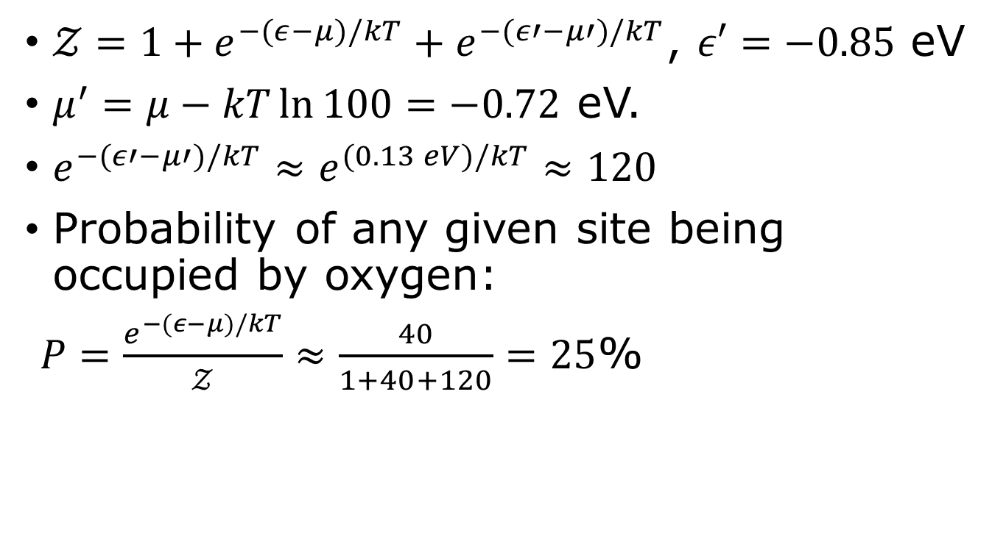
Carbon monoxide poisoning
CO 1/100th of CO₂
$𝒵=1+e^{−(ε−μ)/kT}+e^{−(ε′−μ′)/kT}$, $ε′=−0.85$ eV
$μ^{′}=μ−kT\ln{100}=−0.72$ eV.
$e^{−(ε′−μ′)/kT}≈e^{(0.13 eV)/kT}≈120$
Probability of any given site being occupied by oxygen:
$P=\frac{e^{−(ε−μ)/kT}}{𝒵}≈\frac{40}{1+40+120}=25$%

Slide 5
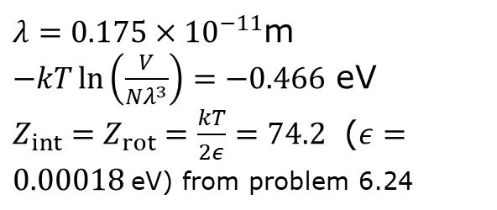
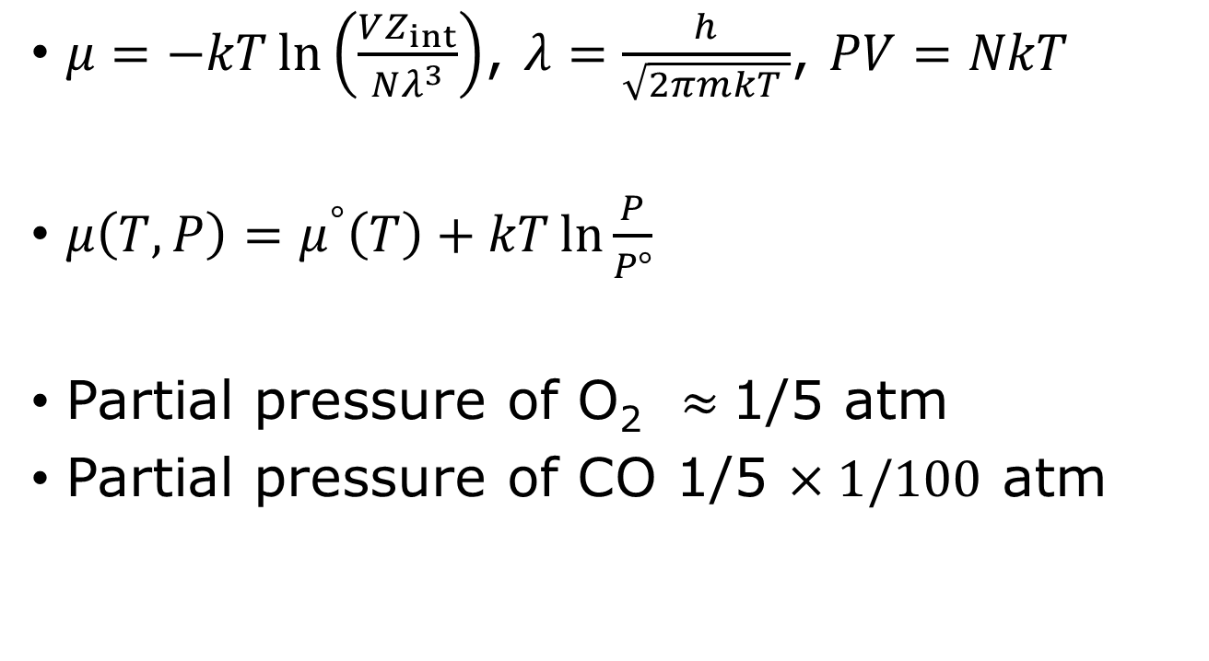
Chemical potential of ideal gas
$μ=−kT\ln\left(\frac{VZ_{int}}{Nλ^{3}}\right)$, $λ=\frac{h}{\sqrt{2πmkT }}$, $PV=NkT$
$μ\left(T,P\right)=μ^{°}\left(T\right)+kT\ln{\frac{P}{P°} }$
Partial pressure of O₂ $≈$1/5 atm
Partial pressure of CO 1/5 $×1/100$ atm
$λ=0.175×{10}^{−11}$m
$−kT\ln\left(\frac{V}{Nλ^{3}}\right)=−0.466$ eV
${Z_{int}=Z}_{rot}=\frac{kT}{2ε}=74.2$ ($ε=0.00018$eV) from problem 6.24

Slide 6
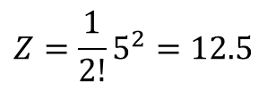
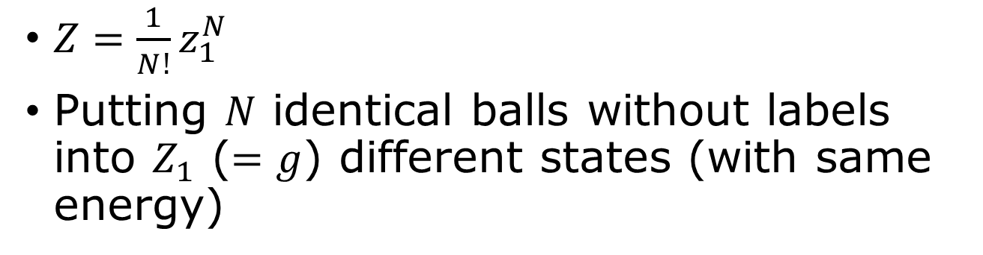
Boltzmann statistics
$Z=\frac{1}{N!}z_{1}^{N}$
Putting $N$ identical balls without labels into $Z_{1}$ ($=g$) different states (with same energy)
Boxes have labels – they are different states.
Balls are the same, indistinguishable.
$$Z=\frac{1}{2!}5^{2}=12.5$$
1 2 3 4 5

Slide 7
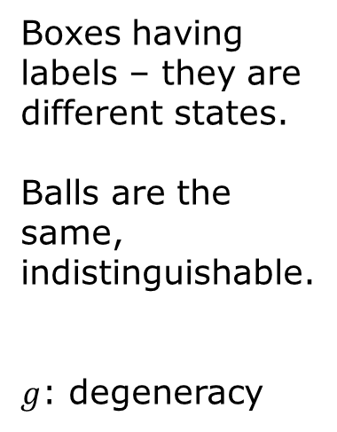
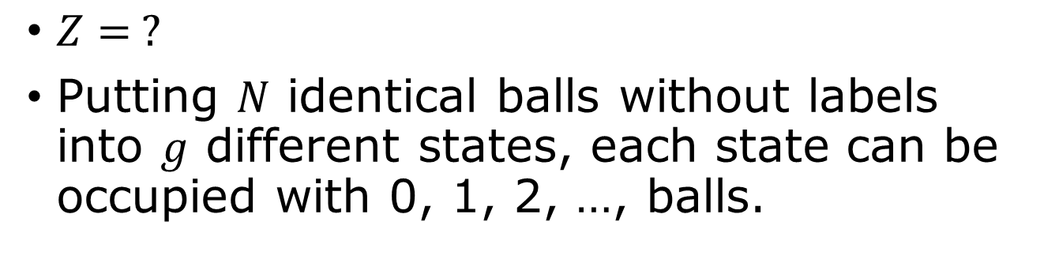
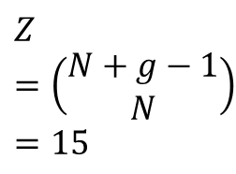
Bose statistics
01010 20000
01001 02000
00110 00200
00101 00020
01100 00011 00002
$Z= ?$
Putting $N$ identical balls without labels into $g$ different states, each state can be occupied with 0, 1, 2, …, balls.
Boxes having labels – they are different states.
Balls are the same, indistinguishable.
$g$: degeneracy
$$Z=\left(\begin{matrix}N+g−1 \\ N\end{matrix}\right)=15$$
1 2 3 4 5

Slide 8
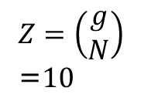
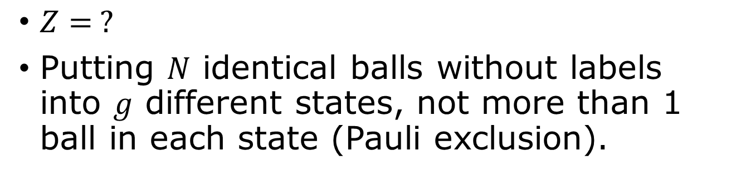
Fermi statistics
01010 20000
01001 02000
00110 00200
00101 00020
01100 00011 00002
$Z= ?$
Putting $N$ identical balls without labels into $g$ different states, not more than 1 ball in each state (Pauli exclusion).
Boxes having labels – they are different states.
Balls are the same, indistinguishable. Cannot put more than one ball is a box.
$Z=\left(\begin{matrix}g \\ N\end{matrix}\right)$ =$10$
1 2 3 4 5

Slide 9
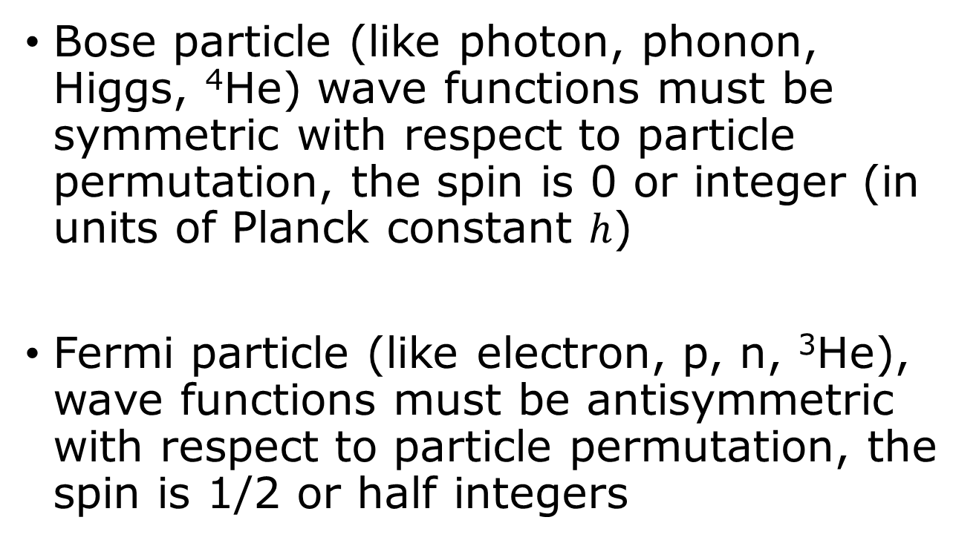
Spin and statistics
Bose particle (like photon, phonon, Higgs, ⁴He) wave functions must be symmetric with respect to particle permutation, the spin is 0 or integer (in units of Planck constant $h$)
Fermi particle (like electron, p, n, ³He), wave functions must be antisymmetric with respect to particle permutation, the spin is 1/2 or half integers

Slide 10

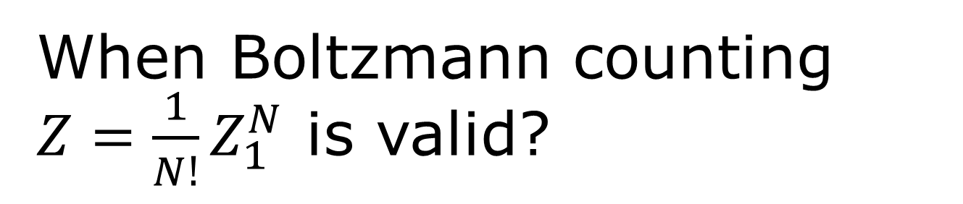


When Boltzmann counting $Z=\frac{1}{N!}Z_{1}^{N}$ is valid?
When we have much more states than balls, each state has very low probability of occupation. $Z_{1}≫N.$
$\frac{V}{Nλ^{3}}≫1$
$λ^{3}=v_{Q}$
$p\sim \sqrt{mkT}≈h/λ$
Normal gas, $\frac{V}{N}≫λ^{3}$
Quantum gas, $\frac{V}{N}≈λ^{3}$

Slide 11
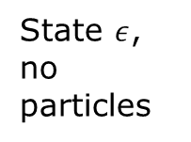
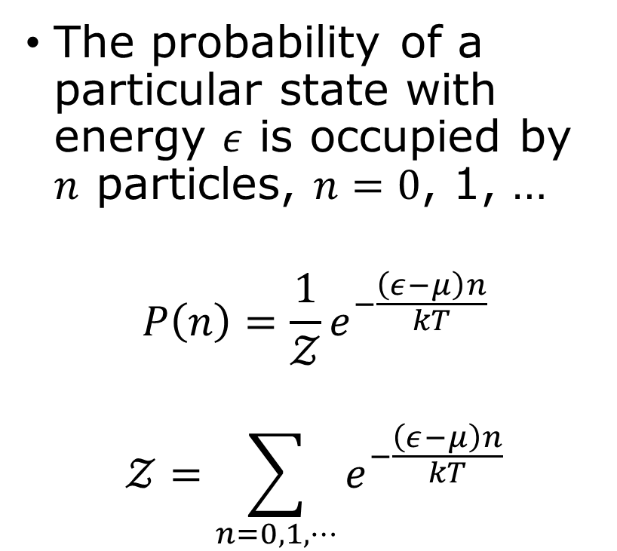
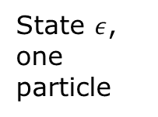
Particle number distribution
The probability of a particular state with energy $ε$ is occupied by $n$ particles, $n=0$, 1, …
$$P\left(n\right)=\frac{1}{𝒵}e^{−\frac{\left(ε−μ\right)n}{kT}}$$
$$𝒵=\sum_{n=0,1,⋯}{e^{−\frac{\left(ε−μ\right)n}{kT}}}$$
State $ε$, no particles
State $ε$, one particle
grand partition function
etc

Slide 12
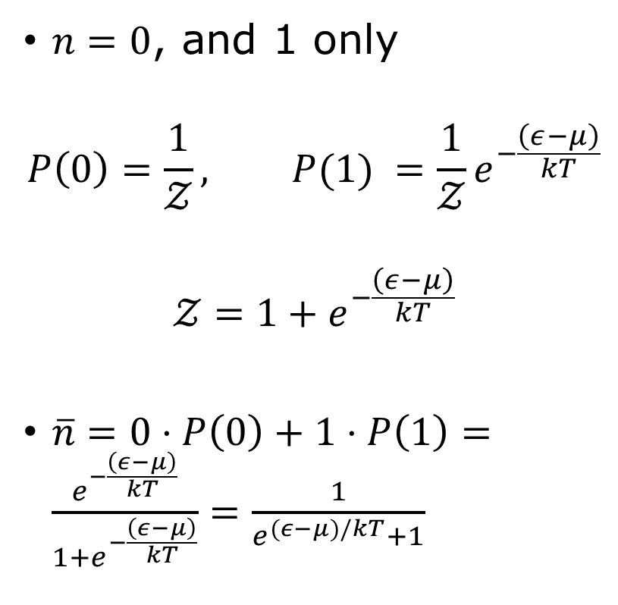
Fermi-Dirac distribution
$n=0$, and 1 only
$$P\left(0\right)=\frac{1}{𝒵}, P(1) =\frac{1}{𝒵}e^{−\frac{\left(ε−μ\right)}{kT}}$$
$$𝒵=1+e^{−\frac{\left(ε−μ\right)}{kT}}$$
$\overline{n}=0⋅P\left(0\right)+1⋅P\left(1\right)=\frac{e^{−\frac{\left(ε−μ\right)}{kT}}}{1+e^{−\frac{\left(ε−μ\right)}{kT}}}=\frac{1}{e^{(ε−μ)/kT}+1}$
State $ε$, no particles
State $ε$, one particle
Not allowed

Slide 13






Fermi-Dirac distribution for fermions
$${\overline{n}}_{FD}=\frac{1}{e^{\frac{ε−μ}{kT}}+1}$$
1
Low $T$
${\overline{n}}_{FD}=$occupancy
High $T$
0
$$ε$$
$$μ$$

Slide 14
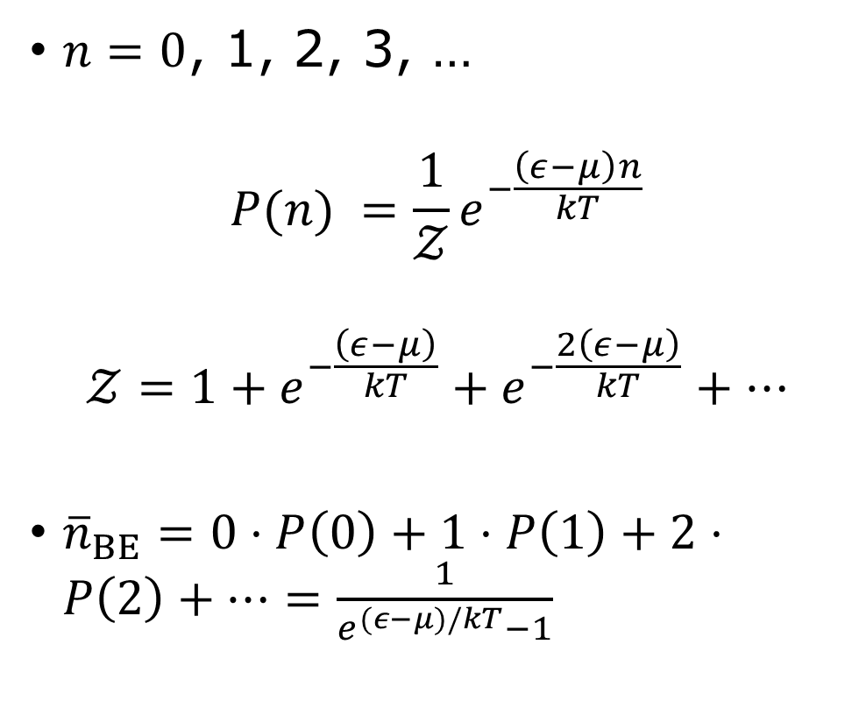
Bose-Einstein distribution
$n=0$, 1, 2, 3, …
$$P(n) =\frac{1}{𝒵}e^{−\frac{\left(ε−μ\right)n}{kT}}$$
$$𝒵=1+e^{−\frac{\left(ε−μ\right)}{kT}}+e^{−\frac{2\left(ε−μ\right)}{kT}}+⋯$$
${\overline{n}}_{BE}=0⋅P\left(0\right)+1⋅P\left(1\right)+2⋅P\left(2\right)+⋯=\frac{1}{e^{(ε−μ)/kT}−1}$
State $ε$, no particles
State $ε$, one particle
etc

Slide 15
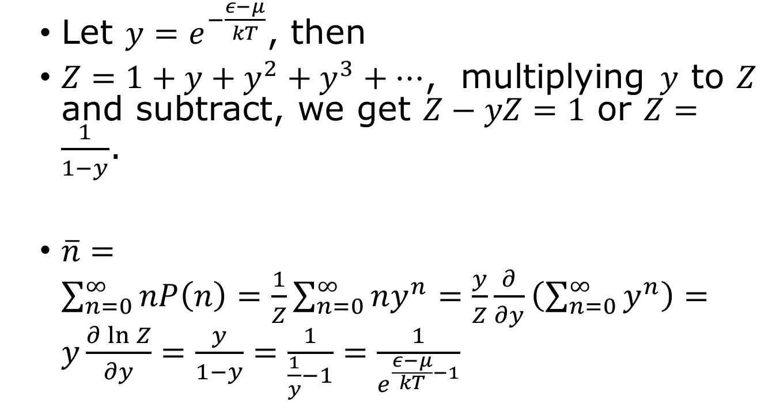

Compute the average $n$
Let $y=e^{−\frac{ε−μ}{kT}}$, then
$Z=1+y+y^{2}+y^{3}+⋯$, multiplying $y$ to $Z$ and subtract, we get $Z−yZ=1$ or $Z=\frac{1}{1−y}$.
$\overline{n}=\sum_{n=0}^{∞}{nP\left(n\right)=\frac{1}{Z}\sum_{n=0}^{∞}{ny^{n}=\frac{y}{Z}\frac{∂}{∂y}\left(\sum_{n=0}^{∞}{y^{n}}\right)}}=y\frac{∂\ln{Z}}{∂y}=\frac{y}{1−y}=\frac{1}{\frac{1}{y}−1}=\frac{1}{e^{\frac{ε−μ}{kT}−1}}$

Slide 16
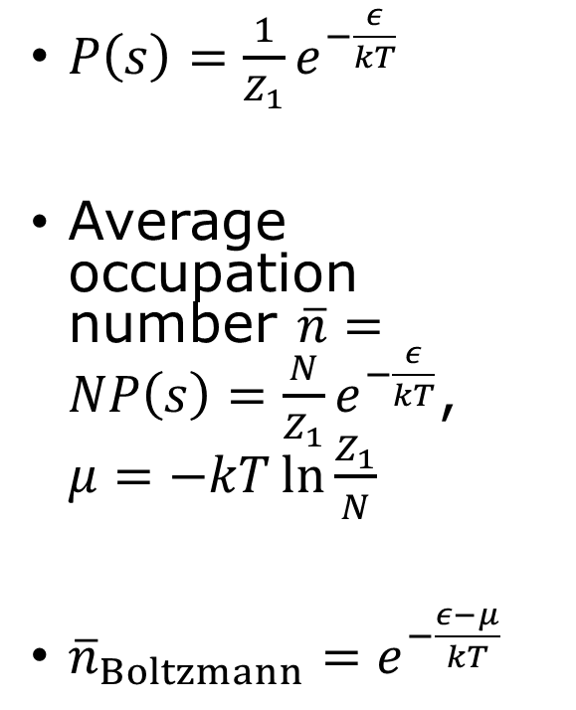
Boltzmann distribution
$P\left(s\right)=\frac{1}{Z_{1}}e^{−\frac{ε}{kT}}$
Average occupation number $\overline{n}=NP\left(s\right)=\frac{N}{Z_{1}}e^{−\frac{ε}{kT}}$, $μ=−kT\ln{\frac{Z_{1}}{N}}$
${\overline{n}}_{Boltzmann}=e^{−\frac{ε−μ}{kT}}$

Slide 17
Tutorial problems

Slide 18
Tutorial problem 6.44

