Slide 1
Week 7, Electron-phonon interaction, SSH Model, Peierls instability
Model for polyacetylene, Born-Oppenheimer approximation, electron band and band gap, density of states, Peierls instability

Slide 2
Polyacetylene (CH)_{n}
H
H
H
H
H
H
. . .
. . .
C
C
C
C
C
C
C
C
C
C
C
C
H
H
H
H
H
H
trans: zigzag
cis: armchair
Notes:
Polyacetylene: usually polymers are insulators. Polyacetylene is one of the first discovered good conductor.

Slide 3
Su-Schrieffer-Heeger (SSH) model
1
2
3
…
N
u₂
t₀
Notes:
W.P. Su, J.R. Schrieffer, A. J. Heeger, PRL 42, 1698 (1979), “solitons in polyacetylene”. See also PRB, 22, 2099 (1980). A unit cell contains one atom, boxed in red.

Slide 4
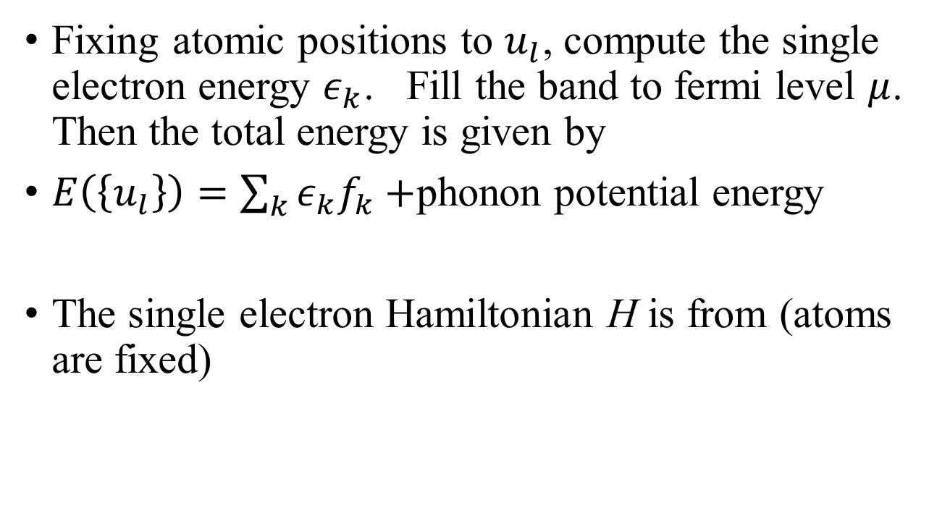
Born-Oppenheimer approximation
Fixing atomic positions to $u_{l}$, compute the single electron energy $ε_{k}$. Fill the band to fermi level $μ$. Then the total energy is given by
$E\left(\left\{u_{l}\right\}\right)=\sum_{k}{ε_{k}f_{k}}+$phonon potential energy
The single electron Hamiltonian H is from (atoms are fixed)
Notes:
The Born-Oppenheimer approximation is to treat the ions fixed (phonon degree fixed). When this is done, the phonons move under a potential where electrons are always in its many-body ground state. The reason is that m/M = 10^4, so we can treat ions not moving when study the electrons. M: mass of ion, m mass of electron.

Slide 5
Single electron H
Notes:
Figure from SSH paper in PRL of figure 2 on page 2100. Here alpha > 0 makes sense as if bond length is longer, the hopping should be smaller.

Slide 6
Special case, uniform displacement $u_{l}$ = const
$$ε_{k}$$
$$2t_{0}$$
k
$$−\frac{π}{a}$$
$$\frac{π}{a}$$
$$−2t_{0}$$

Slide 7
Odd/even displacement $u_{l}={\left(−1\right)}^{l}u_{0}$
$$t_{2} t_{1}$$
$$u_{1} u_{2} u_{3} …$$

Slide 8
Enlarged unit cell
$$t_{1} t_{2} t_{1} …$$
$$0 1 2 3 4 5 ….. N−1$$
Notes:
Each unit cell contains two atoms, with stronger hopping parameter t1 and weaker coupling for inter unit cell hopping t2.

Slide 9
Transform Hamiltonian $\hat{H}$ into k-space

Slide 10
Diagonalize the k-space H
Notes:
Use cos(2x) = 2 cos^2(x) – 1.

Slide 11
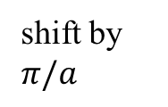
Zone folding when α = 0
$$ε_{k}$$
shift by $π/a$
$$2t_{0}$$
k
$$−\frac{π}{a}$$
$$\frac{π}{a}$$
$$\frac{π}{2a}$$
$$−2t_{0}$$
Original Brillouin zone $[−\frac{π}{a},\frac{π}{a} ),$
New BZ half smaller.
Notes:
The total number of states are the same in the two cases. This means dk is the same, 2pi/(aN) = 2pi/(2aL). L=N/2.

Slide 12
Gapped band structure when $α≠0$
$$ε_{k}$$
$$+2t_{0}$$
$$−\frac{π}{2a}$$
$$\frac{π}{2a}$$
$$−2t_{0}$$
Notes:
Why the band has + and – symmetry? Ans: chiral symmetry (or particle – hole symmetry), which is, in math, there is a G such that, G^-1 H G = -H.

Slide 13
Density of states in 1D system
$$2t_{0}$$
$$Δ$$
$$D(ε)$$
$$−Δ$$
von Hove Singularity
$$−2t_{0}$$

Slide 14
Compute total energy E(u)
Notes:
Extended band figure from Su, Schrieffer, Heeger, PRL 42, 1698 (1979).

Slide 15
Density of states from the Green’s function
Why the density of states D(E) is given by the spectrum function A(E), and what const we need to take so that it agrees with the previous slide?

Slide 16
Peierls instability
$$E(u)/N$$
$${−u}_{0}$$
$$u_{0}$$
$$u$$
$$−E_{c}/N$$
Notes:
From figure 5, W. P. Su, J. R. Schrieffer, and A. J. Heeger, Phys. Rev. B, 22, 2099 (1980).

