Slide 1
Week 11,
Boltzmann Machine
Notes:
See Haykin, “Neural Networks”, 2nd ed, Chap 11.7; or Fischer and Igel. “Training Restricted
Boltzmann Machines: An Introduction,” in Pattern Recognition 47:25-39, 2014

Slide 2
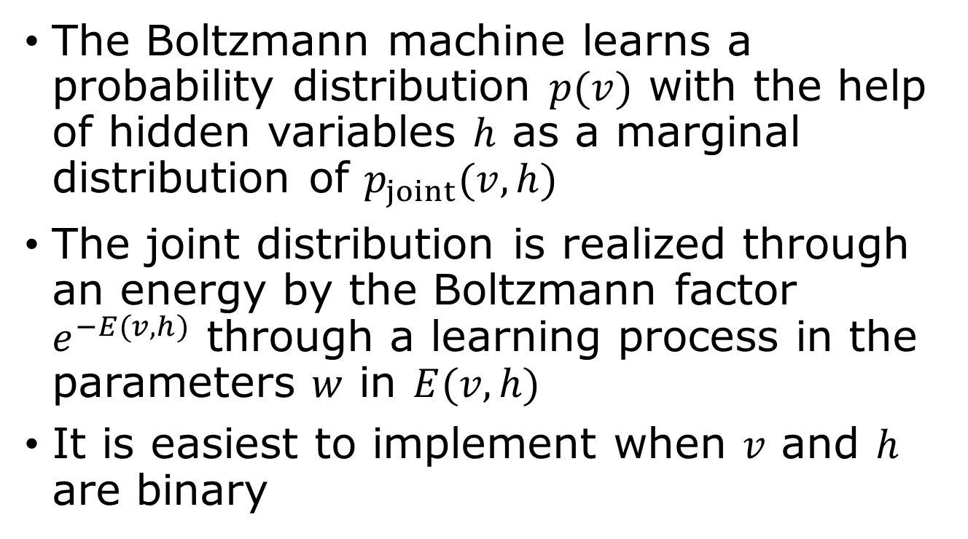
Model data distribution
The Boltzmann machine learns a probability distribution $p(v)$ with the help of hidden variables $h$ as a marginal distribution of $p_{joint}(v,h)$
The joint distribution is realized through an energy by the Boltzmann factor $e^{−E(v,h)}$ through a learning process in the parameters $w$ in $E(v,h)$
It is easiest to implement when $v$ and $h$ are binary

Slide 3
What a Boltzmann machine can do?
Recommendation systems: predict user preferences by analyzing past user-item interactions, allowing for personalized recommendations on online platforms
Image recognition and processing: extract meaningful features from images and used for tasks like image denoising, reconstruction, and general pattern recognition
Natural Language processing and generative modeling

Slide 4

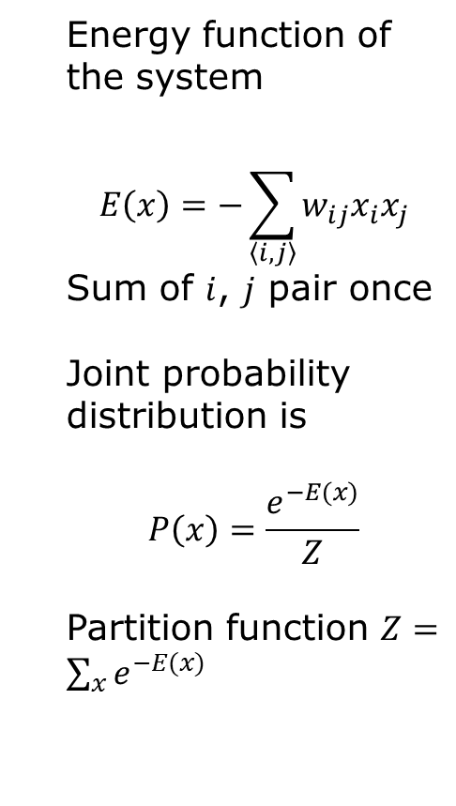





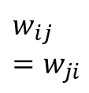

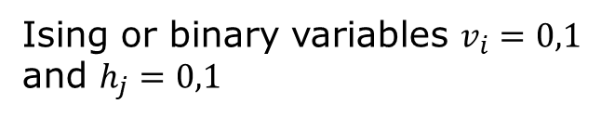


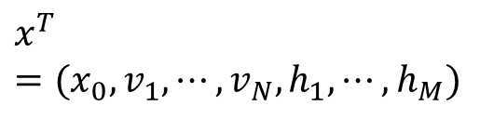
Visible and hidden units
$$x^{T}=(x_{0}, v_{1},⋯, v_{N},h_{1},⋯, h_{M})$$
Energy function of the system
$$E\left(x\right)=−\sum_{\left\langle i,j\right\rangle }{w_{ij}x_{i}x_{j}}$$
Sum of $i$, $j$ pair once
Joint probability distribution is
$$P\left(x\right)=\frac{e^{−E(x)}}{Z}$$
Partition function $Z=\sum_{x}{e^{−E(x)}}$
$$x_{0}=1$$
$${ h}_{1}$$
$${ h}_{2}$$
…
$${ h}_{j}$$
…
$${ h}_{M}$$
$$w_{ij}=w_{ji}$$
$${ v}_{1}$$
$${ v}_{2}$$
…
$${ v}_{i}$$
…
$${ v}_{N}$$
Ising or binary variables $v_{i}=0,1$ and $h_{j}=0,1$

Slide 5
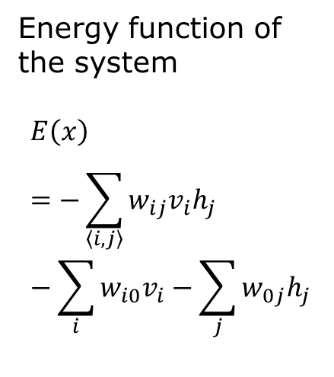

Restricted Boltzmann machine – no self-interaction
$$x^{T}=(x_{0}, v_{1},⋯, v_{N},h_{1},⋯, h_{M})$$
Energy function of the system
$$E\left(x\right)=−\sum_{\left\langle i,j\right\rangle }{w_{ij}v_{i}h_{j}}−\sum_{i}{w_{i0}v_{i}}−\sum_{j}{w_{0j}h_{j}}$$
$$x_{0}=1$$
$${ h}_{1}$$
$${ h}_{2}$$
…
$${ h}_{j}$$
…
$${ h}_{M}$$
$$w_{ij}$$
$${ v}_{1}$$
$${ v}_{2}$$
…
$${ v}_{i}$$
…
$${ v}_{N}$$
bipartite
Ising or binary variables $v_{i}=0,1$ and $h_{j}=0,1$

Slide 6

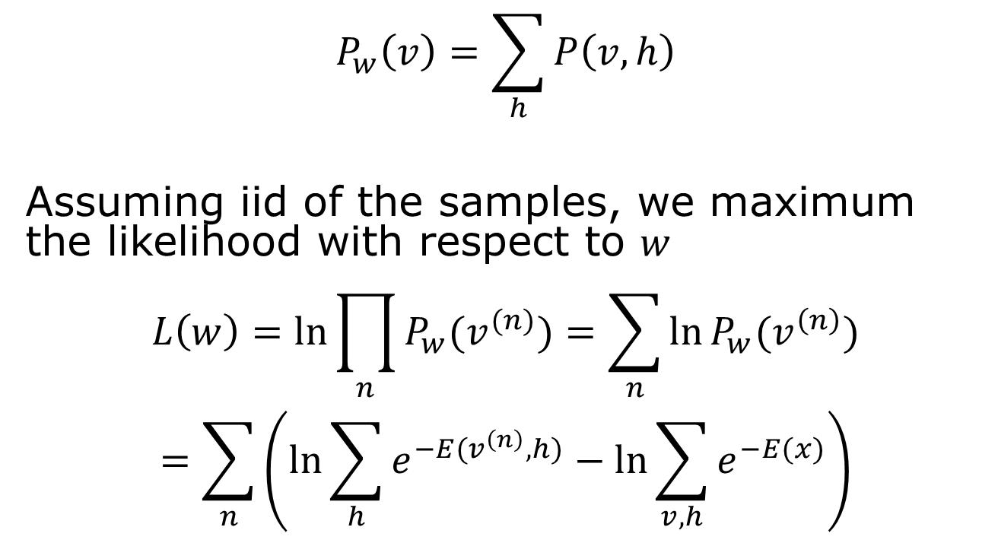
Learn sample probability from data
$$x=\left(\begin{matrix}1 \\ v \\ h\end{matrix}\right)$$
$$P_{w}\left(v\right)=\sum_{h}{P\left(v,h\right)}$$
Assuming iid of the samples, we maximum the likelihood with respect to $w$
$$L\left(w\right)=\ln{\prod_{n}{P_{w}(v^{(n)})}}=\sum_{n}{\ln{P_{w}(v^{\left(n\right)})}}$$
$$=\sum_{n}{\left(\ln{\sum_{h}{e^{−E(v^{\left(n\right)},h)}}}−\ln{\sum_{v,h}{e^{−E(x)}}}\right)}$$
By marginalization

Slide 7
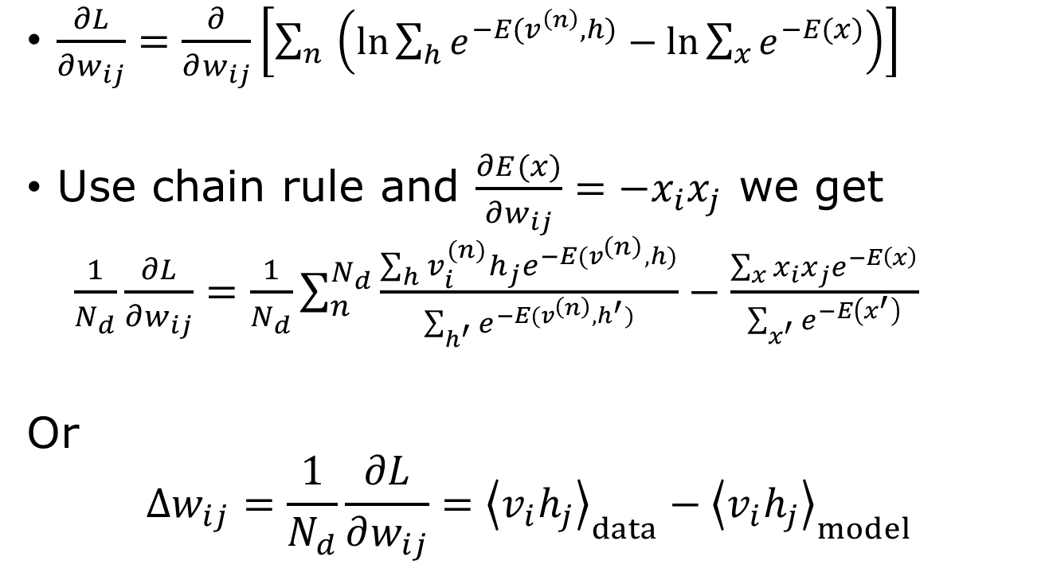
Compute gradient
$\frac{∂L}{∂w_{ij}}=\frac{∂}{∂w_{ij}}\left[\sum_{n}{\left(\ln{\sum_{h}{e^{−E(v^{\left(n\right)},h)}}}−\ln{\sum_{x}{e^{−E(x)}}}\right)}\right]$
Use chain rule and $\frac{∂E(x)}{∂w_{ij}}=−x_{i}x_{j}$ we get
$\frac{1}{N_{d}}\frac{∂L}{∂w_{ij}}=\frac{1}{N_{d}}\sum_{n}^{N_{d}}{\frac{\sum_{h}{v_{i}^{(n)}h_{j}e^{−E(v^{\left(n\right)},h)}}}{\sum_{h^{′}}{e^{−E(v^{\left(n\right)},h^{′})}}}}−\frac{\sum_{x}{{x_{i}x_{j}e}^{−E\left(x\right)}}}{\sum_{x^{′}}{e^{−E\left(x^{′}\right)}}}$
Or
$$Δw_{ij}=\frac{1}{N_{d}}\frac{∂L}{∂w_{ij}}={\left\langle v_{i}h_{j}\right\rangle }_{data}−{\left\langle v_{i}h_{j}\right\rangle }_{model}$$

Slide 8
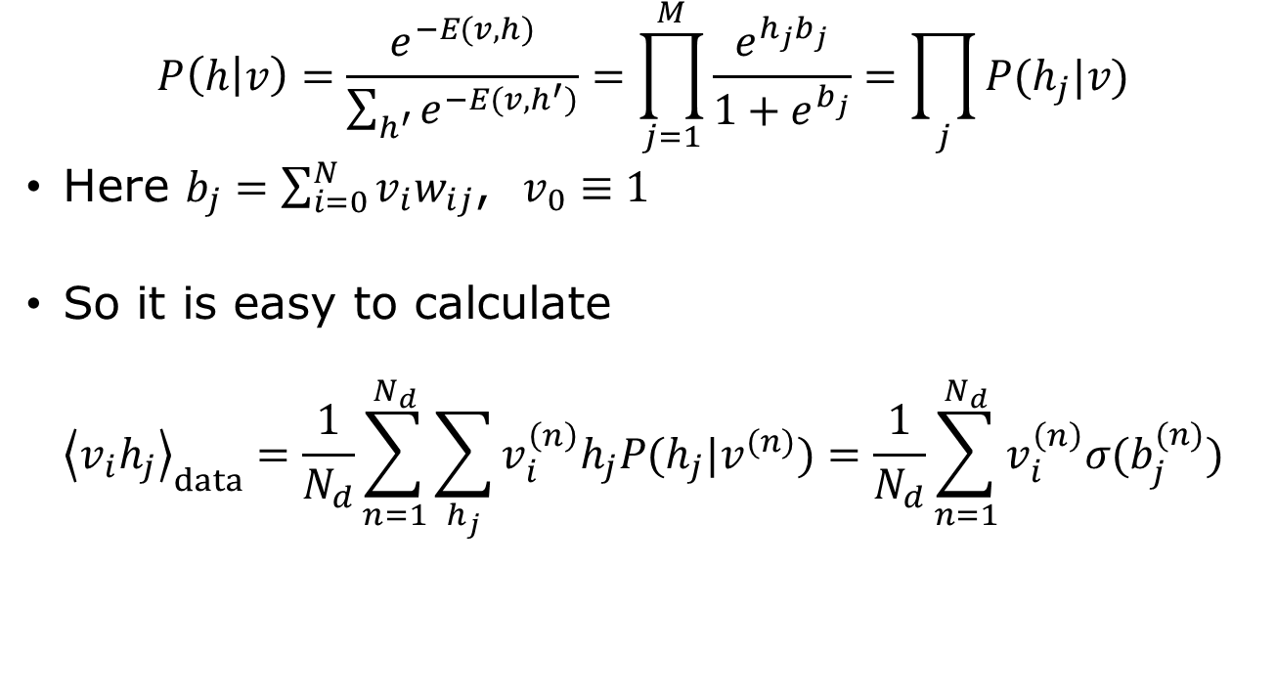
Conditional probability of h given data
$$P\left(h | v\right)=\frac{e^{−E(v,h)}}{\sum_{h^{′}}{e^{−E(v,h^{′})}}}=\prod_{j=1}^{M}{\frac{e^{{h_{j}b}_{j}}}{1+e^{b_{j}}}}=\prod_{j}{P(h_{j}|v)}$$
Here $b_{j}=\sum_{i=0}^{N}{v_{i}w_{ij}}$, $v_{0}≡1$
So it is easy to calculate
$${\left\langle v_{i}h_{j}\right\rangle }_{data}=\frac{1}{N_{d}}\sum_{n=1}^{N_{d}}{\sum_{h_{j}}{v_{i}^{\left(n\right)}h_{j}P(h_{j}|v^{(n)})}}=\frac{1}{N_{d}}\sum_{n=1}^{N_{d}}{v_{i}^{\left(n\right)}σ(b_{j}^{(n)})}$$

Slide 9
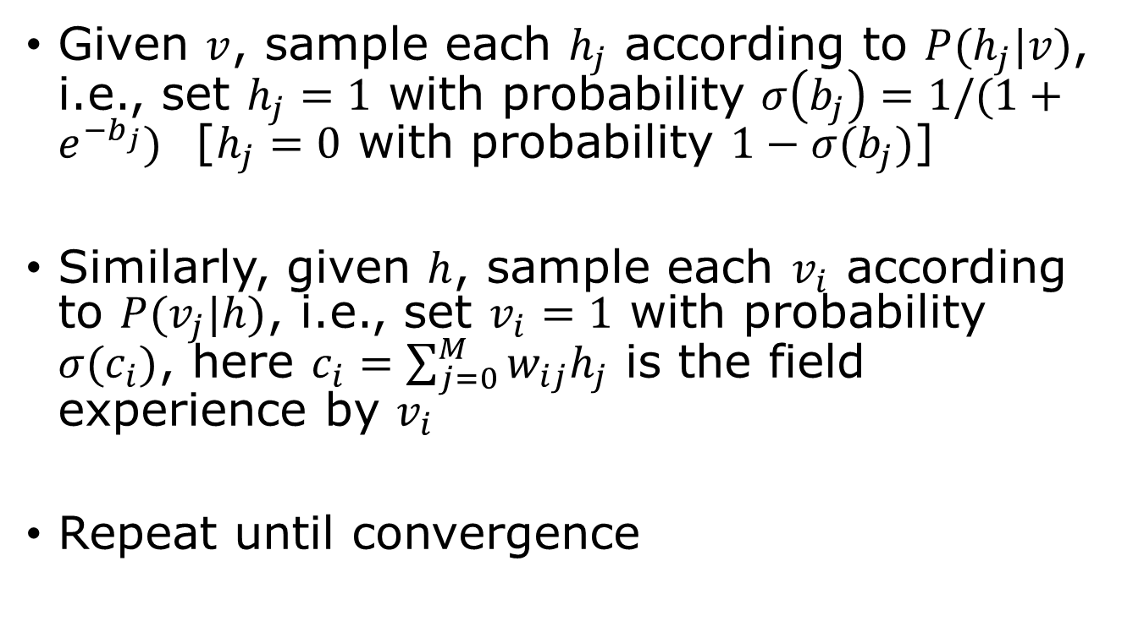
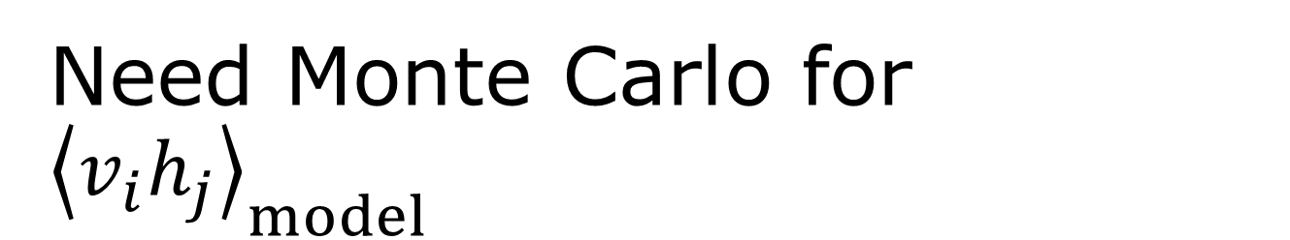
Need Monte Carlo for ${\left\langle v_{i}h_{j}\right\rangle }_{model}$
Given $v$, sample each $h_{j}$ according to $P(h_{j}|v)$, i.e., set $h_{j}=1$ with probability $σ\left(b_{j}\right)=1/(1+e^{−b_{j}})$ [$h_{j}=0$ with probability $1−σ(b_{j})$]
Similarly, given $h$, sample each $v_{i}$ according to $P(v_{j}|h)$, i.e., set $v_{i}=1$ with probability $σ(c_{i})$, here $c_{i}=\sum_{j=0}^{M}{w_{ij}h_{j}}$ is the field experience by $v_{i}$
Repeat until convergence

Slide 10
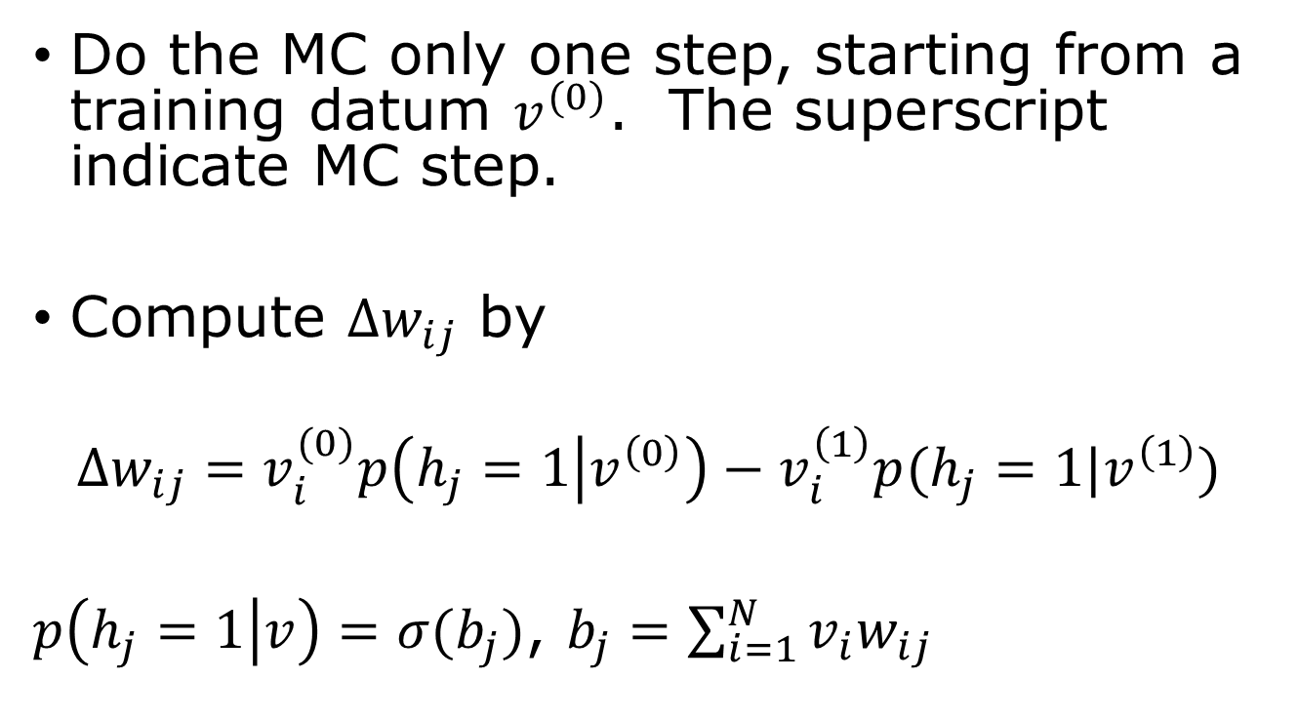
Contrastive divergence
Do the MC only one step, starting from a training datum $v^{(0)}$. The superscript indicate MC step.
Compute $Δw_{ij}$ by
$${Δw_{ij}=v}_{i}^{(0)}p\left(h_{j}=1 | v^{\left(0\right)}\right)−v_{i}^{\left(1\right)}p(h_{j}=1|v^{\left(1\right)})$$
$p\left(h_{j}=1 | v\right)=σ(b_{j})$, $b_{j}=\sum_{i=1}^{N}{v_{i}w_{ij}}$

Slide 11
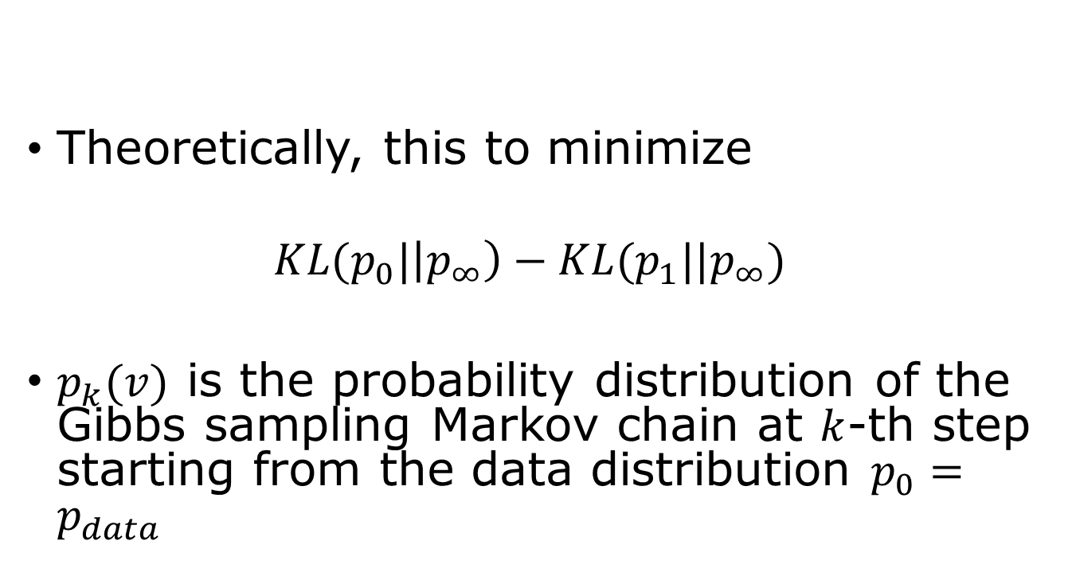
Contrastive divergence
Theoretically, this to minimize
$$KL(p_{0}|\left|p_{∞}\right)−KL(p_{1}||p_{∞})$$
$p_{k}(v)$ is the probability distribution of the Gibbs sampling Markov chain at $k$-th step starting from the data distribution $p_{0}=p_{data}$

Slide 12
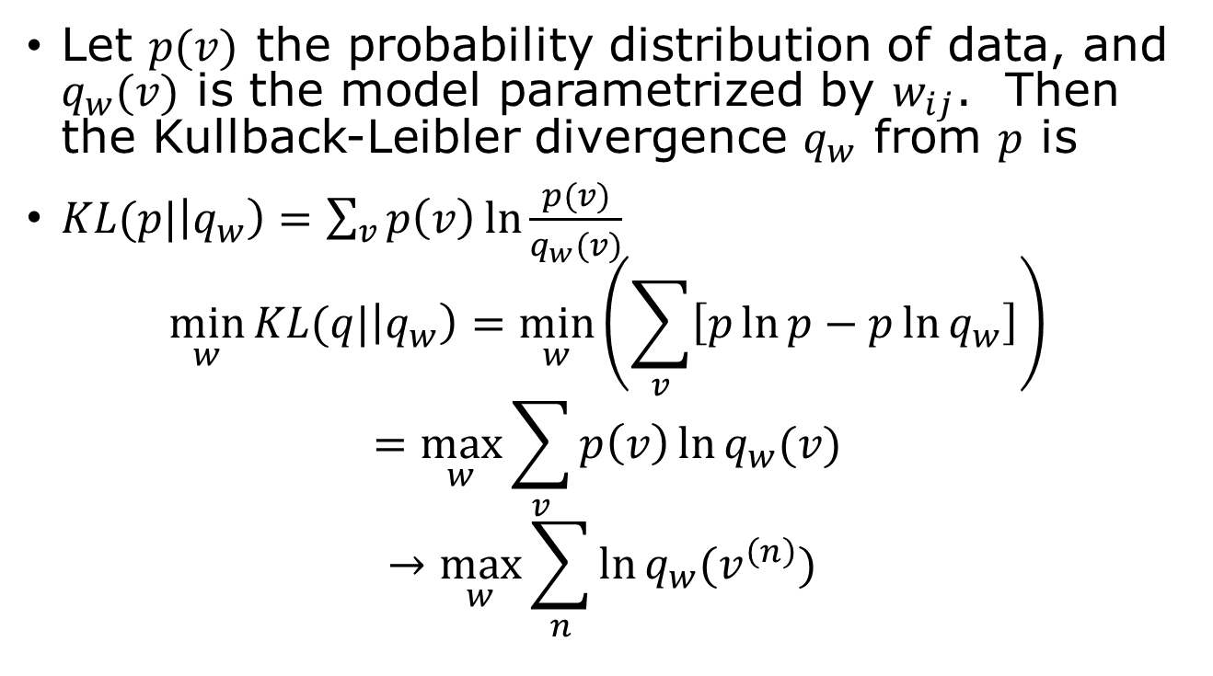
Maximising Likelihood is equivalent to minimizing KL Divergence
Let $p(v)$ the probability distribution of data, and $q_{w}(v)$ is the model parametrized by $w_{ij}$. Then the Kullback-Leibler divergence $q_{w}$ from $p$ is
$KL(p|\left|q_{w}\right)=\sum_{v}{p\left(v\right)\ln{\frac{p(v)}{q_{w}(v)}}}$
$$\min_{w}{KL(q|\left|q_{w}\right)=\min_{w}\left(\sum_{v}{\left[p\ln{p}−p\ln{q_{w}}\right]}\right)}$$
$$=\max_{w}{\sum_{v}{p\left(v\right)\ln{q_{w}(v)}}}$$
$$→\max_{w}{\sum_{n}{\ln{q_{w}(v^{\left(n\right)}) }}}$$
Replace probability average by sample average

