Slide 1
Week 2, Programming in machine learning, Python & Pytorch

Slide 2
Install Python
www.python.org
www.anaconda.com/download
Go to the download tab
Download the installer of the latest version for the operating system of your PC (windows vs macOS, or Linux)
Follow the instructions in executing the exe file.
Use IDLE
Choose your OS (Windows, Mac or Linux)
Download the graphical installer
Advantage: you get jupyter notebook, numpy, as well as many other packages

Slide 3
First Python Example
How to run the script? option 1, in cmd command prompt DOS box, using py hello.py (name of this file).
option 2, open the file in Python IDLE and click Run -> Run Module.
Press shift-enter on jupyter notebook.
# This program prints hello
#
print("hello, world!")
x = 1
y = 2
z = x + y
print(x, "+", y, "=", z)
Notes:
For Python, see for example, E. Matthes, “Python crash course”, 2nd edition. Or B. Lubanovic, “Introducing Python”. IDLE: integrated development and learning environment.

Slide 4
Data Types
booleans (True or False)
integers: 42, 1000, 2**100
floats: pi = 3.14159
complex: z = 1.0 + 2.5j
string, four ways: single quote, 'like', double quote, "open or close", or triple quotes, """this""", or '''this and that is in "a" la'''
Notes:
j is used as the complex units, you can type 1j for sqrt(-1), but not j alone.

Slide 5
Name of a Variable
The name serves as a handle to refer to the data (boolean, integer, etc)
The name is case sensitive, cannot start with a digit. Special character underscore can be used:
a, a1, A, x_result

Slide 6
Reserved words cannot be used as ordinary variables
False
None
True
and
as
assert
break
class
continue
def
del
elif
else
except
finally
for
from
global
if
import
in
is
lambda
nonlocal
not
or
pass
raise
return
try
while
with
yield
Notes:
Reserved words are also known as keywords.

Slide 7
Equal is not equal
x = 10 is not 10 = x
x = x + 1 made no sense if it is math
x = a + b OK if a and b have been defined earlier, but a+b = x is not.
In general, left side of ‘=’ refers to memory location, right side expression can be evaluated to numerical values

Slide 8
Expressions
Expressions can be formed with +, -, *, / with the usual meaning
Use parentheses ( …) for evaluation order, e.g., (a+b)*c
Special operators: // integer division, % modulus (remainder), ** exponentiation
a += b, is the same as a = a+b, etc.
Logical operators, ==, !=, <, <=, >, >= and, or, not, in

Slide 9
Bitwise operations
|, &, ^, ~ : bitwise or, and, exclusive or, and not. <<, >>: left shift and right shift.
Examples:
5 | 1 -> 5 5 -> 101₂
5 & 1 -> 1 1 -> 001₂
5 ^ 1 -> 4
~5 -> -6
5 << 1 -> 10
5 >> 1 -> 2

Slide 10
Control Structures - loop
for j in range(0,10,1):
print(j)
n = 1
while n < 10:
print(n)
n *= 2
0, 1, 2, …, 9 are printed.
Important: indentation serves the purpose of grouping, like the { … } pair in C, or begin/end in Pascal.
Notes:
The range(…) is an “range” object.

Slide 11
Control Structure - conditional
The colon : are needed after structure control key words, such as for, while, if, else, def etc.
Correct indentation important here.
if b > 3:
a = 1
n =1
if n < 1000:
n *= 2
else:
n = 0

Slide 12
Control Structure – break, continue, else
while True:
...
if … :
break
...
else:
...
Opposite of break is continue.

Slide 13
Structured Data Type - List
a=[1,2,3]
defines elements a[0],a[1],a[2] to be 1, 2, and 3.
y=[a,”we”,3.14]
The member of elements does not have to be of the same type. A list can contain a list. So y[0] is a, and y[0][0] is 1.
Index in [ ] starts from 0, just like in C.
Notes:
The C compiler cannot check if the array is out-of-bound. Fortran is much better in array processing. Python is “foolproof”.

Slide 14
List “processing” method
Slice of the list using [start:stop:step]
append() : add an item at the end
+= : combine two lists.
insert(i,item) : insert at offset i
pop() : get then delete (the last) entry
index() : find an item offset
sort() : sort the items
copy() : make a copy of the list
Use list method with the dot notation, e.g.,
a.pop( )

Slide 15
Tuples and Dictionaries
t=(1,2,3)
defines tuple with elements 1, 2, and 3. It is the same as list except the values cannot be changed. It behaves like a constant list.
d={"A":1, "B":2, "C":3}
Dictionary consists of list of key:value pair. The value is referred to by the key, e.g., d["A"] gives 1.
Notes:
There is also data structure called set. It is a dictionary without value. See next slide. Tuple [tjupl]

Slide 16
Set: dictionaries without value
s={"A","B","C"}
Set operations: & set and, | set or, <=, <, subset of (proper subset of)
Using in to test membership of set.
Notes:
What is the difference between a set and list in mathematical sense?

Slide 17
Use Packages
import math
theta = 0.5*math.pi
x = math.sin(theta)
y = math.sqrt(x)
z = math.log(y)
print(theta,x,y,z)
Other standard packages or modules in Python includes cmath, os, datetime, etc.
Notes:
The import key word loads a module, it is just another file contains python script.

Slide 18
Define Functions
def my_print():
'''Just say hello'''
print("Hello from my print!")
def square(x):
return (x*x)
def sum(a,b):
c = a+b
return c
x = 1.0
y = 2.0
my_print()
print(square(y))
z=sum(x,y)
print(x,y,z)
Docstring: Use ''' …''' to document the function, and help(name) to view the documentation.

Slide 19
Function argument types
Set default value by arg = value
Call with key words
Variable number of parameters with *arg
Variable number of keyword arguments with **arg
E.g.:
def func(a,b=“0”)
def func(*a)
def func(arg_a=1,arg_b=2)
Notes:
*arg passes a tuple to the function, while **arg passes a dictionary to the function.

Slide 20
Use Files
import math
filepath = "oscillator.eps"
log ="test"
fp = open(filepath, "w")
fp.write("%!PS Adobe 2.0\n")
# we trace of the shape of ellipse
b = 100
a = math.sqrt(2.0)*b
x = a
y = 0.0
fp.write("%f %f moveto\n" % (x,y))
fp.write("0.0 120.0 lineto stroke\n")
fp.write("closepath")
fp.close()
open(…) function returns a file object.
write(…) method is used to write to a file. Or use print(…,file=fp)
Finally, file is closed with the close(…) method.

Slide 21
Call by Value vs Call by Reference
a copy of the value is passed to a function argument for number. But reference is passed for a list.
def passnumber(a):
a = a + 1
print("in passnumber function, a=", a)
b = 1
passnumber(b)
print(b)
b is still 1 outside function
def listfun(mylist):
mylist[0] = 10
print("in listfunc, list=", mylist)
List = [1,2,3]
listfun(list)
print(list)
list is updated to [10,2,3]
Notes:
Ans: i is still 1, unaffected by the function call. A[0] becomes 2, because address associated with A[0] is passed to the function.

Slide 22
Numpy
Install with (in cmd)
pip install numpy
import numpy as np
l=[1.0,2.0,3.0]
a = np.array(l)
a[0]
np.array( ) converts list into number array.
Indexing by [0,…] (not [0][0] etc.
Notes:
https://numpy.org/ is the office numpy website which contains the complete information about it.

Slide 23
Create & change arrays
A=np.zeros(3)
B=np.zeros((3,2))
C=np.zeros((3,3),dtype=int)
Other functions that generate matrices are ones( ), eye( ), diag( ), etc.
B.flatten() # a copy of 1D data
B.reshape((2,3)) # a view of new shape
Notes:
Copy vs view, shape is given by tuple.

Slide 24
Algebra with ndarray
Element-wise +, -, *, /, if they are the same shape.
A + B; A – B; A * B; A / B
Scalar multiplication
3.0*A
Matrix multiplication
A @ B or np.matmul(A,B)
Notes:
Ndarray is a class for array, np.array( ) is a method for ndarray. An ndarray is a (usually fixed-size) multidimensional container of items of the same type and size.

Slide 25
Array functions
np.max( ), np.min( )
np.sum( )
np.transpose( ), np.trace( )
Linear algebra routines
np.linalg.solve( ), np.linalg.det( ), np.linalg.inv(), np.linalg.norm( ), etc
Random number: np.random.uniform()

Slide 26
Pytorch
What Pytorch can do for you?

Slide 27
tensor
tensor is very similar to numpy array, but with extra features such as putting it in cpu or gpu.
Create tensor with list or ndarray
import torch
import numpy as np
data = [[1,2],[3,4]]
x_data = torch.tensor(data)
np_array = np.array(data)
x_np = torch.from_numpy(np_array)

Slide 28
Create tensor and slicing
shape = (2,3,)
R_tensor = torch.rand(shape)
O_tensor = torch.ones(shape)
Z_tensor = torch.zeros(shape)
R_tensor[0] # 0th row
R_tensor[:,0] # 0th column
R_tensor[:,-1] # last column
R_tensor[:,0:2] # column 0, 1

Slide 29
Tensor operations
t=torch.rand(3,3) # generate a 3x3 random tensor
y =t.T # transpose the matrix
Matrix multiplication
z = t @ y or z = t.matmul(y)
Elementwise multiplication by
x = t * y
agg = t.sum() # result is 1x1 tensor
a = agg.item() # back to python float

Slide 30
Manage predefined dataset
import torch
from torch.utils.data import Dataset
from torchvision import datasets
from torchvision.transforms import ToTensor
import matplotlib.pyplot as plt
training_data = datasets.FashionMNIST(
root="data",
train=True,
download=True,
transform=ToTensor()
)
test_data = datasets.FashionMNIST(
root="data",
train=False,
download=True,
transform=ToTensor()
)

Slide 31
Visualize fashion data
labels_map = {
0: "T-Shirt",
1: "Trouser",
2: "Pullover",
3: "Dress",
4: "Coat",
5: "Sandal",
6: "Shirt",
7: "Sneaker",
8: "Bag",
9: "Ankle Boot",
}
figure = plt.figure(figsize=(8, 8))
cols, rows = 3, 3
for i in range(1, cols * rows + 1):
sample_idx = torch.randint(len(training_data), size=(1,)).item()
img, label = training_data[sample_idx]
figure.add_subplot(rows, cols, i)
plt.title(labels_map[label])
plt.axis("off")
plt.imshow(img.squeeze(), cmap="gray")
plt.show()
See the datasetMNST jupyter notebook

Slide 32

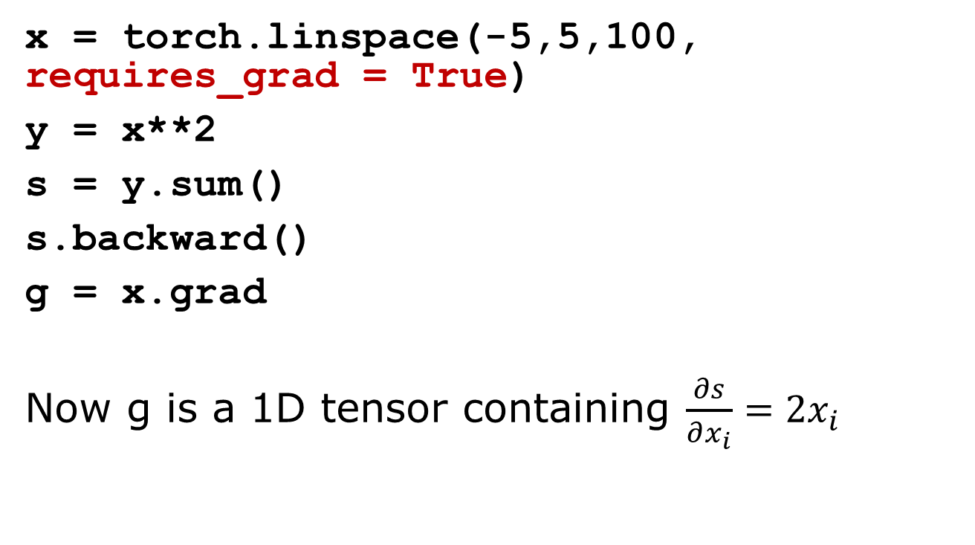
Automatic gradient computation in pytorch
x = torch.linspace(-5,5,100, requires_grad = True)
y = x**2
s = y.sum()
s.backward()
g = x.grad
Now g is a 1D tensor containing $\frac{∂s}{∂x_{i}}=2x_{i}$
$$s=\sum_{i=0}^{99}{x_{i}^{2}}$$
See autograd jupyter notebook

