Slide 1
Week 3, Machine learning fundamentals

Slide 2
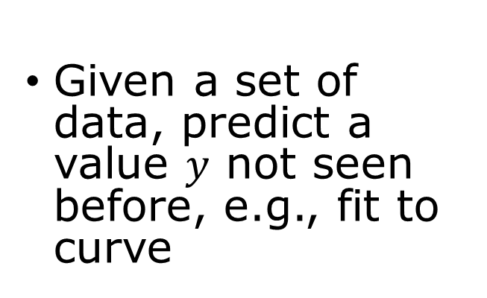
Problem to solve
Regression
Classification
Given a set of data, predict a value $y$ not seen before, e.g., fit to curve
Identify which one it is (discrete output)
E.g., recognized handwritten numbers
Generative AI
Model probability distributions

Slide 3
Task, Performance, Experience
Task: to do something without being explicitly programmed for it
Performance: how good it does, accuracy (training set, testing set)
Experience: supervised vs unsupervised learning (generative AI); reinforcement learning

Slide 4
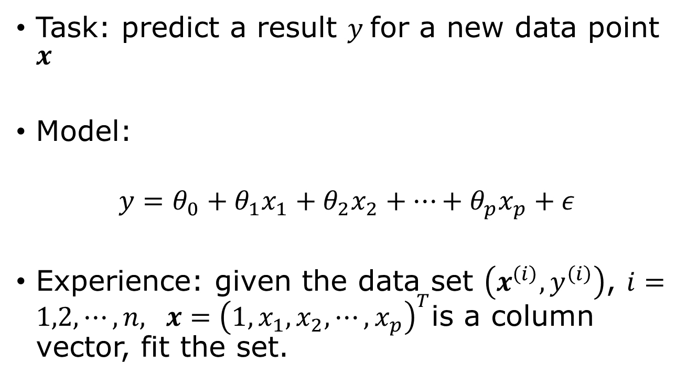
Linear regression as machine learning
Task: predict a result $y$for a new data point $x$
Model:
$$y=θ_{0}+θ_{1}x_{1}+θ_{2}x_{2}+…+θ_{p}x_{p}+ε$$
Experience: given the data set $\left(x^{\left(i\right)},y^{\left(i\right)}\right)$, $i=1,2,⋯,n,$ $x={\left(1,x_{1},x_{2},⋯, x_{p}\right)}^{T}$is a column vector, fit the set.
random error

Slide 5

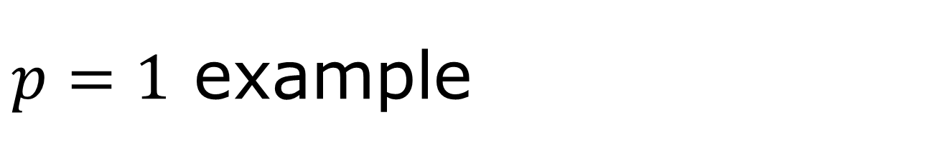



$p=1$ example
$$y$$
Error in $y$, but no error in $x_{1}$.
Data do not follow exactly the straight line. The basic assumption in linear regression (least squares fit) is that the deviations ε are independent gaussian random noise.
ε
fitting to $y=θ_{0}+θ_{1}x_{1}$
$$x_{1}$$

Slide 6
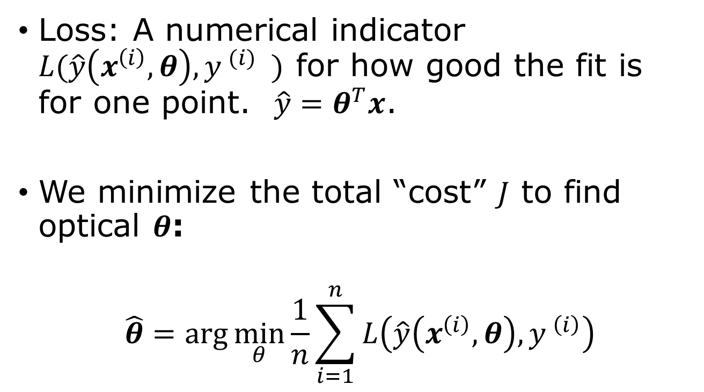
Loss function
Loss: A numerical indicator $L(\hat{y}\left(x^{\left(i\right)},θ\right),y^{ (i)} )$ for how good the fit is for one point. $\hat{y}=θ^{T}x$.
We minimize the total “cost” $J$ to find optical $θ$:
$$\hat{θ}=\arg{\min_{θ}{\frac{1}{n}\sum_{i=1}^{n}{L\left(\hat{y}\left(x^{\left(i\right)},θ\right),y^{ \left(i\right)}\right)}}}$$

Slide 7
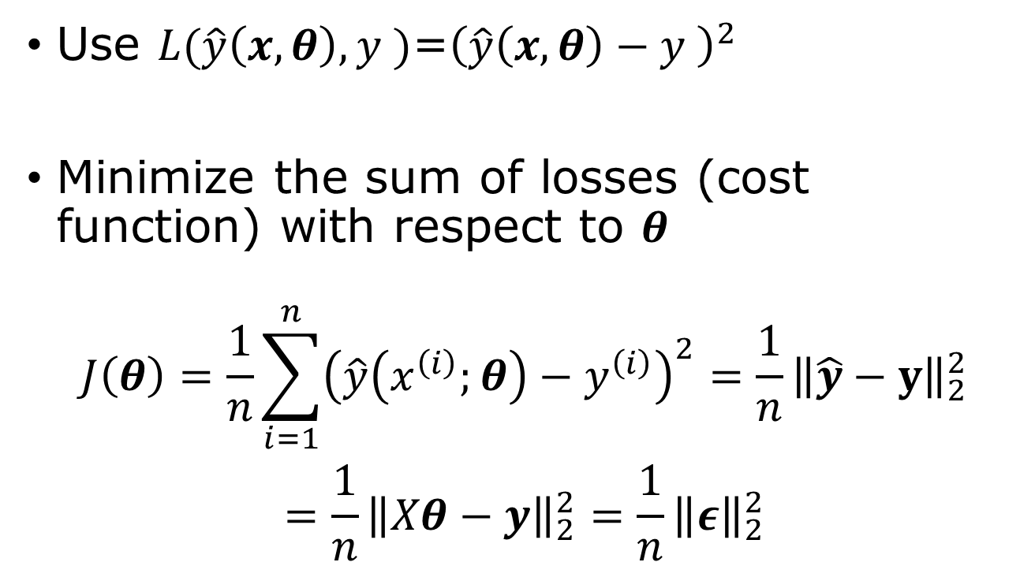
Least squares loss and exact solution
Use $L(\hat{y}\left(x,θ\right),y^{ })$=${\left(\hat{y}\left(x,θ\right)−y^{ }\right)}^{2}$
Minimize the sum of losses (cost function) with respect to $θ$
$$\begin{aligned}J\left(θ\right)=\frac{1}{n}\sum_{i=1}^{n}{{\left(\hat{y}\left(x^{\left(i\right)};θ\right)−y^{\left(i\right)}\right)}^{2}}=\frac{1}{n}{\left\|\hat{y}−y\right\|}_{2}^{2} \\ =\frac{1}{n}{\left\|Xθ−y\right\|}_{2}^{2}=\frac{1}{n}{\left\|ε\right\|}_{2}^{2}\end{aligned}$$
2-norm squared

Slide 8
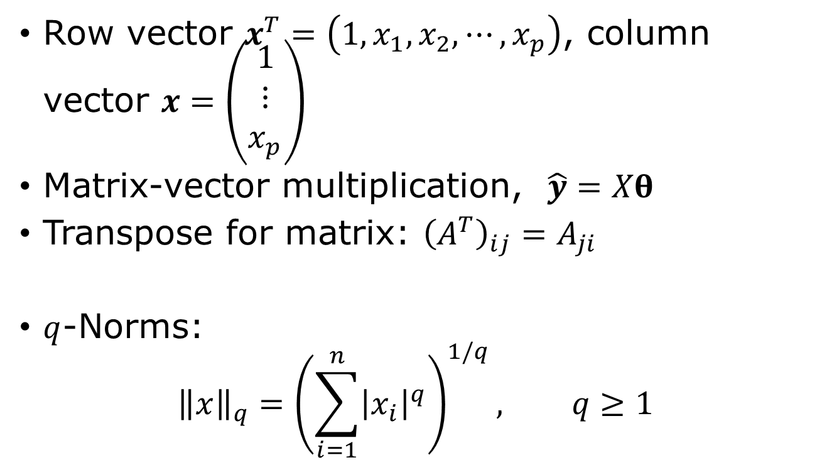
Linear algebra notations
Row vector $x^{T}=\left(1,x_{1},x_{2},⋯, x_{p}\right)$, column vector $x=\left(\begin{matrix}1 \\ ⋮ \\ x_{p}\end{matrix}\right)$
Matrix-vector multiplication, $\hat{y}=Xθ$
Transpose for matrix: ${\left(A^{T}\right)}_{ij}=A_{ji}$
$q$-Norms:
$${\left\|x\right\|}_{q}={\left(\sum_{i=1}^{n}{{\left|x_{i}\right|}^{q}}\right)}^{1/q}, q≥1$$

Slide 9




The design matrix $X$
$$X=\left(\begin{matrix}1 & x_{1}^{\left(1\right)} & ⋯ & x_{p}^{\left(1\right)} \\ 1 & x_{1}^{\left(2\right)} & ⋯ & ⋯ \\ ⋯ & ⋯ & & \\ 1 & x_{1}^{(n)} & ⋯ & x_{p}^{(n)}\end{matrix}\right)$$
$$=\left(\begin{matrix}{(x^{(1)})}^{T} \\ ⋮ \\ {\left(x^{\left(n\right)}\right)}^{T}\end{matrix}\right)$$
$$θ=\left(\begin{matrix}θ_{0} \\ ⋮ \\ θ_{p}\end{matrix}\right)$$
$$y=\left(\begin{matrix}y^{(1)} \\ ⋮ \\ y^{(n)}\end{matrix}\right)$$
$$Xθ=y ?$$

Slide 10



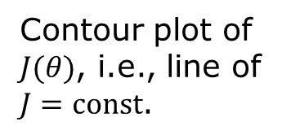
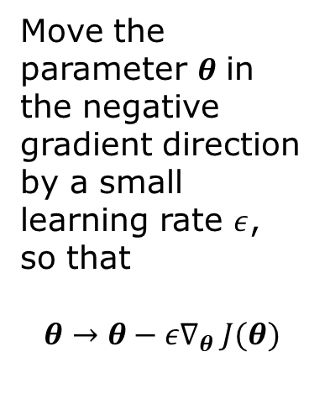
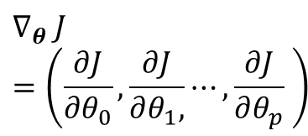
Gradient descent
$$dJ=\sum_{j}{dθ_{j}\frac{∂J}{∂θ_{j}}}$$
$$∇_{θ} J=\left(\frac{∂J}{∂θ_{0}},\frac{∂J}{∂θ_{1},}⋯,\frac{∂J}{∂θ_{p}} \right)$$
$$θ_{1}$$
Move the parameter $θ$ in the negative gradient direction by a small learning rate $ε$, so that
$$θ→θ−ε∇_{θ} J(θ)$$
Contour plot of $J(θ)$, i.e., line of $J=const$.
$$θ_{0}$$

Slide 11

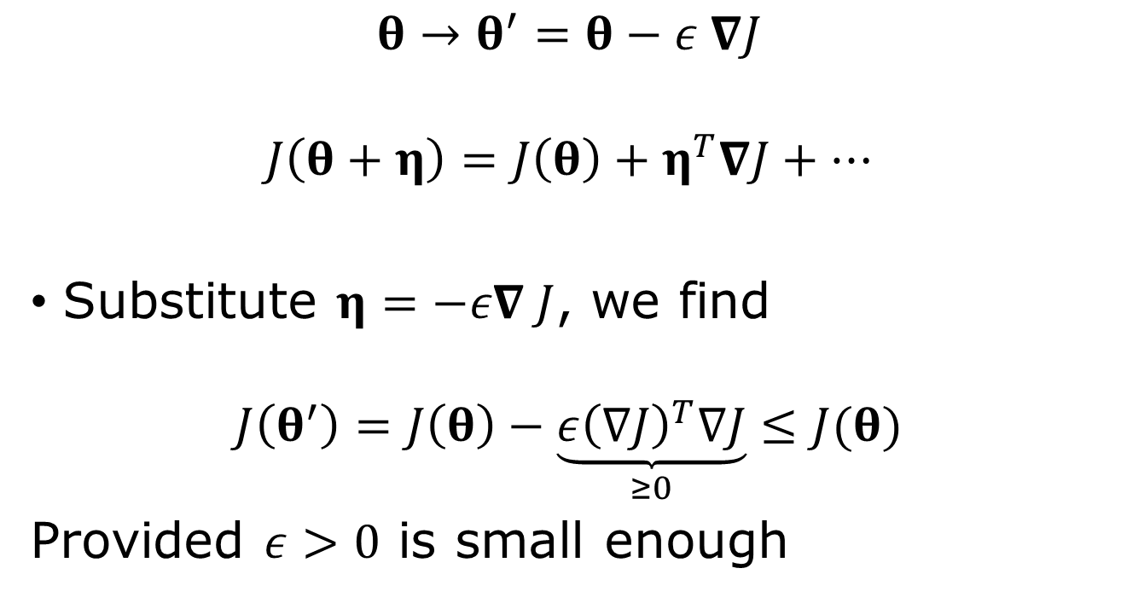
Negative gradient move lower the objective $J$
$$θ→θ^{′}=θ−ε ∇J$$
$$J\left(θ+η\right)=J\left(θ\right)+η^{T}∇J+⋯$$
Substitute $η=−ε∇ J$, we find
$$J\left(θ^{′}\right)=J\left(θ\right)−\underset{≥0}{\underbrace{ε{\left(∇J\right)}^{T}∇J}}≤J(θ)$$
Provided $ε>0$ is small enough
Notes:
The ideal is attributed to Cauchy, 1847.

Slide 12

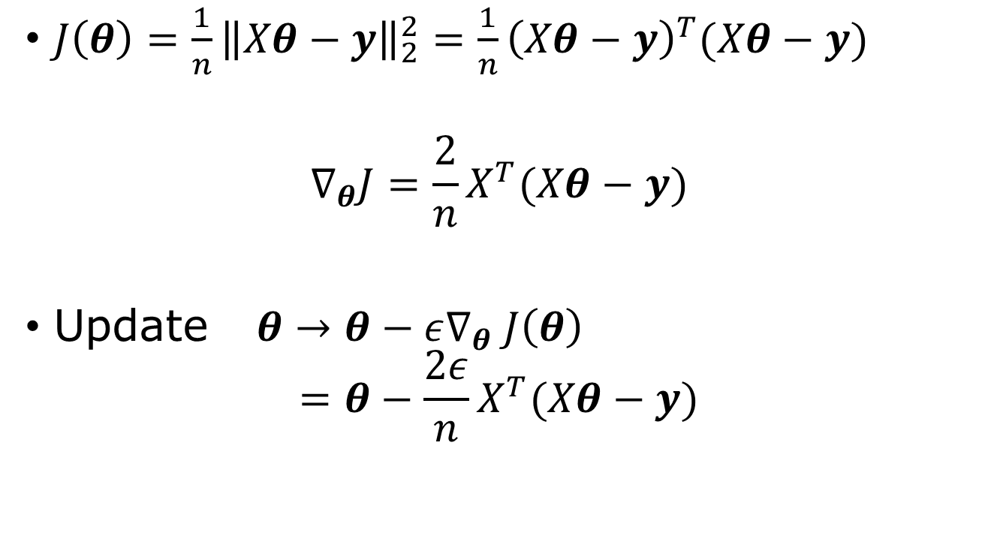
Gradient in linear regression problem
$J\left(θ\right)=\frac{1}{n}{\left\|Xθ−y\right\|}_{2}^{2}=\frac{1}{n}{\left(Xθ−y\right)}^{T}(Xθ−y)$
$$∇_{θ}J=\frac{2}{n}X^{T}(Xθ−y)$$
Update $θ→θ−ε∇_{θ} J\left(θ\right)$ $=θ−\frac{2ε}{n}X^{T}(Xθ−y)$
$$∇_{θ}=\frac{∂}{∂θ}$$
$$∇_{θ}θ^{T}=I$$

Slide 13

Normal equation
$∇_{θ}J=0$ at the minimum, so
$X^{T}\left(Xθ−y\right)=0$
Or
$X^{T}Xθ=X^{T}y$ $→$ $\hat{θ}={\left(X^{T}X\right)}^{−1}X^{T}y$
Moore-Penrose pseudo-inverse

Slide 14
Least-square fitting, machine learning way (code)
n = 3 # three fitting parameters
w = torch.rand((n),requires_grad=True)
def fit(x,w):
…
lr = 0.01
# loop over epoch; compute los
los.backward()
with torch.no_grad():
w -= lr*w.grad
w.grad.zero_()

Slide 15
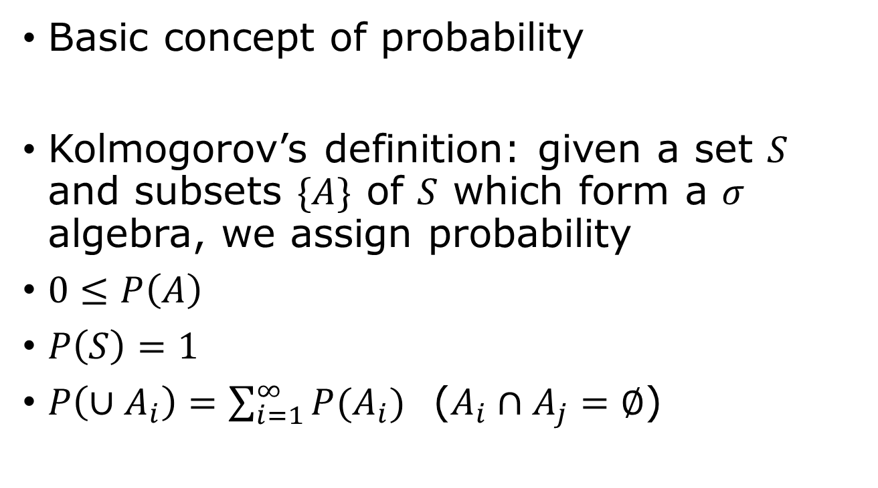
Probability
Basic concept of probability
Kolmogorov’s definition: given a set $S$ and subsets $\{A\}$ of $S$ which form a $σ$ algebra, we assign probability
$0≤P\left(A\right)$
$P\left(S\right)=1$
$P\left(∪A_{i}\right)=\sum_{i=1}^{∞}{P(A_{i})}$ ($A_{i}∩A_{j}=∅$)

Slide 16
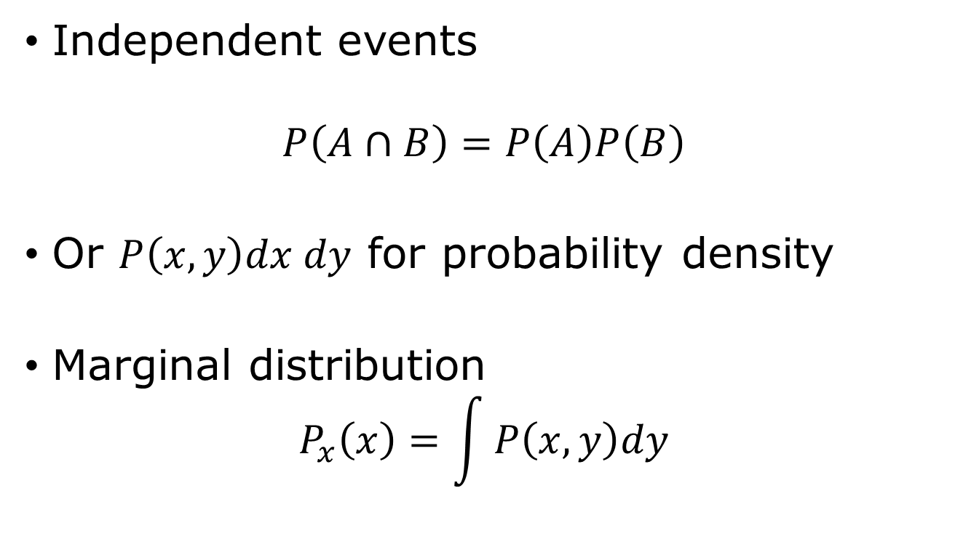
Joint distribution, marginal probability
Independent events
$$P\left(A∩B\right)=P\left(A\right)P\left(B\right)$$
Or $P\left(x,y\right)dx dy$ for probability density
Marginal distribution
$$P_{x}\left(x\right)=\int{P\left(x,y\right)dy}$$

Slide 17
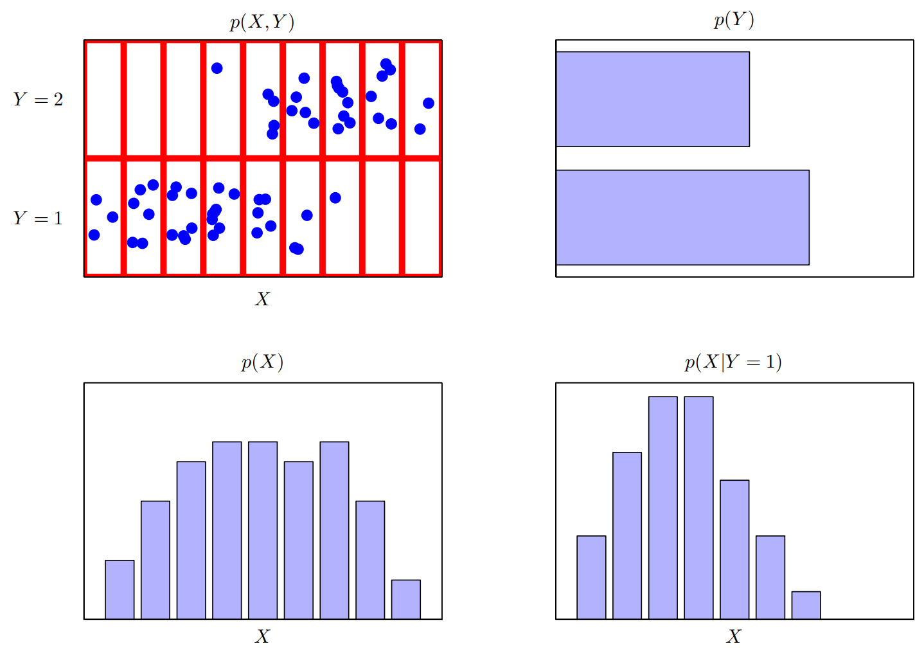
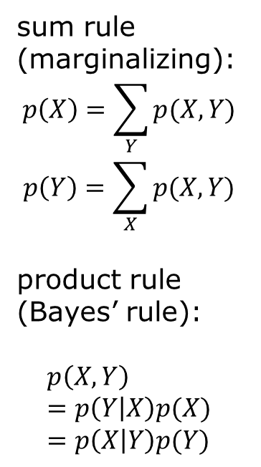
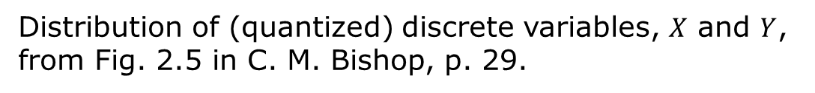
Joint, marginal, conditional distributions
sum rule (marginalizing):
$$p\left(X\right)=\sum_{Y}{p(X,Y)}$$
$$p\left(Y\right)=\sum_{X}{p(X,Y)}$$
product rule (Bayes’ rule):
$$p\left(X,Y\right)=p\left(Y | X\right)p(X)=p\left(X | Y\right)p(Y)$$
Distribution of (quantized) discrete variables, $X$ and $Y$, from Fig. 2.5 in C. M. Bishop, p. 29.

Slide 18

Conditional probability
$$P\left(A | B\right)≝ \frac{P(A∩B)}{P(B)}$$
Bayes theorem
$$P\left(B | A\right)=\frac{P(A|B) P(B)}{P(A)}$$

Slide 19
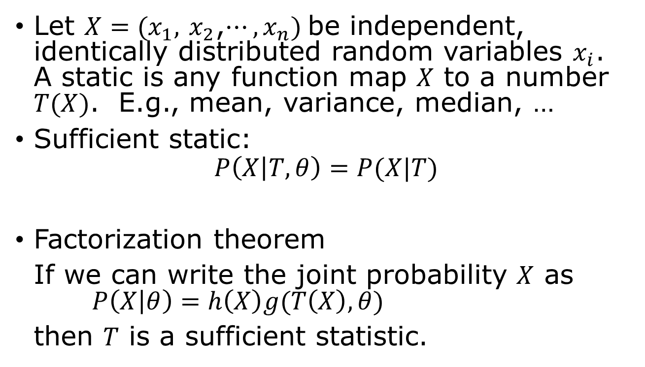
Statistic, sufficiency
Let $X=(x_{1},$ $x_{2}$,$⋯,x_{n})$be independent, identically distributed random variables $x_{i}$. A static is any function map $X$ to a number $T(X)$. E.g., mean, variance, median, …
Sufficient static:
$$P\left(X | T,θ\right)=P(X|T)$$
Factorization theorem
If we can write the joint probability $X$ as $P\left(X | θ\right)=h\left(X\right)g(T\left(X\right),θ)$
then $T$ is a sufficient statistic.

Slide 20
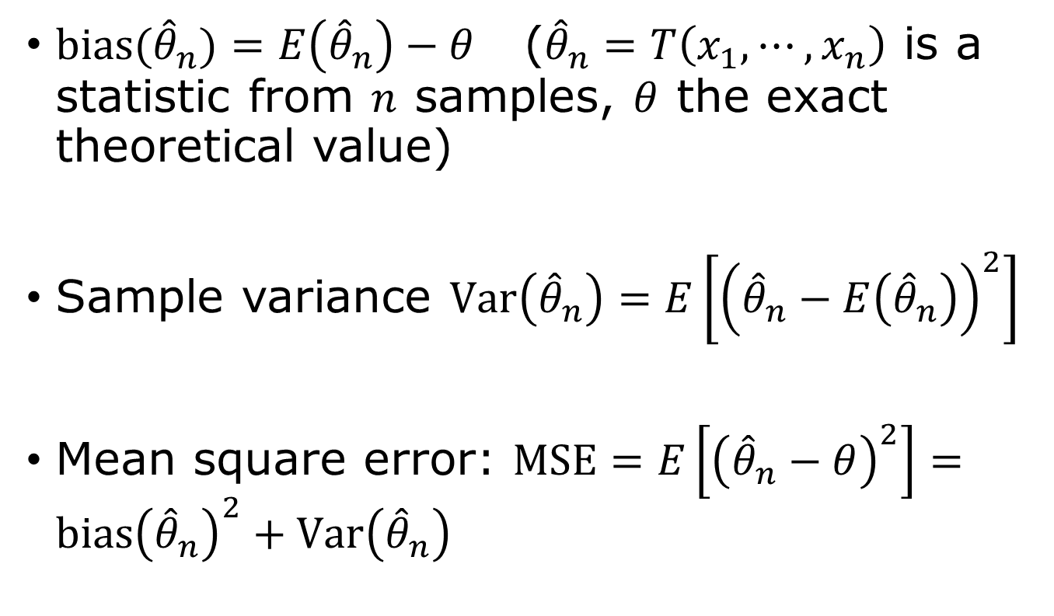
Bias, variance
$bias({\hat{θ}}_{n})=E\left({\hat{θ}}_{n}\right)−θ$ (${\hat{θ}}_{n}=T\left(x_{1},⋯, x_{n}\right)$ is a statistic from $n$ samples, $θ$ the exact theoretical value)
Sample variance $Var\left({\hat{θ}}_{n}\right)=E\left[{\left({\hat{θ}}_{n}−E\left({\hat{θ}}_{n}\right)\right)}^{2}\right]$
Mean square error: $MSE=E\left[{\left({\hat{θ}}_{n}−θ\right)}^{2}\right]=bias{\left({\hat{θ}}_{n}\right)}^{2}+Var\left({\hat{θ}}_{n}\right)$

Slide 21
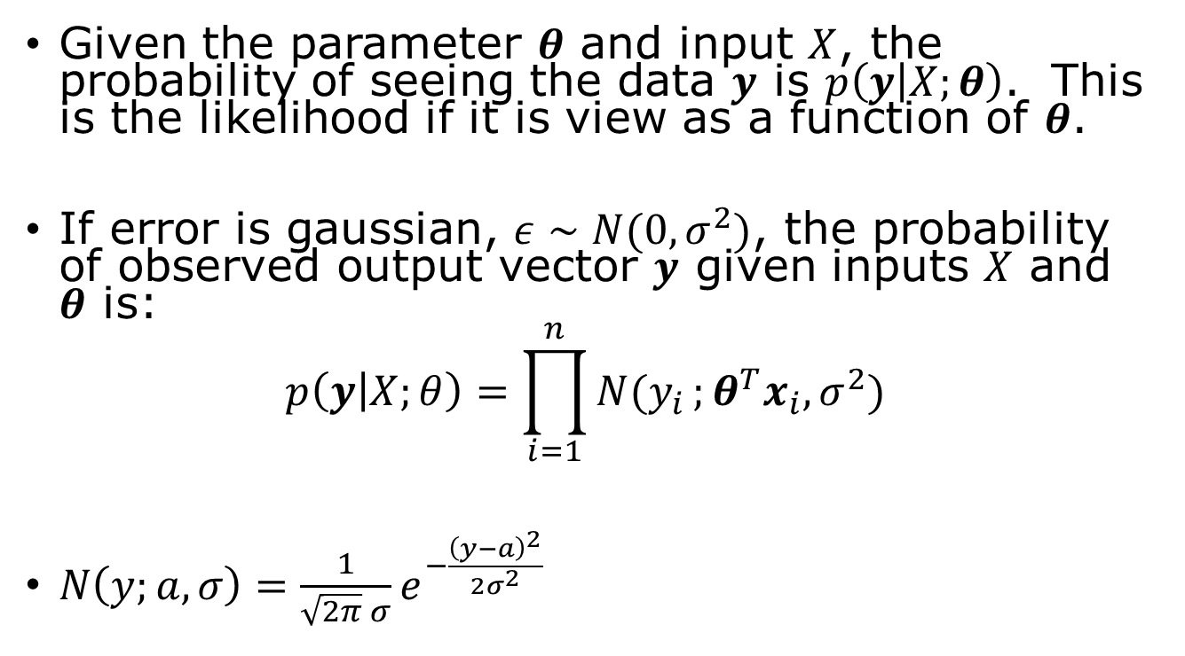
Maximum Likelihood perspective
Given the parameter $θ$ and input $X$, the probability of seeing the data $y$ is $p\left(y | X;θ\right)$. This is the likelihood if it is view as a function of $θ$.
If error is gaussian, $ε∼N(0,σ^{2})$, the probability of observed output vector $y$ given inputs $X$ and $θ$ is:
$$p\left(y | X;θ\right)=\prod_{i=1}^{n}{N(y_{i}};θ^{T}x_{i},σ^{2})$$
$N\left(y;a,σ\right)=\frac{1}{\sqrt{2π} σ}e^{−\frac{{\left(y−a\right)}^{2}}{2σ^{2}}}$

Slide 22
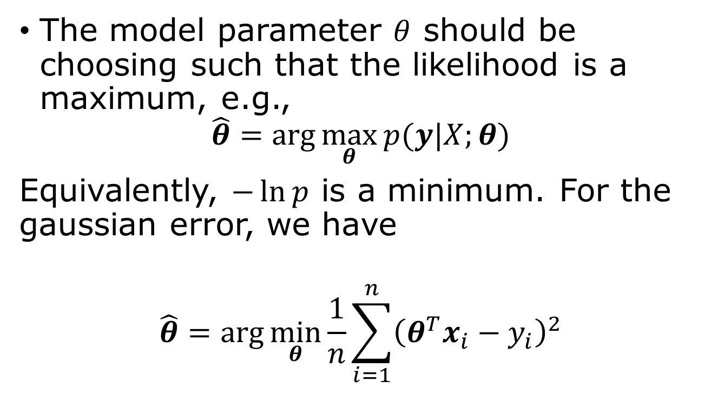
Maximum likelihood principle
Why maximum likelihood estimator? 1) consistent, 2) lowest MSE, 3) asymptotically normality.
The model parameter $θ$ should be choosing such that the likelihood is a maximum, e.g.,
$$\hat{θ}=\arg{\max_{θ}{p(y|X;θ)}}$$
Equivalently, $−\ln{p}$ is a minimum. For the gaussian error, we have
$$\hat{θ}=\arg{\min_{θ}{\frac{1}{n}}}\sum_{i=1}^{n}{{\left(θ^{T}x_{i}−y_{i}\right)}^{2}}$$

Slide 23
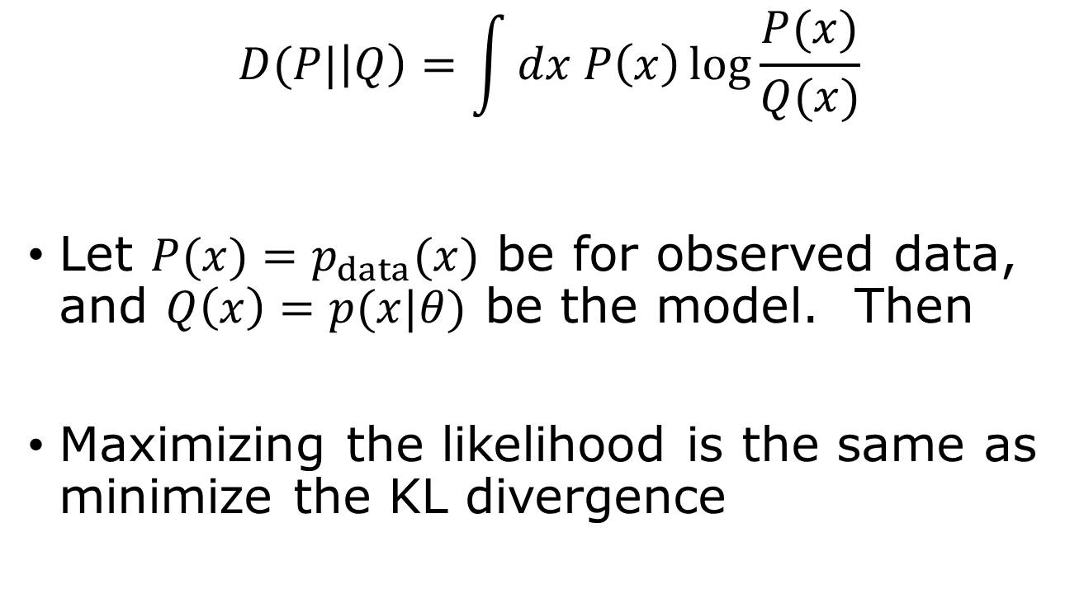
Kullback-Leibler divergence
$$D(P|\left|Q\right)=\int{dx P\left(x\right)\log{\frac{P(x)}{Q(x)}}}$$
Let $P(x)=p_{data}(x)$ be for observed data, and $Q\left(x\right)=p(x|θ)$ be the model. Then
Maximizing the likelihood is the same as minimize the KL divergence

Slide 24
Testing performance
Train error
Testing error
Generalization gap

Slide 25
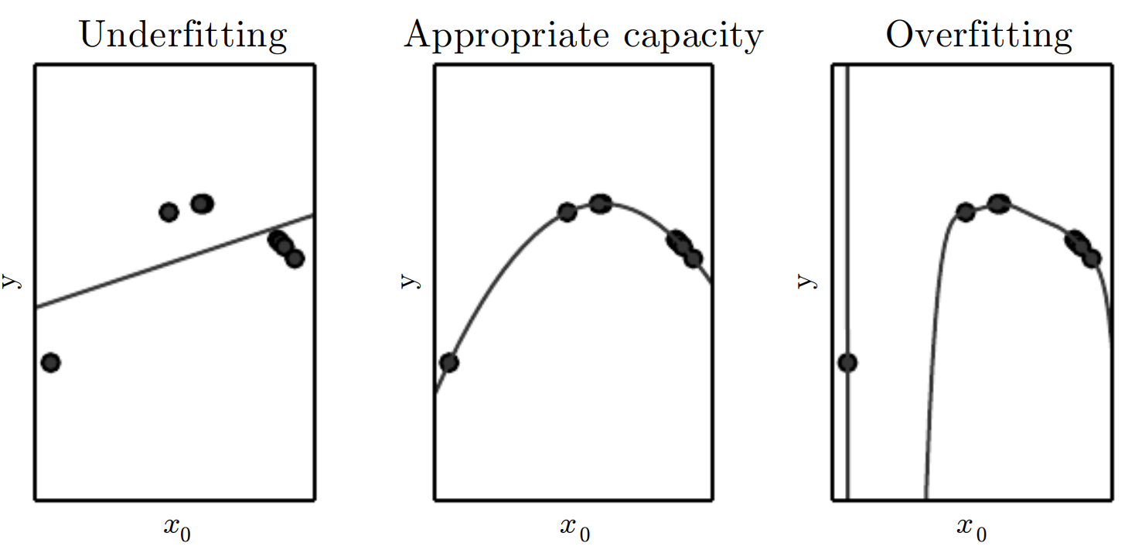
Underfit, overfit, capacity
Data follows a quadratic curve. Left: fit to a linear line (underfit), middle: fit to a quartic curve, right: fit to a polynomial of degree 9 (overfit). From fig 5.2 “Deep Learning,” Goodfellow, et al.

Slide 26


Performance evaluation
underfit
overfit
$$E_{new}$$
error
Generalization gap
$$E_{train}$$
Model complexity capacity (training iterations)

Slide 27
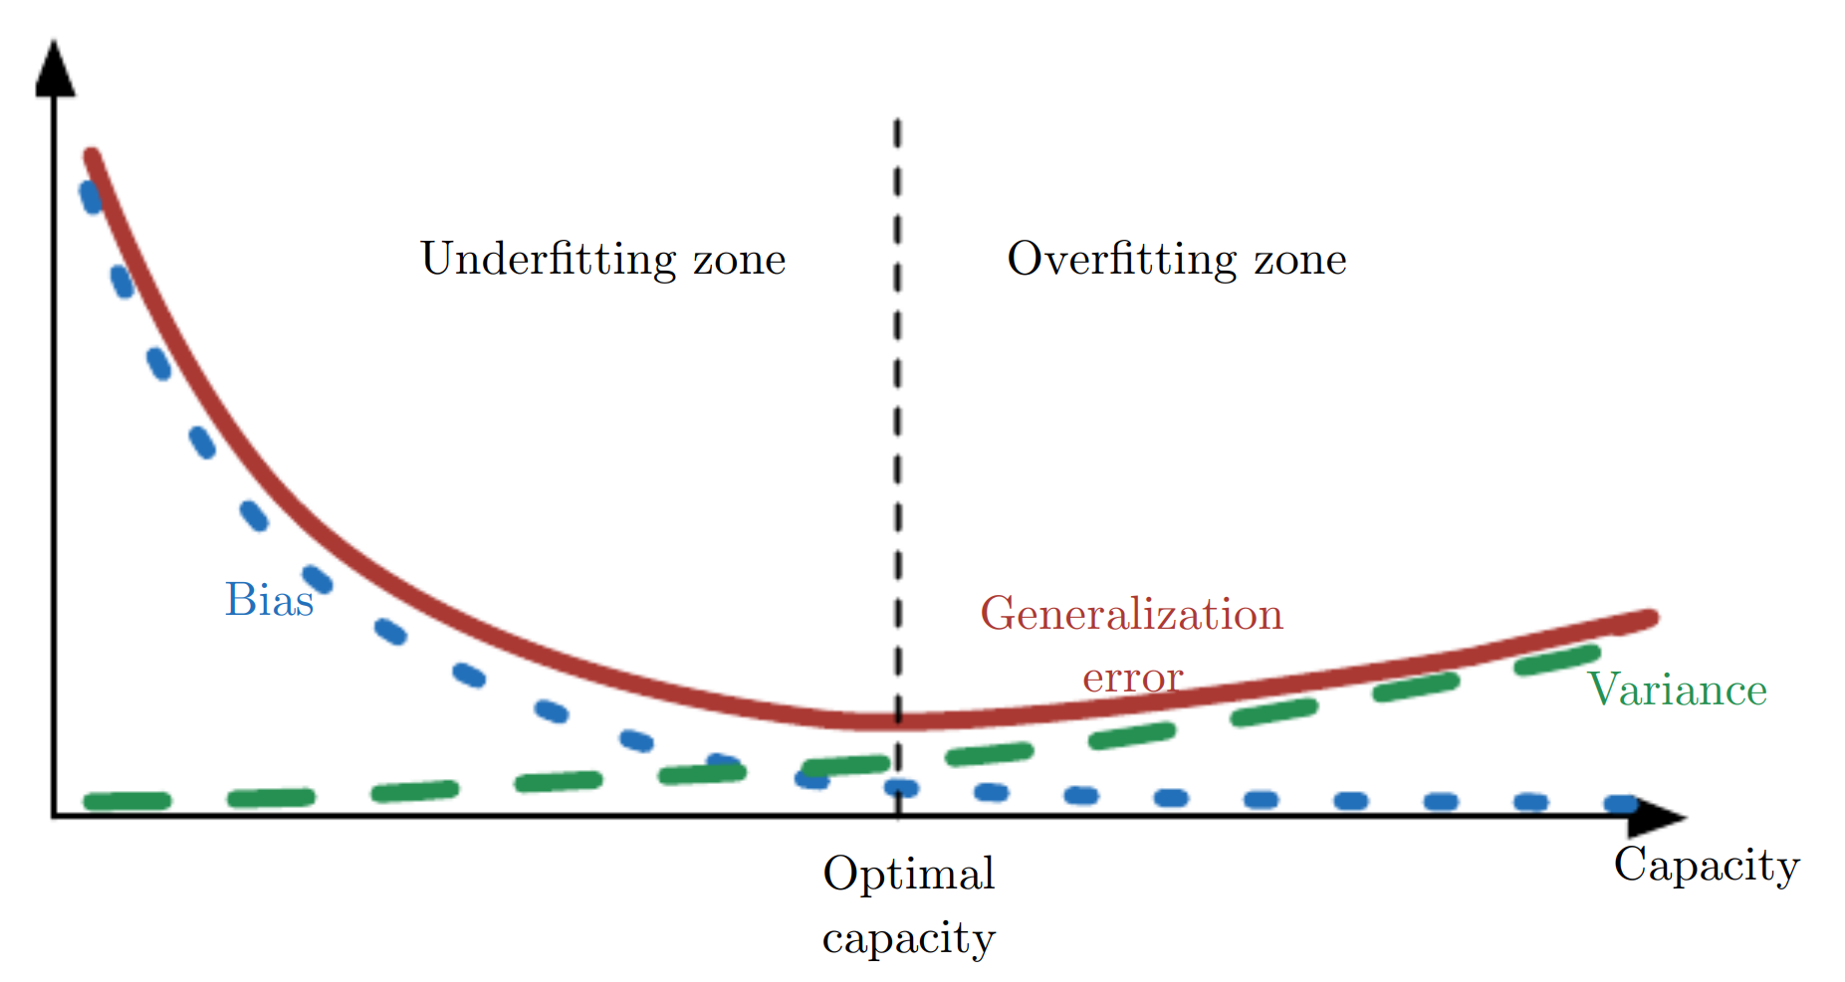
Bias-variance trade-off
MSE (generalization error) = Bias² + Variance
As capacity increases, bias (blue dotted) decreases and variance (green dashed) increases. There is an optimal capacity choice. From Fig. 5.6, Goodfellow, et al.

Slide 28

Regularization
Any modification to learning algorithm to reduce generalization error but not training error.
$L^{2}$ regularisation $J→J+λ{\left\|θ\right\|}_{2}^{2}$
LASSO, or $L^{1}$ regularization
$J→J+λ{\left\|θ\right\|}_{1}$

Slide 29

$k$-fold cross-validation for error estimate $E_{new}$
all data
1
2
3
4
5
Split the data into k parts (or k-folds), use the i-th fold as testing data, the rest as training data, i = 1, 2,..., k. The final performance is the average of k cases.

Slide 30
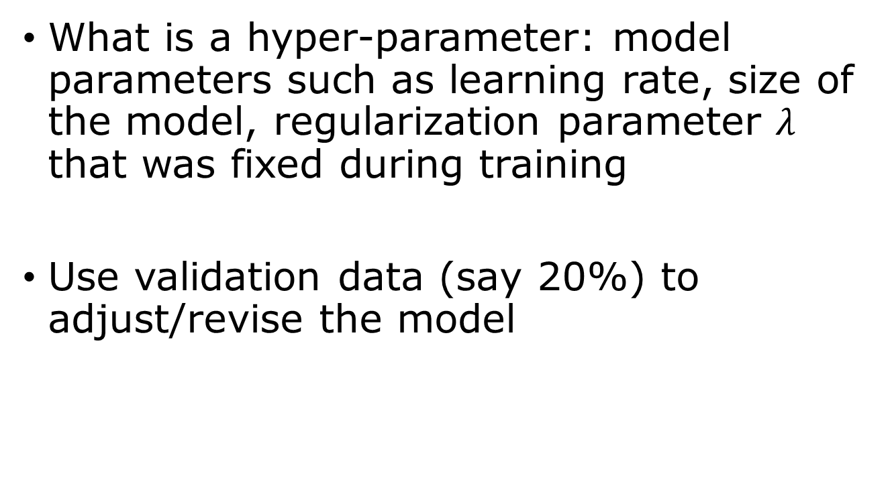
Hyper-parameter optimization
What is a hyper-parameter: model parameters such as learning rate, size of the model, regularization parameter $λ$ that was fixed during training
Use validation data (say 20%) to adjust/revise the model
Train data/validation data/testing data

Slide 31
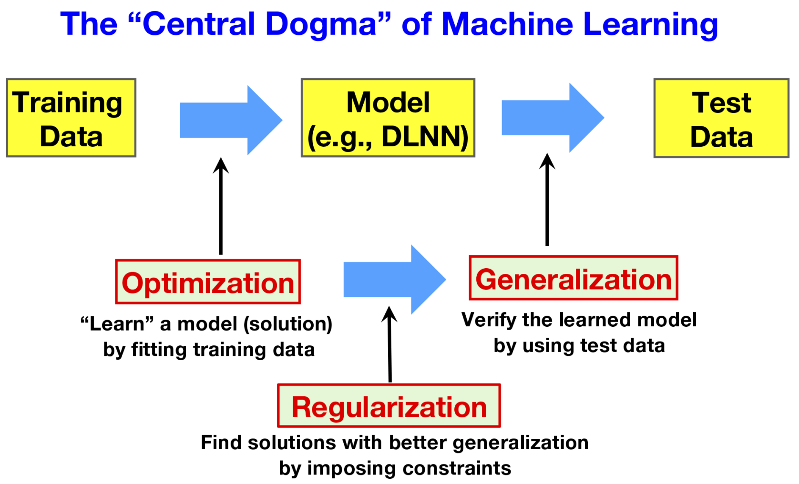
From Fig.2, Levine & Tu, PNAS, 2024.

