Slide 1
Week 7, Convolutional neural network (CNN)

Slide 2
What deep network can do?
Computer Vision
Classification
Detection
Segmentation
Caption generation
Large language models
Protein folding
ML-based force field, etc

Slide 3

Inductive biases for image processing in CNN
Translation equivariance
Locality (sparseness)
Parameter sharing
$$f\left(g\left(x\right)\right)=g(f\left(x\right))$$

Slide 4
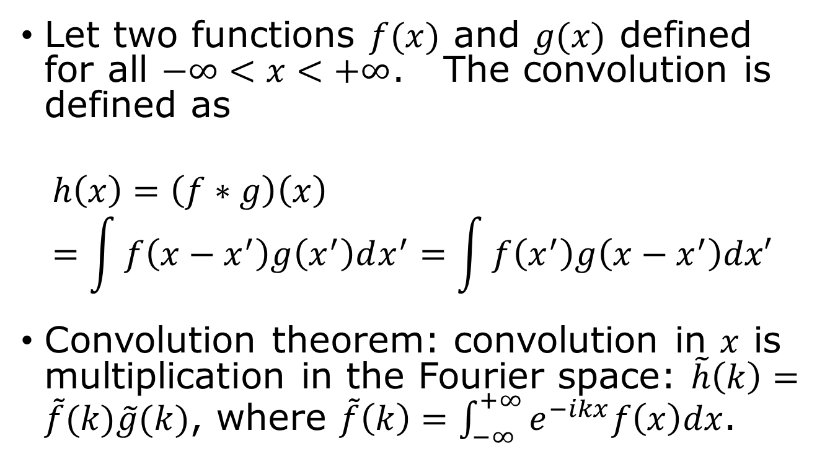
Convolution in 1D
Let two functions $f(x)$ and $g(x)$ defined for all $−∞<x<+∞$. The convolution is defined as
$$h\left(x\right)=\left(f∗g\right)\left(x\right)=\int{f\left(x−x^{′}\right)g\left(x^{′}\right)dx^{′}=\int{f\left(x^{′}\right)g\left(x−x^{′}\right)dx′}}$$
Convolution theorem: convolution in $x$ is multiplication in the Fourier space: $\tilde{h}\left(k\right)=\tilde{f}(k)\tilde{g}(k)$, where $\tilde{f}\left(k\right)=\int_{−∞}^{+∞}{e^{−ikx}f\left(x\right)dx}$.

Slide 5
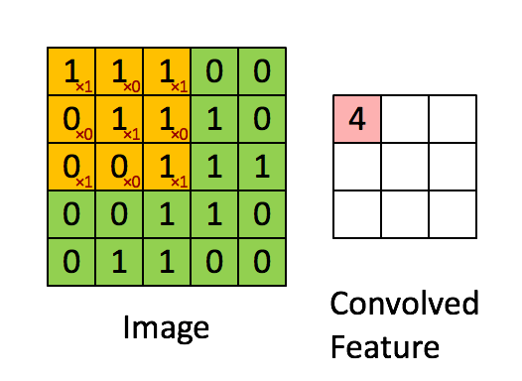

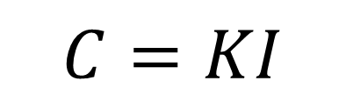


Convolution in 2D images
$$C=KI$$
Kernel $K$
1 | 0 | 1
0 | 1 | 0
1 | 0 | 1
kernel size 3, stride 1, channel 1
The point of CNN is to learn the kernel by training.
$$I$$
$$C$$

Slide 6
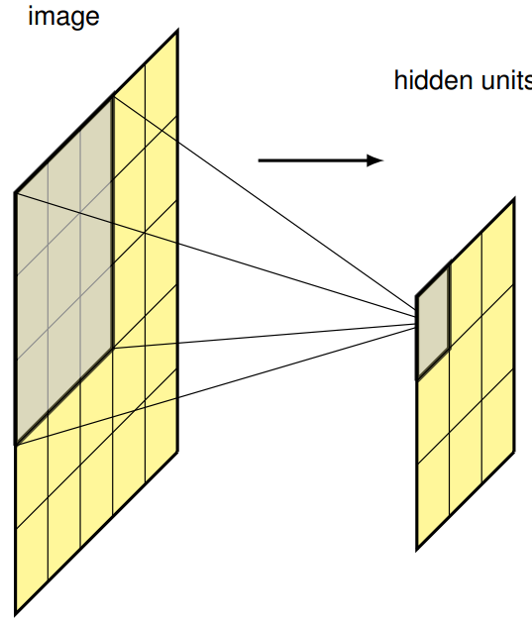
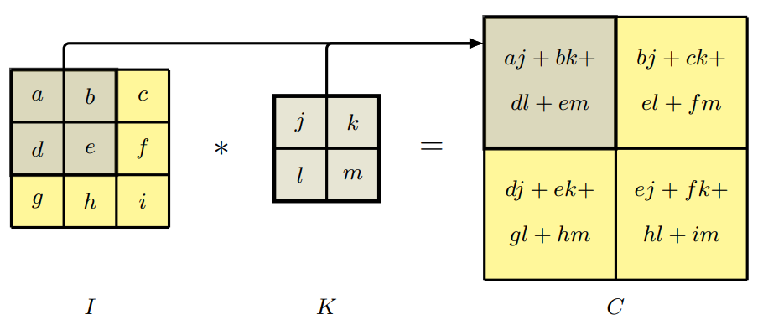

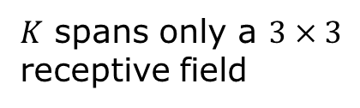
Convolution in neural network (cross correlation)
$$C\left(j,k\right)=\sum_{l}{\sum_{m}{\underset{input image}{\underbrace{I(j+l,k+m)}}\underset{kernel}{\underbrace{K(l,m)}}}}$$
output
$K$ spans only a $3×3$ receptive field

Slide 7
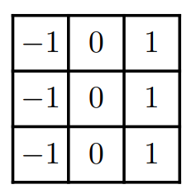
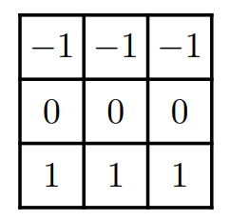
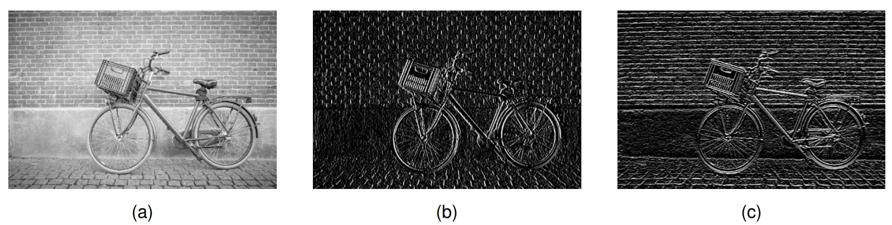

Convolution as discrete derivatives – edge detection
$3×3$ kernels
original image
Central point of CNN: Kernels are “learned”.

Slide 8
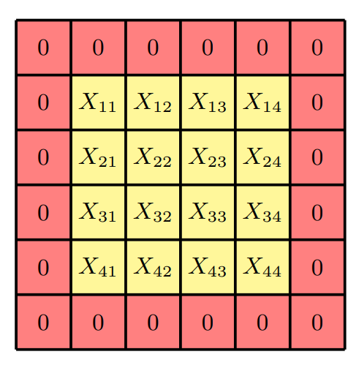
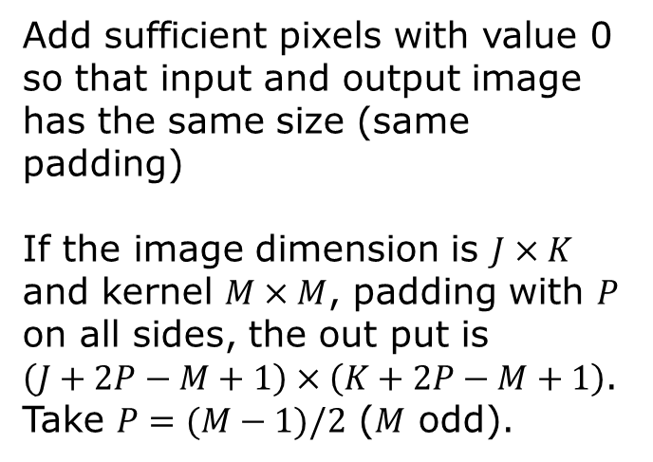
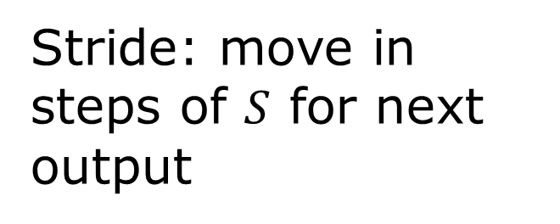
Padding and Stride
Add sufficient pixels with value 0 so that input and output image has the same size (same padding)
If the image dimension is $J×K$ and kernel $M×M$, padding with $P$ on all sides, the out put is $\left(J+2P−M+1\right)×\left(K+2P−M+1\right)$. Take $P=(M−1)/2$ ($M$ odd).
Stride: move in steps of $S$ for next output

Slide 9
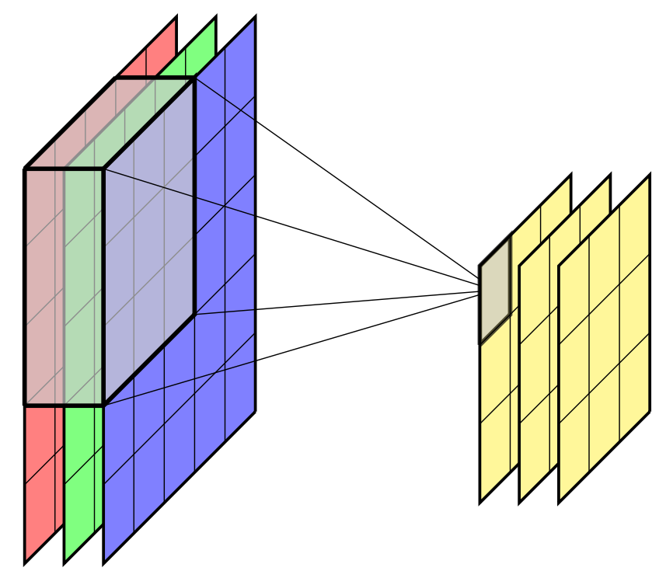
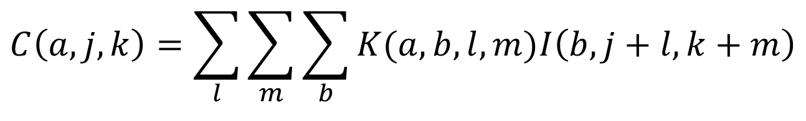
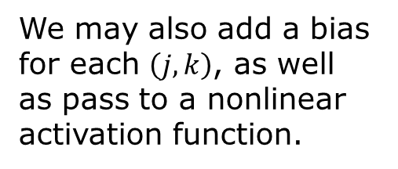
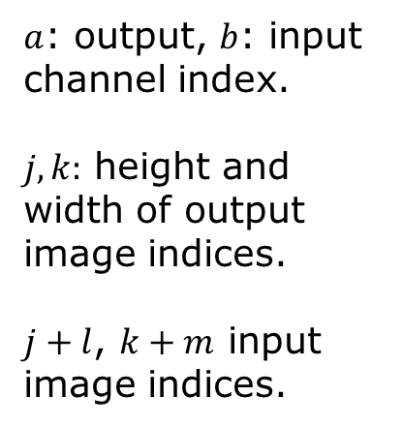
Channels
We may also add a bias for each $\left(j,k\right)$, as well as pass to a nonlinear activation function.
$$C\left(a,j,k\right)=\sum_{l}{\sum_{m}{\sum_{b}{K(a,b,l,m)I\left(b,j+l,k+m\right)}}}$$
$a$: output, $b$: input channel index.
$j,k:$ height and width of output image indices.
$j+l$, $k+m$ input image indices.

Slide 10
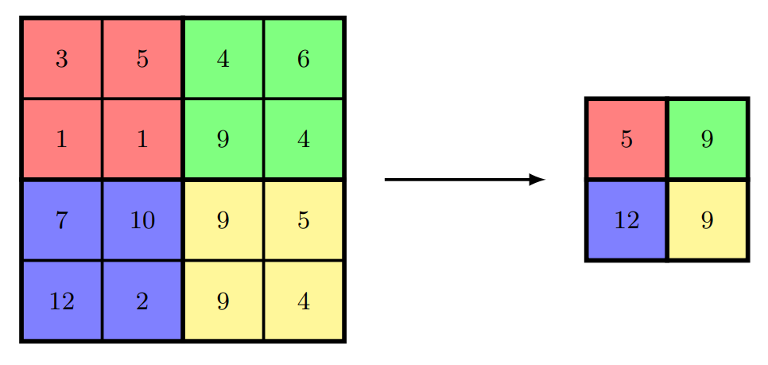
Pooling
Purpose: make output invariant with respect to small translation
max pool
Size : 2
Stride: 2
Compare: renormalization group transform

Slide 11
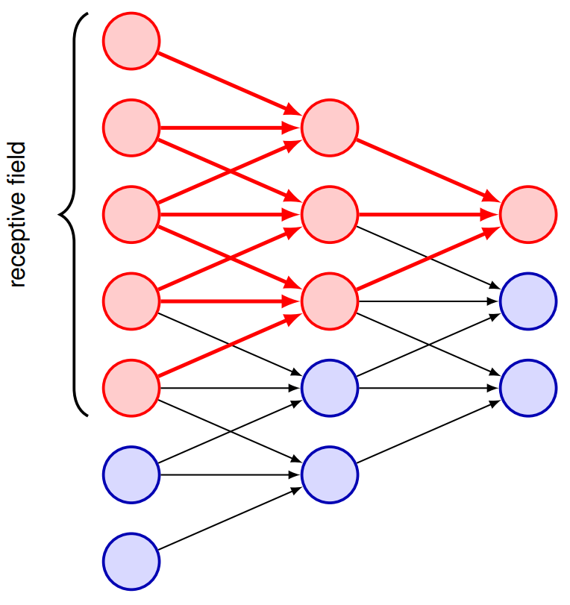
Multiple-layer convolution to increase range of locality
Effective receptive field grows with depth in a multilayer convolutional network. Increase by 2 each time we do deeper by 1 layer.

Slide 12
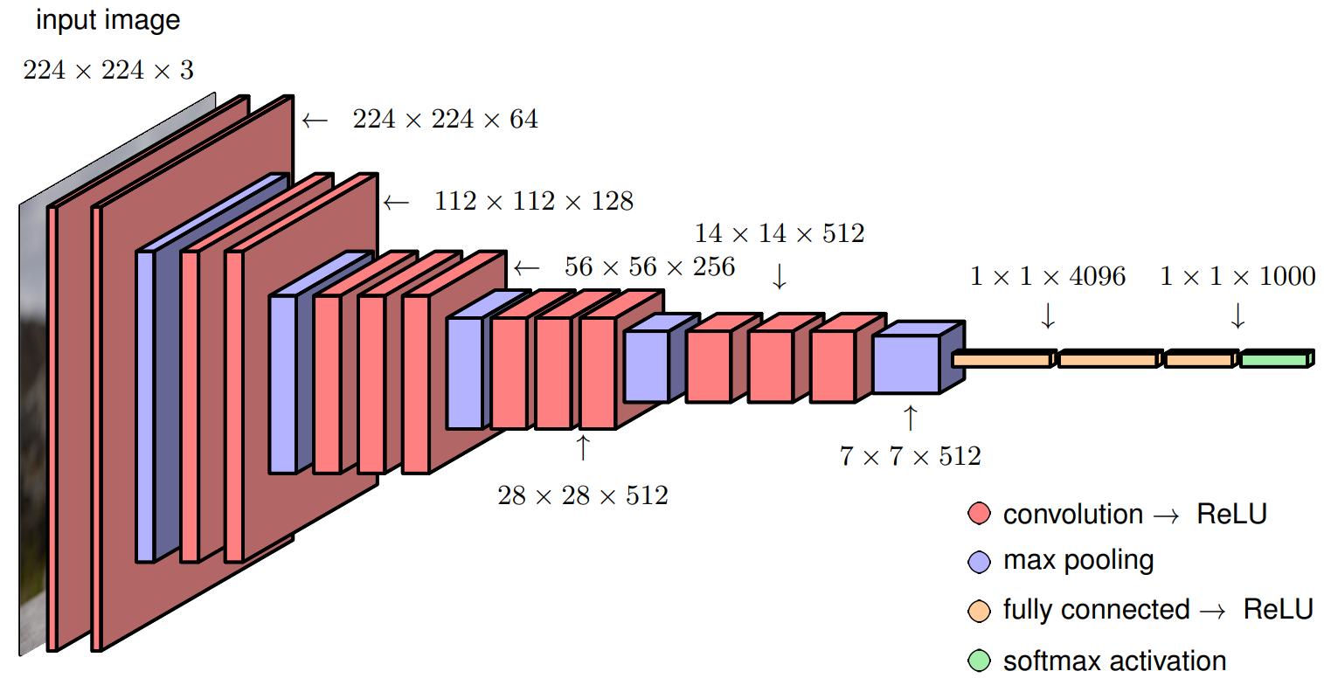
Typical CNN architecture, VGG-16
H: height
W: width
C: channel
H W C

Slide 13
AlexNet and chatGPT
The moment we stopped understanding AI [AlexNet]
https://youtu.be/UZDiGooFs54

Slide 14
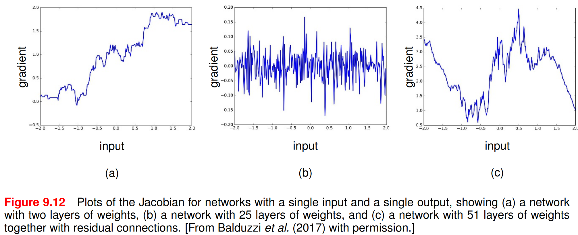
Problem with deep network
1) shattered gradients
2) vanishing or exploding gradients
From Bishop, “Deep Learning”, p. 274.

Slide 15
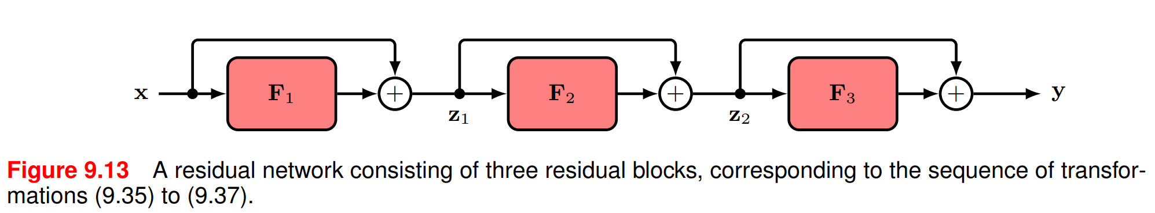

Residual connections
$$z_{1}=F_{1}\left(x\right)+x$$
$$z_{2}=F_{2}\left(z_{1}\right)+z_{1}$$
$$y=F_{3}\left(z_{2}\right)+z_{2}$$

Slide 16
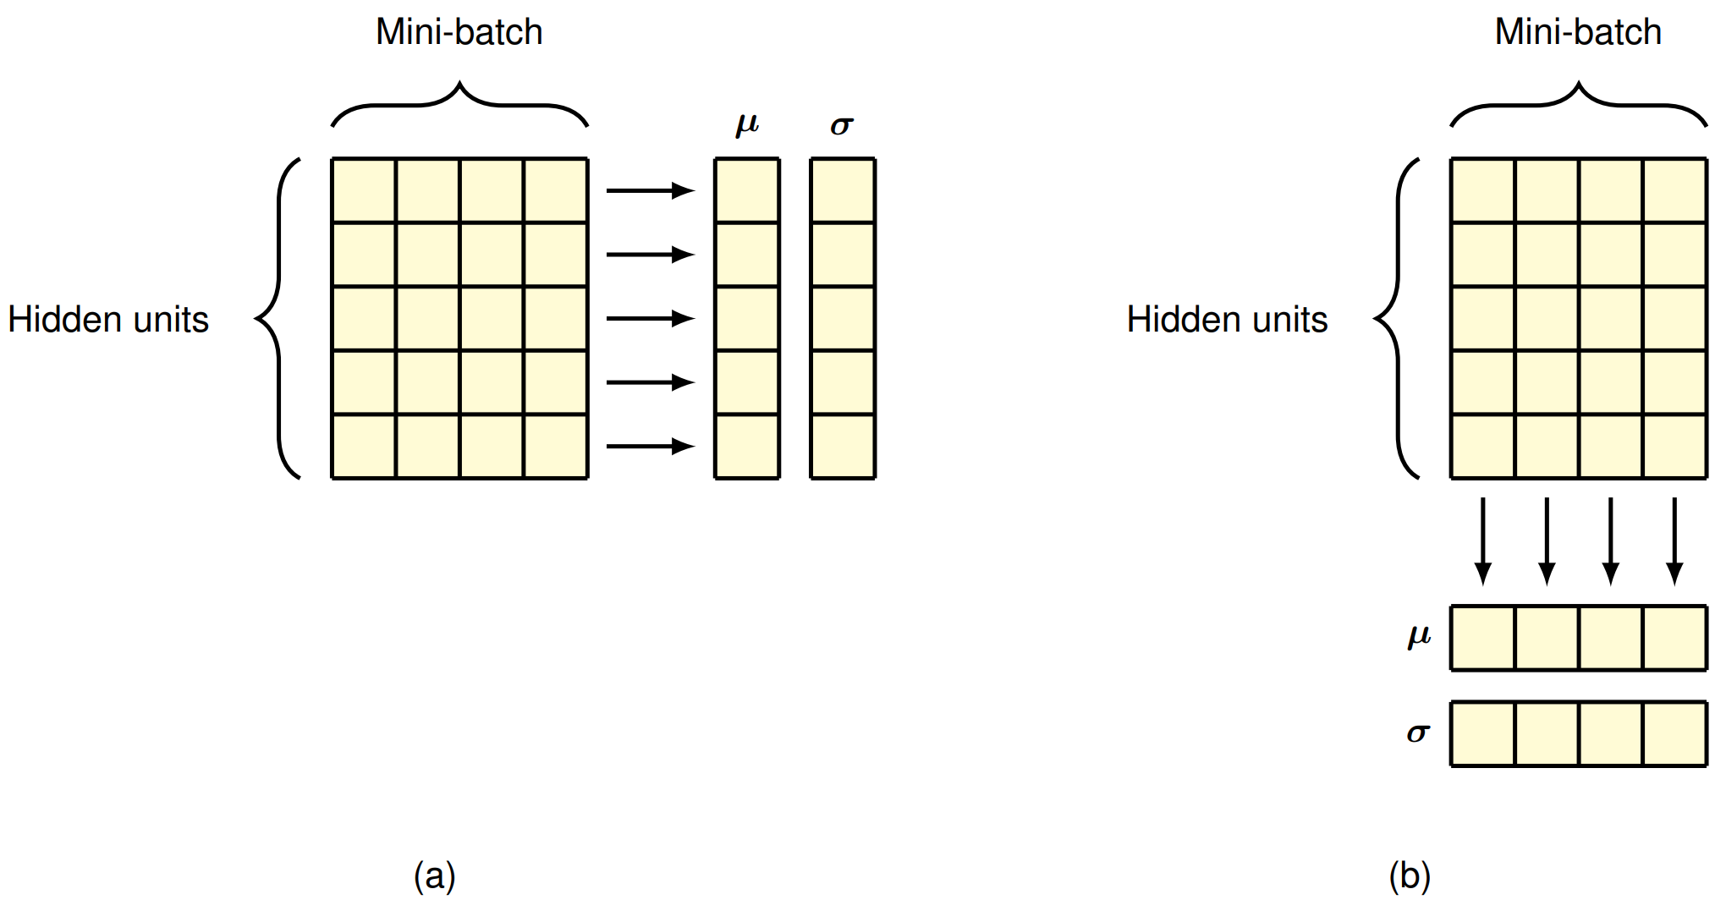

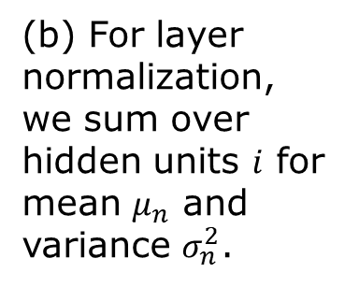


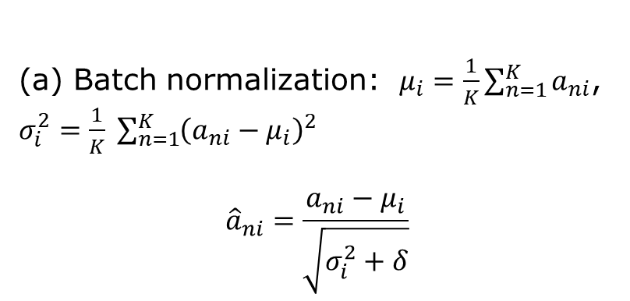
Batch normalization/Layer normalization
$$i$$
$$n$$
$${\tilde{a}}_{ni}=γ_{i}{\hat{a}}_{ni}+β_{i}$$
(a) Batch normalization: $μ_{i}=\frac{1}{K}\sum_{n=1}^{K}{a_{ni}}$, $σ_{i}^{2}=\frac{1}{K} \sum_{n=1}^{K}{{\left(a_{ni}−μ_{i}\right)}^{2}}$
$${\hat{a}}_{ni}=\frac{a_{ni}−μ_{i}}{\sqrt{σ_{i}^{2}+δ}}$$
(b) For layer normalization, we sum over hidden units $i$ for mean $μ_{n}$ and variance $σ_{n}^{2}$.

