Slide 1

8. Selected Applications

Slide 2
Applications of Monte Carlo Method
Structural and thermodynamic properties of matter [gas, liquid, solid, polymers, (bio)-macro-molecules]
Ising model as an example
Notes:
Many example applications are discussed in Landau and Binder’s book, “A Guide to Monte Carlo Simulations in Statistical Physics”.

Slide 3
Equilibrium Statistical Mechanics
Interactions between atoms or molecules (at a classical mechanical level) are described by inter-molecular potentials
Macroscopic observables are predicted by ensemble average

Slide 4
Micro-Canonical Ensemble
When a system has a fixed energy E, volume V, and number of particles N, each microstate has equal probability
Entropy
S = k_{B} log Ω
Ω is the number of microstates and k_{B} is the Boltzmann constant.
Notes:
That is, in a micro-canonical ensemble. See book by K. Huang “Statistics Mechanics”, or L. E. Reichl, “A Modern Course in Statistical Physics”.

Slide 5
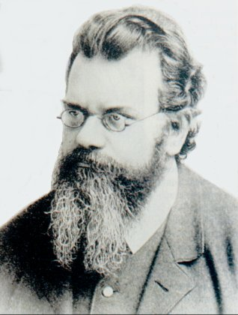
Boltzmann Distribution
In canonical ensemble (fixed temperature T, volume V, and particle number N), the distribution of a (micro) state is
P(X) ∝ e^{—E(X)/(kT)}
Ludwig Boltzmann, 1844-1906
Notes:
Picture from http://www.sciences.univ-nantes.fr/physique/enseignement/tp/hist/boltzmann.jpg

Slide 6
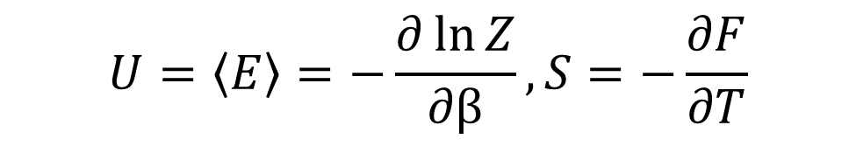
Partition Function and Free Energy
We define partition function
Z = ∑_{X} exp(-βE(X)), β = 1/(k_{B}T)
Free energy is F = -k_{B}T ln Z. We have
F = U – TS, dF = - S dT - p dV
Thus
$$U=\left\langle E\right\rangle =−\frac{∂\ln{Z}}{∂β}, S=−\frac{∂F}{∂T}$$
Notes:
U is called internal energy, P is pressure, T is temperature, V is volume. The “Helmholtz” free energy F is considered a function of T, V, and N.

Slide 7
Force Field -Van der Waals
Lennard-Jones potential, useful to represent van der Waals force and model for noble gases
Notes:
E.g., For Ar, σ=3.40 Å, ε=0.04 eV. See Ashcroft and Mermin, “Solid State Physics”, p.398.

Slide 8
Embedded-Atom Potential for Metal
where density is a complicated function of local coordinates and
Notes:
See J Cai and J-S Wang, Phys. Stat. Sol. (b) 223 (2001) 773. The exponential form of pair potential is also known as Morse potential.

Slide 9
Potential for Bio-molecules
V = (bonding) + (angle and torsion angle) + (Coulomb) + (van der Waals) + …
E.g., the bonding is usually modeled by an elastic spring:
Notes:
See, for example, A R Leach, “Molecular Modelling – principles and applications” (Logman, 1996).

Slide 10
Equilibrium Properties and Minimum Energy Configuration
Nearly all of them can be determined by the configuration integral
Simulated annealing let T -> 0 gradually

Slide 11
Properties of Interests
Average energy, specific heat, free energy
Pair correlation functions
Equation of state (pressure)
Temperature?

Slide 12
Pair Correlation
Let ρ(r) = ∑_{i} δ(r-r_{i}), we define the pair correlation function as
g(r) = < ρ(r’) ρ(r’+r) >
Both the average potential energy and pressure can be expressed in terms of g(r) (for system with pair-wise potentials).

Slide 13
“Configuration” Temperature
We can also sample the temperature from the configuration based on virial theorem:
k_{B}T = < u • ∇H>
where u is any vector satisfies ∇•u =1
(u and ∇ are in the space of all momentum p and coordinates q)
Notes:
See Lepri, R Livi, and A Politi, Phys. Rep. 377 (2003) 1, Appendix A.
The formula is derived from micro-canonical ensemble, but is it good in canonical ensemble?

Slide 14
Use Locality for Efficient Calculation of ΔE
The most time-consuming part in MC is calculating ΔE:

Slide 15
2D Hard disks
The hexatic phase of the two-dimensional hard disk system
A. Jaster
Published in Phys. Lett. A 330 (2004) 120
We report Monte Carlo results for the two-dimensional hard disk system in the transition region. Simulations were performed in the NVT ensemble with up to 1024² disks. The scaling behaviour of the positional and bond-orientational order parameter as well as the positional correlation length prove the existence of a hexatic phase as predicted by the Kosterlitz-Thouless-Halperin-Nelson-Young theory. The analysis of the pressure shows that this phase is outside a possible first-order transition.
Cond-mat/0305239
The article can be downloaded from http://arxiv.gov/
Notes:
The hard disk problem started by Metropolis et al in 1953 is still very active research problem today.
The cond-mat paper is at http://xxx.lanl.gov/abs/cond-mat?0305239

Slide 16
The Ising Model
-
-
+
-
+
-
The energy of configuration σ is
E(σ) = - J ∑_{<ij>} σ_{i} σ_{j}
where i and j run over a lattice, <ij> denotes unordered nearest neighbors, σ = ±1
-
-
-
+
+
-
+
+
-
-
-
+
+
-
+
+
+
-
+
+
-
-
-
-
+
+
-
-
+
-
σ = {σ₁, σ₂, …, σ_{i}, … }
Notes:
In 1925, physicist W. Lenz asked his student E. Ising to solve a statistical mechanics problem relevant to the magnetic properties of matter. Ising was able to solve it on a one-dimensional lattice. Almost twenty years were passed before L. Onsager found analytic solution to the two-dimensional version of the problem. The three-dimensional Ising model which is most relevant in the physical world has denied any serious attempt. Thus, any information we have is from approximations and numerical simulations.
Ising model and its generalizations are extremely important in our understanding of the properties of matter, especially the phenomena of phase transitions. Ising model is still actively used in various ways to model systems in condensed matter physics.

Slide 17
Periodic Boundary Condition
To minimize the effect of edges, we usually use periodic boundary condition
The neighbors of the site at coordinates [I,J] are at
[ (I±1) mod L, J] and
[I, (J±1) mod L]
I or J takes value 0, 1, 2, …, L-1.

Slide 18
General Ising Model
E(σ) = -B ∑σ_{i} - ∑J_{ij}σ_{i}σ_{j} - ∑K_{ijk}σ_{i}σ_{j}σ_{k}+ …
A general Ising model can be used to understand variety of problems such as phase transitions, molecular adsorption on surfaces, image processing, classification problems

Slide 19
Single Spin Flip
The basic move we can do in an Ising model is a spin flip, σ_{i} -> -σ_{i}
One possible choice of the T matrix is
Notes:
N is the number of spins. How to implement T(σ -> σ’) on a computer?

Slide 20
Compute ΔE
where summation j is over the nearest neighbors of current site i.
Notes:
Note that σ_{i} is the spin before flip.

Slide 21
C Program for Nearest Neighbor Ising Model
montecarlo( )
{ int k, i, e, nn[Z];
for(k=0; k<N; ++k) {
i = drand48() * ( (double) N);
neighbor(i,nn);
for(e=0, j=0; j < Z; ++j)
e += s[nn[j]];
e *= 2*s[i];
if(e <= 0 || drand48() < exp(-e/T) ) {
s[i] = - s[i];
}
}
}
where Z, N, T are constants.
Notes:
For a complete working program, see ising_Metropolis.c and sw-oner-gg.c.

Slide 22
Statistics to Collect
Average energy <E(σ)>
Specific heat per site by the formula:
3. Magnetization <M> = <|∑_{i}σ_{i}|>
Notes:
For finite system it does make a difference between M with absolute value and without.

Slide 23
Quantities to Compute
Susceptibility by
k_{B}Tχ = <M²>-<M>²
5. Binder’s 4-th order cumulant
U = 1 - <M⁴>/(3<M²>²)
Spin correlation function <σ_{i} σ_{j}>
Time-dependent correlation function, e.g., <E(t’)E(t’+t)>
Notes:
Susceptibility above is for zero field, B=0. 4th order cumulant can be used to determine T_{c}, by the crossing of curves from different systems.

Slide 24
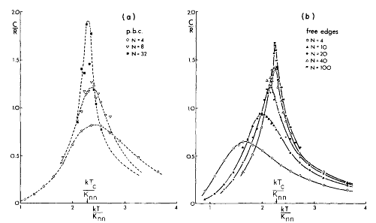
Specific Heat of 2D Ising Model
From D P Landau, Phys Rev B 13 (1976) 2997.

Slide 25
Finite-Size Scaling
Singular part of free-energy has the scaling form:
F(L,T) = L^{-(2-α)/ν} ĝ( (T-T_{c})/T_{c} L^{1/ν} )
This implies at T_{c} for large size L,
M ∝ L^{-β/ν}, χ ∝ L^{γ/ν}, C ∝ L^{α/ν}
Notes:
α, β, γ, and ν are known as critical exponents. To derive the results, we need to use the thermodynamic relation between free energy and other quantities. They are related by derivatives.

Slide 26
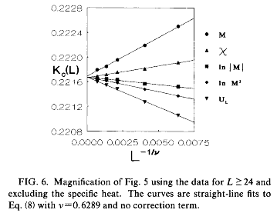
Shift of T_{c}
T_{c}(L) = T_{c}(∞) + a L^{-1/ν}
By considering the shift of T_{c} with respect to sizes, Ferrenberg, Xu, and Landau determined highly accurate 1/T_{c} = 0.221654626±0.000000005 for the 3D Ising model.
From A M Ferrenberg and D P Landau, Phys Rev B 44 (1991) 5081; A M Ferrenberg, J Xu, and D P Landau, Phys. Rev. E 97 (2018) 043301
Notes:
The shift equation for T_{c} is a consequence of the finite-size scaling. A recent paper, cond-mat/0405197, appears in disagreement with the establishment of the 3D Ising model critical exponents.

Slide 27
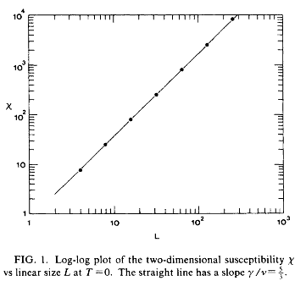
Accurate Exponent Ratio
Finite-size scaling χ ∝ L^{γ/ν} at T_{c}=0 for the three-state anti-ferromagnetic Potts model:
E(σ) = J ∑_{<i,j>} δ(σ_{i}, σ_{j})
Where σ = 1,2,3 and δ is Kronecker delta function.
We found numerically that γ/ν = 1.666 ± 0.002
From J S Wang, R H Swendsen, and R Kotecký, Phys Rev. B, 42 (1990) 2465.
Notes:
We used a cluster algorithm for the calculation.

