Slide 1
An introduction to neural network and machine learning

Slide 2
Numpy
Install with (in cmd)
pip install numpy
import numpy as np
l=[1.0,2.0,3.0]
a = np.array(l)
a[0]
np.array( ) converts list into number array.
Indexing by [0,…] (not [0][0] etc.
Notes:
https://numpy.org/ is the office numpy website which contains the complete information about it.

Slide 3
Create & change arrays
A=np.zeros(3)
B=np.zeros((3,2))
C=np.zeros((3,3),dtype=int)
Other functions that generate matrices are ones( ), eye( ), diag( ), etc.
B.flatten() # a copy of 1D data
B.reshape((2,3)) # a view of new shape
Notes:
Copy vs view, shape is given by tuple.

Slide 4
Algebra with ndarray
Element-wise +, -, *, /, if they are the same shape.
A + B; A – B; A * B; A / B
Scalar multiplication
3.0*A
Matrix multiplication
A @ B or np.matmul(A,B)
Notes:
Ndarray is a class for array, np.array( ) is a method for ndarray. An ndarray is a (usually fixed-size) multidimensional container of items of the same type and size.

Slide 5
Array functions
np.max( ), np.min( )
np.sum( )
np.transpose( ), np.trace( )
Linear algebra routines
np.linalg.solve( ), np.linalg.det( ), np.linalg.inv(), np.linalg.norm( ), etc
Random number: np.random.uniform()

Slide 6
Machine learning/neural network in physics research
“Mechanical properties of single and polycrystalline solids from machine learning,” F. N. Jalolov, et al, arXiv:2309.15868.
“Galaxy Zoo: reproducing galaxy morphologies via machine learning,” M. Banerji, et al, Monthly Notices …, 406, 342, (2010).
“Prediction of thermal boundary resistance by the machine learning method,” T Zhan, et al, Sci Rep 7, 7109 (2017).
“Searching for exotic particles in high-energy physics with deep learning,” P. Baldi, et al, Nature Comm 5, 4308 (2014).

Slide 7
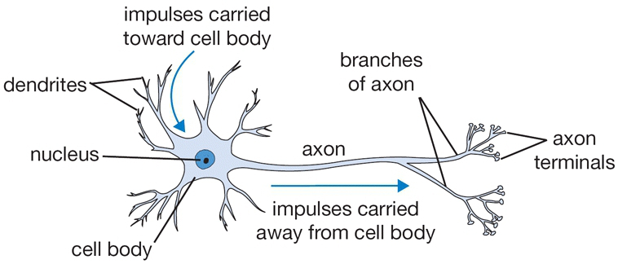
Biological neuron
Notes:
Picture from http://cs231n.github.io/neural-networks-1/

Slide 8
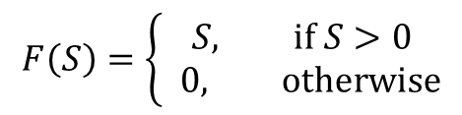
A “mathematical” neuron
x₁
w₁
x₂
w₂
output
input
…
F(.)
y
w_{N}
x_{N}
F (ReLU)
S
sssss
Notes:
The function F is called activation, and the particular form F=0 if S < 0 and F=S is called rectified linear unit or reLU.

Slide 9
(feedforward) Neural network
Y₁
X (input layer)
Y₂
x₁
Y (output layer)
x₂
x₃
Notes:
The neutral network represents a function X -> Y; this function is not known explicitly but we can present it with W and b by “training” the network.

Slide 10
Supervised “learning”
Determine W^{(i)} and b^{(i)} with a training set of inputs {x} to minimize the predicted differences.
Least square errors: we minimize (y^{(j)} is the output of j-th sample and d^{(j)} is expected value):

Slide 11
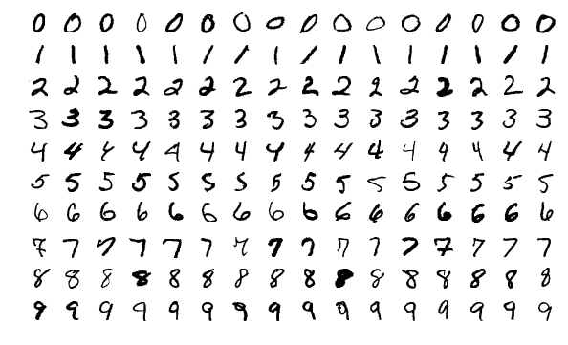
Classification problems
Handwritten digits in 28x28 grey-scale pixels
With 10 output neutrons answering the question: is it 0? is it 1? …, is it 9?
60000 for a training set, 10000 examples for testing set.
From MNIST dataset
Notes:
From MNIST dataset.

Slide 12
Network
x₁
y₀
x₂
y₁
The input “2” is a 28×28 bitmap of 0< x_{i} <1 of 784 numbers.
…
…
…
x₇₈₄
y₉
The predicted digit is j if y_{j} is a maximum, i.e., y gives a score for each of the 10 possibilities. The last step does not apply the F function.

Slide 13
Hinge loss function
Example: Given an image for 2, the 10 outputs (scores), let’s say, are 10, 2, 8, …, 13 for j = 0, 1, .., 9. Clearly, j = 2 should be the correct answer. Let take Δ=1. Then the loss is max(0, 10-8+1) + max(0,2-8+1) + … + max(0,13-8+1) = 3 + 6 = 9. {Incorrect scores get a large penalty}
The learning algorithm tries to minimize total L summed over each sample i with a “regularization” term:
Superscript n denotes the layer number of the network.
Notes:
Lambda is called super-parameter and is not changed.

Slide 14
Softmax or cross-entropy loss
Softmax method for judging the correctness of result is given by the following formula for the i-th sample. We can interpret P_{j} as a probability of having value j.
Notes:
This is essentially the principle of maximum entropy in physics. We recall the Boltzmann distribution function.

Slide 15
Update the network
The steepest descent or (stochastic) gradient descent
Where is the “stochastic” part?
W
Notes:
To evaluate the gradient efficiently we use something called back propagation on the network. “Stochastic”, we choose a small set of data for each step. The W is a vector of all the weights.

Slide 16
Back Propagation
Suppose we like to compute the derivative of Y with respect to W⁽¹⁾. We do this by the chain rule of calculus. This can be computed efficiently from the output layers down to starting layer.
Notes:
Since Y are vectors, the partial derivatives are Jacobians.

Slide 17
The gradient
Notes:
Here we have assumed one layer only, n=1, and omitted the superscript in. Lambda is called “hyper-parameter” In the derivative, we assume y = F(Wx) with retified linear function is used.

Slide 18
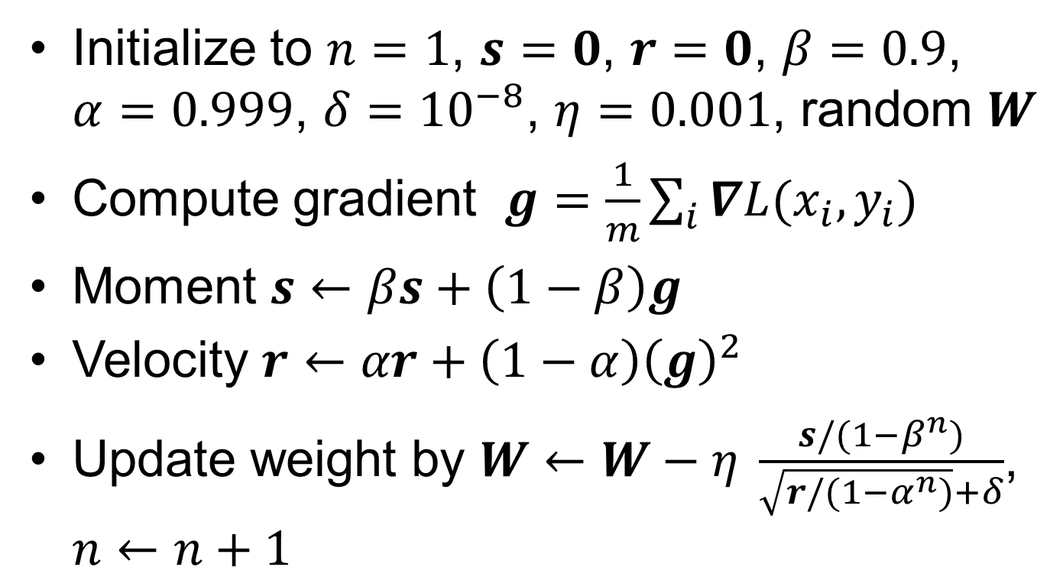
Adam algorithm
Initialize to $n=1$, $s=0$, $r=0$, $β=0.9$, $α=0.999$, $δ={10}^{−8}$, $η=0.001$, random $W$
Compute gradient $g=\frac{1}{m}\sum_{i}{∇L(x_{i},y_{i})}$
Moment $s←βs+\left(1−β\right)g$
Velocity $r←αr+\left(1−α\right){\left(g\right)}^{2}$
Update weight by $W←W−η \frac{s/(1−β^{n})}{\sqrt{r/(1−α^{n})}+δ}$, $n←n+1$
Notes:
See page 301 of Goodfellow et al. The square root and division are applied element-wise. The square of g is also element-wise.

Slide 19
Preventing under-fit and over-fit by adjust λ
Notes:
From “Deep learning”, Goodfellow, et al, page 119.

Slide 20
LASSO method to fit force constants
Problem: determine the coefficients Φ of the expansion for potential energy of a (crystal) solid as a function of atom displacement u:
Force:
Notes:
LASSO stands for “least absolute shrinkage and selection operator”. There are three related regression method, Ridge method use so-called L0 norm, LASSO use L1 norm for penalty, and the elastic-net is a linear combination of both.

Slide 21
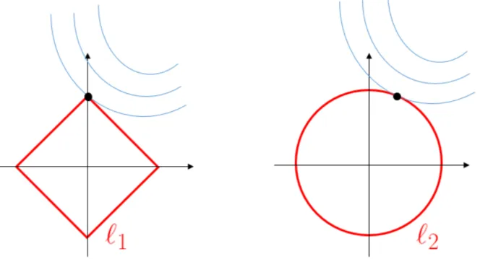
LASSO method
Notes:
We have much more coefficients to determine that the number of set set of force displacement pairs (u,f).

Slide 22
Convolutional network
Convolutional networks are simply neural networks that use convolution in place of general matrix multiplication (Wx) in at least one of their layers.
Pooling: replace the results by some static
Notes:
From Figure 9.8 in Goodfellow, et al, page 358.

Slide 23
Convolution
Convolution in math sense
x₁
x₂
x₃
Each neuron is connected to only three inputs based on locality. Three weights w₁, w₂, w₃ are the same on all of the neurons.
…
x₇₈₄

Slide 24
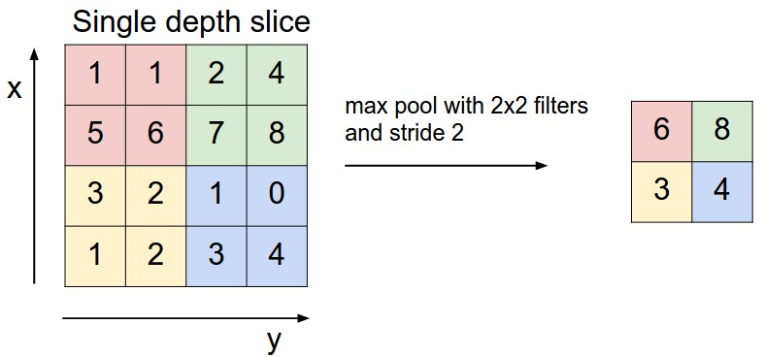
Max Pool
This is very much like the real space RG transform in physics.
Notes:
From http://cs231n.github.io/convolutional-networks/

Slide 25
Other topics not covered
Recurrent network
Boltzmann Machine/statistical mechanics
etc

Slide 26
Tensorflow
TensorFlow is an open source software library from google for high performance numerical computation.
an open-source machine learning library for research and production.
In Python, C++, javaScript.
We use high level keras.
Notes:
https://www.tensorflow.org/

Slide 27
Example codes
import tensorflow as tf
mnist = tf.keras.datasets.mnist
(x_train, y_train),(x_test, y_test) = mnist.load_data()
x_train, x_test = x_train / 255.0, x_test / 255.0
model = tf.keras.models.Sequential([
tf.keras.layers.Flatten(),
tf.keras.layers.Dense(512, activation=tf.nn.relu),
tf.keras.layers.Dropout(0.2),
tf.keras.layers.Dense(10, activation=tf.nn.softmax)
])
model.compile(optimizer='adam',
loss='sparse_categorical_crossentropy',
metrics=['accuracy'])
model.fit(x_train, y_train, epochs=5)
model.evaluate(x_test, y_test)
Notes:
For more information, see: https://www.tensorflow.org/tutorials/quickstart/beginner

Slide 28
Research Project
Can we use a convolutional neutral network to determine the critical temperatureT_{c} of 2D Ising model accurately? When the network is trained with only low (ferromagnetic phase) and high temperature (paramagnetic phase) spin configurations for the two-dimensional Ising model.

Slide 29
References
Stanford Univ CS231n “Convolutional Neural Networks for Visual Recognition,” http://cs231n.github.io/
“Deep Learning”, Goodfellow, Bengio, and Courville, MIT press (2016).
“Neural Networks”, Haykin, 3rd ed, Pearson (2008).

