Slide 1
Chapter 12
Fast Fourier Transform

Slide 2
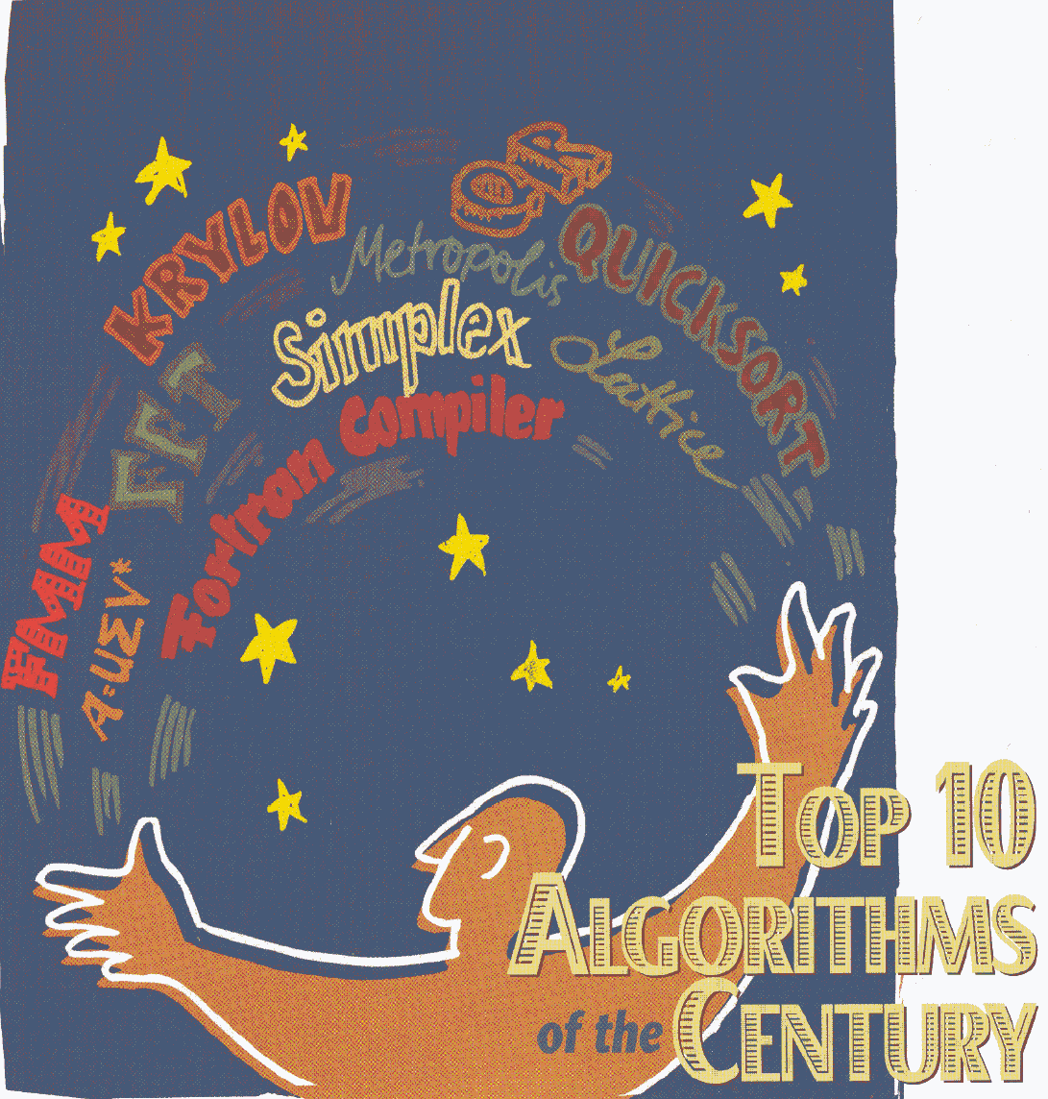
Metropolis algorithm for Monte Carlo
Simplex method for linear programming
Krylov subspace iteration (CG)
Decomposition approach to matrix computation (LU, Singular value)
The Fortran compiler
QR algorithm for eigenvalues
Quick sort
Fast Fourier transform
Integer relation detection
Fast multipole
Notes:
From “Computing in science & engineering” Jan/Feb 2000. See https://www.cs.fsu.edu/~lacher/courses/COT4401/notes/cise_v2_i1/index.html

Slide 3
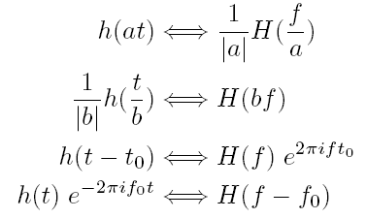
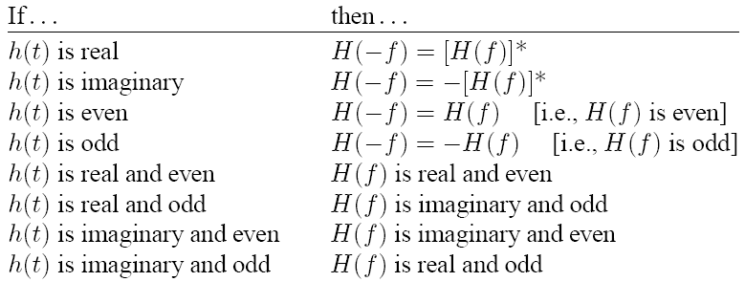
Definition of Fourier Transform
Notes:
The preferred notation in physics is the angular frequency ω, instead of frequency f.

Slide 4
Convolution, Correlation, and Power
Total power:
Autocorrelation if g = h. Autocorrelation is equal to power spectrum |G(f)|² in frequency space.

Slide 5
Sampling Theorem
Let Δ be the spacing in time domain, with h_{n}=h(nΔ), n = …,-2,-1,0,1,2,…, the sampled value of continuous function h(t). Let
f_{c}=1/(2Δ) [Nyquist critical frequency]. If H( f ) = 0 for all | f | ≥ f_{c}, then the function h(t) is completely determined by h_{n.}
Notes:
Why this is so, give a proof. Since H(f) is in a bounded domain, we can made it periodic in f, and thus we have a Fourier series in t instead of Fourier integral. However, we need a rectangular function in frequency domain to cut off a periodic
Function, this results the sinc function in the formula. See https://en.wikipedia.org/wiki/Nyquist%E2%80%93Shannon_sampling_theorem

Slide 6
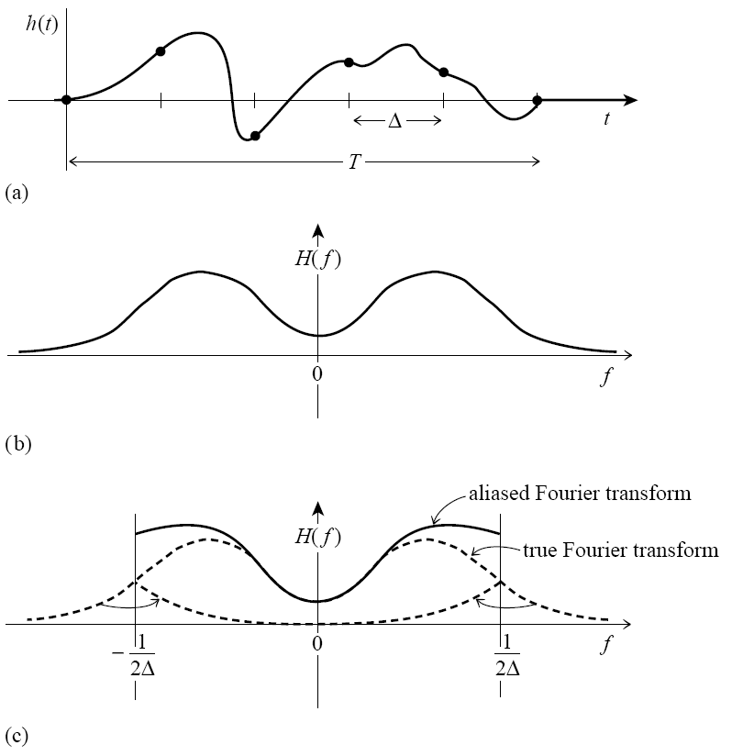
Aliasing
Figure 12.1.1. The continuous function shown in (a) is nonzero only for a finite interval of time T. It follows that its Fourier transform, whose modulus is shown schematically in (b), is not bandwidth limited but has finite amplitude for all frequencies. If the original function is sampled with a sampling interval Δ, as in (a), then the Fourier transform (c) is defined only between plus and minus the Nyquist critical frequency. Power outside that range is folded over or “aliased” into the range. The effect can be eliminated only by low-pass filtering the original function before sampling.

Slide 7
From Continuous to Discrete
Sample time at interval Δ for N points (N even), t_{k}=kΔ, k = 0, 1, 2, …, N-1.
Frequency takes values at f_{n}=n/(NΔ), n=-N/2,-N/2+1, …, 0, 1, 2,…,N/2-1.
Then

Slide 8
Discrete Fourier Transform
Definition
Some properties
  F is symmetric, F^{T}=F
  (F^{T})* F = N I
  F⁻¹=F*/N (inverse transform is obtained by replacing i with –i, and dividing by N)
Notes:
I is the identity matrix. The asterisk * stands for complex conjugate.

Slide 9
Discrete Fourier Transform – computational complexity
Slow way - O(N²)
Fast way, FFT - O(N log N)
What is the computational complexity of a matrix multiplying a vector, Ax? What if A_{ij}=A(i-j), i.e., a convolution?

Slide 10
Basic Idea of FFT
Where H^{N/2,e} is the discrete Fourier transform of N/2 points formed from even set of points, and H^{N/2,o} similar but from odd set of points. This calculation is performed recursively.

Slide 11
Example for N=8
(A) The order of input data need to be rearranged (according to binary bit-reversed pattern).
(B) Values for all k can be evaluated in place. No additional memory is needed.

Slide 12
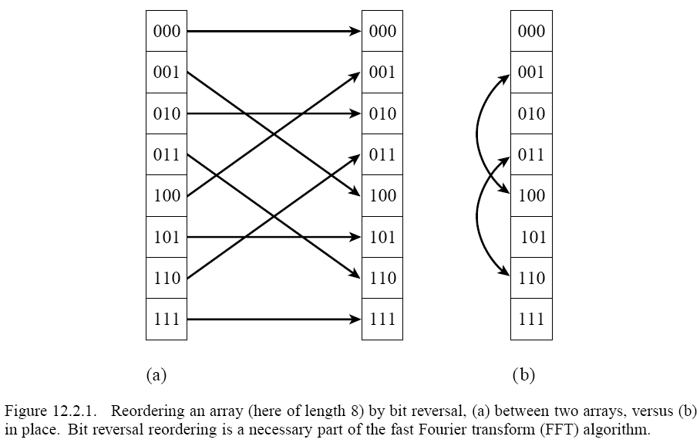
Bit Reversal

Slide 13
Example of FFT
Swap data according to bit reversal
FT of x in place
ω⁴= e^{iπk}
ω²= e^{iπk/2}
ω= e^{iπk/4}
x₀
x₀
x₀+x₄
x₀+x₄+x₂+x₆
x₀+x₄+x₂+x₆+x₁+x₅+x₃+x₇
F₂
x₁
x₄
x₀–x₄
x₀-x₄+i(x₂-x₆)
x₀-x₄+i(x₂-x₆)+e^{iπ/4} (x₁-x₅+i(x₃-x₇))
F₄
x₂
x₂
x₂+x₆
x₀+x₄-(x₂+x₆)
x₀+x₄-x₂-x₆+i(x₁+x₅-x₃-x₇)
x₃
x₆
x₂–x₆
x₀-x₄-i(x₂-x₆)
x₀-x₄-i(x₂-x₆)+ e^{iπ3/4}(x₁-x₅-i(x₃-x₇))
F₈
x₄
x₁
x₁+x₅
x₁+x₅+x₃+x₇
x₀+x₄+x₂+x₆-(x₁+x₅+x₃+x₇)
x₅
x₅
x₁–x₅
x₁-x₅+i(x₃-x₇)
x₀-x₄+i(x₂-x₆)-e^{iπ/4} (x₁-x₅+i(x₃-x₇))
x₆
x₃
x₃+x₇
x₁+x₅-(x₃+x₇)
x₀+x₄-x₂-x₆-i(x₁+x₅-x₃-x₇)
x₇
x₇
x₃–x₇
x₁-x₅-i(x₃-x₇)
x₀-x₄-i(x₂-x₆)- e^{iπ3/4}(x₁-x₅-i(x₃-x₇))
Spacing =1
Spacing =2
Spacing =4

Slide 14
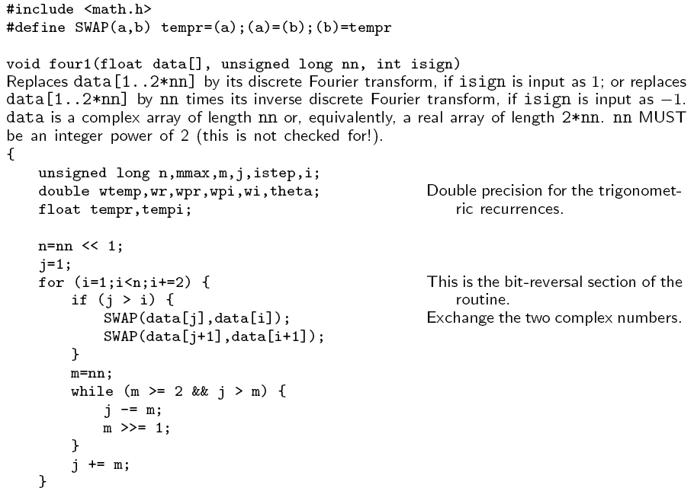
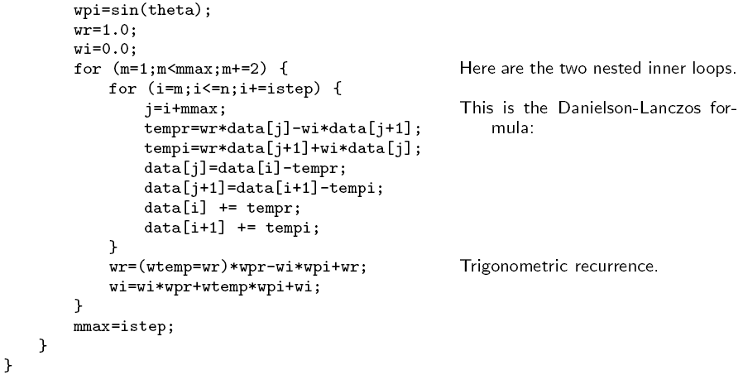
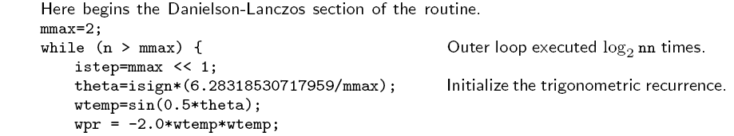
Cooley-Tukey bit reversal FFT program
FFT runs in O(N log N)

Slide 15
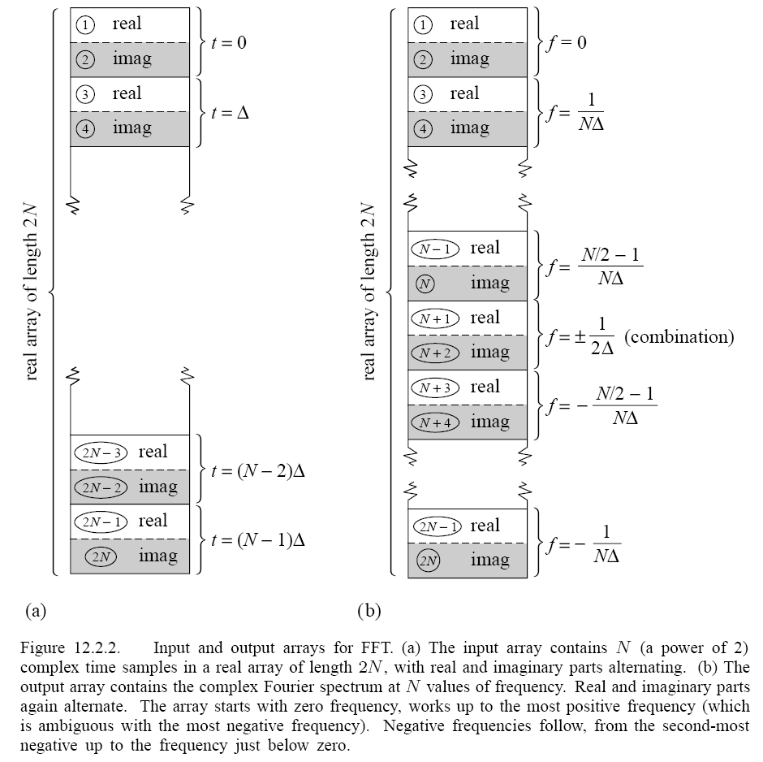
Input
Output

Slide 16
Wavelets
Fourier transform is local in frequency domain and nonlocal in time
Wavelet transforms are generalization that is local in both
Discrete wavelet transform is some kind of matrix transform y = Fx, where F^{T}F=I
Wavelets are used in data compression and efficient representation of functions

Slide 17
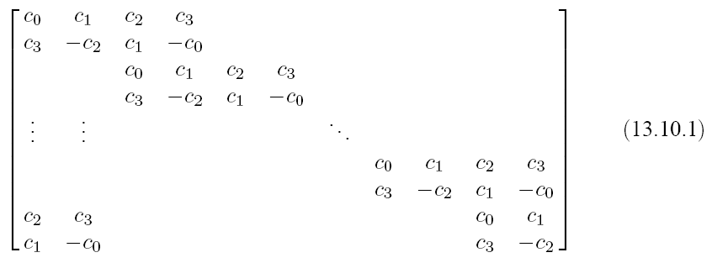
Daubechies Wavelet Filter
F =
The coefficients c_{i} are determined by requirements of orthogonality (F^{T}F=I), and certain “vanishing moments”.

Slide 18
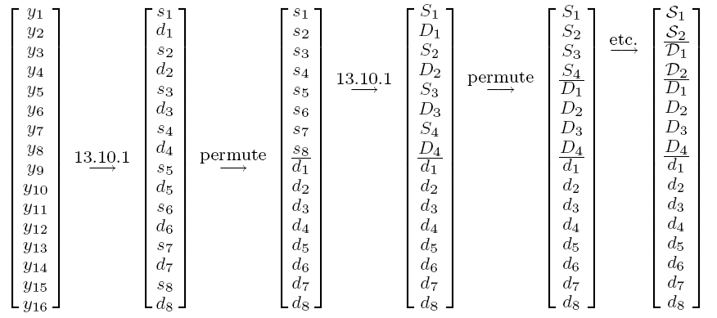
Discrete Wavelet Transform
F
F
F
Apply F to the upper half of the vector only

Slide 19
Suggested Reading and Software
For an in-depth discussion of FFT algorithms, see C van Loan, “Computational Frameworks for the Fast Fourier Transform”
For state-of-the-art free software in C, use FFTW at http://www.fftw.org/
FFT in python:
from numpy.fft (or scipy.fftpack) import fft
Notes:
The definition of DFT used in scipy or numpy has opposite sign conversion compare with NR, i.e., the forward Fourier transform is sum h_n exp( - i 2pi nk/N).

Slide 20
Problem set 8
In the mode-coupling theory of heat transport through materials, one need to solve a set of coupled nonlinear integral-differential equations numerically as follows:
(a) Transform the first equation into frequency domain and solve (algebraically) g in terms of Γ. (b) Describe a procedure to solve the system iteratively using FFT.
Where ω_{k}² are given, and g_{k}(t) and Γ_{k}(t) are unknown real functions. Dot means time derivative.

