Slide 1
Week 6,
Feynman’s diagrams, Hedin’s equations
Feynman’s rule, Hedin’s equation, GW method, functional derivatives

Slide 2
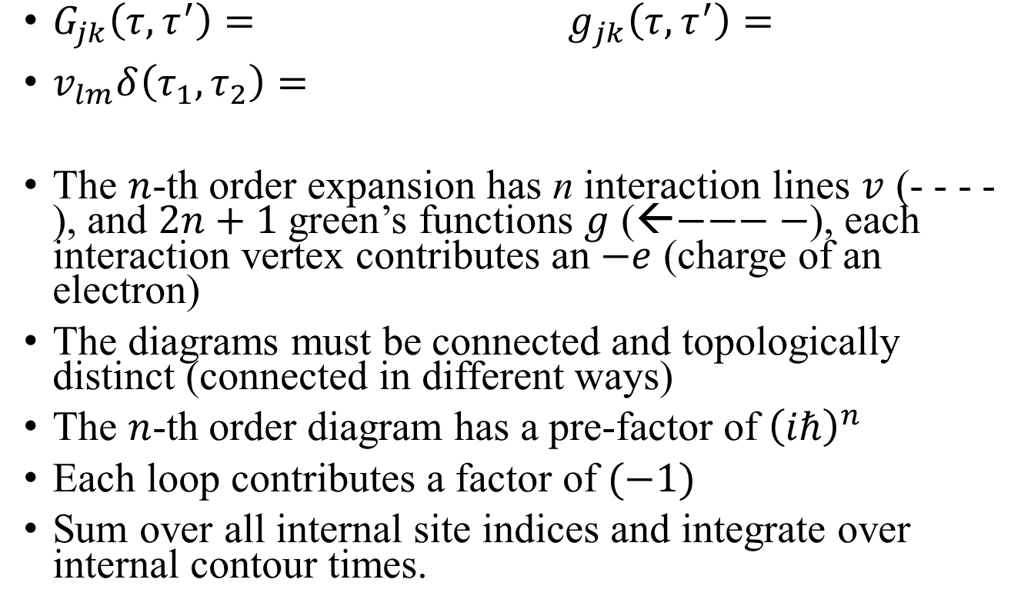




Feynman’s rule for G
$G_{jk}\left(τ, τ^{′}\right)=$ $g_{jk}\left(τ,τ^{′}\right)=$
$v_{lm}δ\left(τ_{1},τ_{2}\right)=$
The $n$-th order expansion has n interaction lines $v$ (- - - -), and $2n+1$ green’s functions $g$ (←$−−−−$), each interaction vertex contributes an $−e$ (charge of an electron)
The diagrams must be connected and topologically distinct (connected in different ways)
The $n$-th order diagram has a pre-factor of ${\left(iℏ\right)}^{n}$
Each loop contributes a factor of $(−1)$
Sum over all internal site indices and integrate over internal contour times.
$$j,τ$$
$$k,τ′$$
$$l,τ_{1}$$
$$m,τ_{2}$$
Notes:
The direction of arrows on g (noninteracting), or G (with interaction) is from the creation operator to the annihilation operator. The interaction v itself is symmetric, so there is no arrow on it. The standard notation for v is the wiggly line. However, I have difficulty drawing it with PowerPoint, I replace it with dotted line.

Slide 3





Fundamental interaction vertex, emission/absorption of virtue photon
$$m,τ_{2}$$
$−$e
$$l,τ_{1}$$
$$j,τ$$
$$k,τ′$$

Slide 4













G up to second order
$$=$$
$$+$$
$$+$$
$$+$$
$$+$$
$$+$$
$$+$$
$$+$$
$$+$$
$$+$$
$$+$$
$$+$$
$$+$$
$$+ O(v^{3})$$
Notes:
See also figure 10.5 on page 285 in Stefanucci and van Leeuwen, “Nonequilibrium Many-body …”

Slide 5








Self energy and Dyson equation
$$=$$
$$+$$
$$+$$
$$+$$
$$+$$
$$+$$
$$+$$
$$+ O(v^{3})$$
$$=$$
$$+$$
Notes:
See also page 298, Fig.6.14 in Giuliani and Vignale, “Quantum theory of the electron liquid”.

Slide 6





Hedin equations
$$=$$
$$+$$
$$=$$
$$+$$
3
4
1
2
$$=$$
1
2
4
1
2
$$=$$
1
2
3
3
$$=$$
Γ
1
2
Notes:
See Stefanucci and Leeuwen, “Nonequilibrum many-body …”, or Morawetz, “Interacting systems far from equilibrium, quantum kinetic theory”.

Slide 7
GW approximation (RPA)
$$=$$
$$+$$
$$=$$
$$+$$
1
2
$$=$$
1
2
1
2
$$=$$
2
1
Notes:
RPA: random phase approximation, this referred to the approximation to Pi. Check the correctness of the equations by dimensions, [G]=[g]=1/h, so [g Sigma t^2] = 1, [vPi t^2] = 1, the extra t^2 due to convolution in time, two times. Note I have absorbed deta(tau, tau’) into the v in the dyson equation W = v + v*Pi*W. So [Sigma] = h/t^2, [Pi] = e^2/h. So the dimensions for the expressions of Sigma and Pi are consistent.

Slide 8
Density functional theory
Notes:
KS: Kohn-Sham. For a good introduction to density functional theory, see Parr and Yang, “Density-functional theory of atoms and molecules”. If we take only the exchange part and no correlation, then DFT is equivalent to Hartree-Fock method. f( ) is fermi function, usually at T -> 0 in DFT.

Slide 9
Deriving the Hedin equations, starting point – introducing external driving

Slide 10
Derive an equation of motion for G, replace the Coulomb interaction term by a functional derivative
Notes:
{ v \dot delta / \delta phi }, is diagonal in the space of site, with the diagonal elements indicated in the bracket. Note v is a maitrx, d/dphi is a vector, the dot product produces a vector which populate the diagonal. read page 287 of Hedin equation notes. Phi is external potential, V^{tot} is total potential (that is, external plus Hartree contribution).
Tau^+ means take the derivative, then set tau value slight later than tau itself.

Slide 11
Functional derivative
Notes:
Functional: map a function phi(tau) into a number F. The last equation defines what we call functional derivative of F with respect to the function phi(tau).

Slide 12
By a change of variable from G to G⁻¹, we turn it into a Dyson equation

Slide 13
Define dielectric function, eliminate φ in favor of V ^{tot}

Slide 14
Charge-charge correlation χ, screened potential W
Notes:
It can be shown that chi and W are symmetric (in some sense), but epsilon is not.

Slide 15
Define vertex function, use it to express Π
Notes:
The Ward identity is a relation between vertex function Gamma and self energy Sigma.

Slide 16
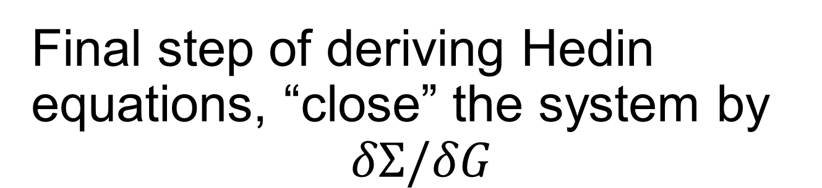
Final step of deriving Hedin equations, “close” the system by
$$δΣ/δG$$
Notes:
See also Giustino, Rev Mod Phys. 89, 015003 (2017).

