Slide 1
NEGF method for transport mediated by photons and the super-Planckian problem
Jian-Sheng Wang
Department of Physics,
National University of Singapore

Slide 2
Outline
Tight-binding model for electrons
NEGF theory of energy, momentum, and angular momentum transfer, Meir-Wingreen formulas
Applications
van der Waals force vs Biot-Savart law
Super-Planckian near-field radiation in 2D metals

Slide 3
Electron tight-binding model with bath(s)
$$G^{r}\left(E\right)={\left(E−H−Σ^{r}\left(E\right)\right)}^{−1}$$
$$G^{<}\left(E\right)=G^{r}\left(E\right)Σ^{<}\left(E\right)G^{a}\left(E\right)$$
$$Σ^{<}\left(E\right)=−f(E)\left(Σ^{r}\left(E\right)−Σ^{a}\left(E\right)\right)$$
$$Σ^{a}\left(E\right)={\left(Σ^{r}\left(E\right)\right)}^{†}$$
system
bath

Slide 4
Electron-field interaction, Peierls substitution
system
$$\sum{c_{j}^{†}H_{jk}c_{k}\exp\left(−ie/ℏ\int_{k}^{j}{A⋅dr}\right)}$$
bath
$A$ : vector field

Slide 5
NEGF definitions

Slide 6
Fluctuation-dissipation theorem in thermal equilibrium
Callen and Welton 1951,
Eckhardt 1984

Slide 7
Dyson equations

Slide 8
Keldysh equation

Slide 9
From surface integral to volume integral
α

Slide 10
Self energy $Π$
diamagnetic
RPA

Slide 11
Meir-Wingreen formula
Krüger, et al (2012); Strekha, et al, PRA
Notes:
Levi Civita symbol

Slide 12
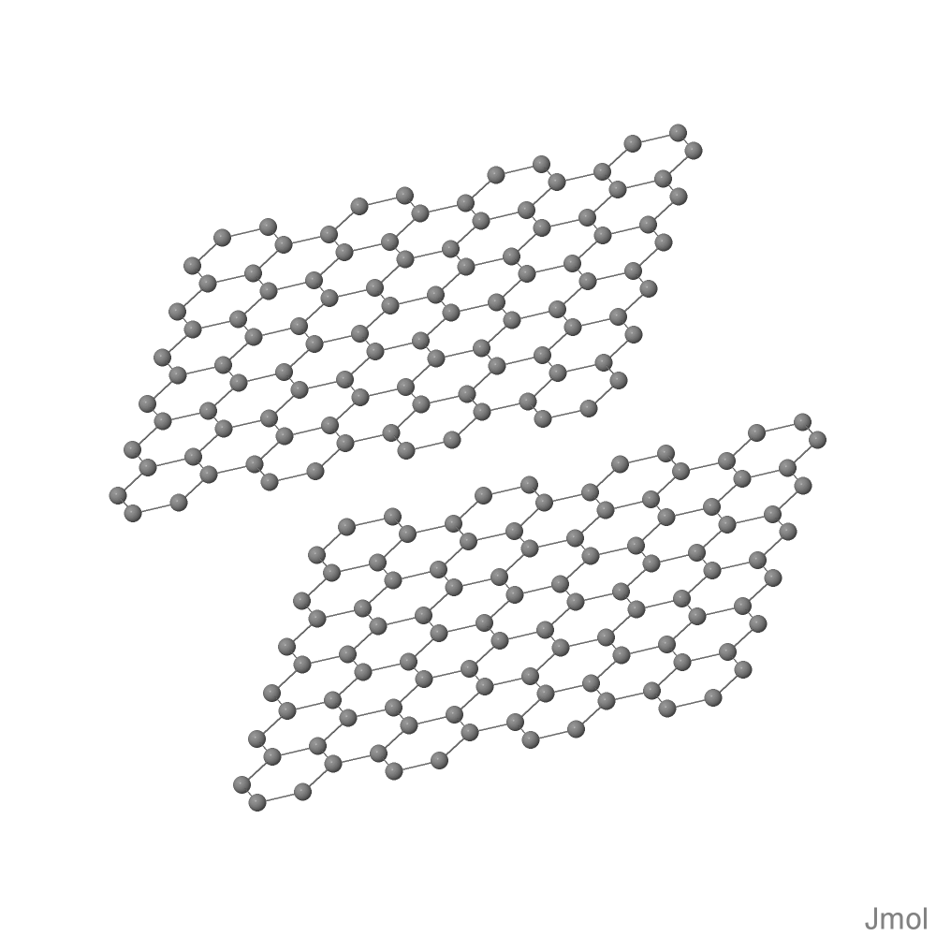
van der Waals force between current-carrying graphene nanostrips
nearest neighbor hopping t = 2.7 eV
Chemical potential bias, $μ_{L}={−μ}_{R}=−1$eV, electric current $1.2×{10}^{−4}$A. Temperature at 300 K.
d
$$μ_{R}$$
$$μ_{L}$$
$$μ_{R}$$
$$μ_{L}$$

Slide 13
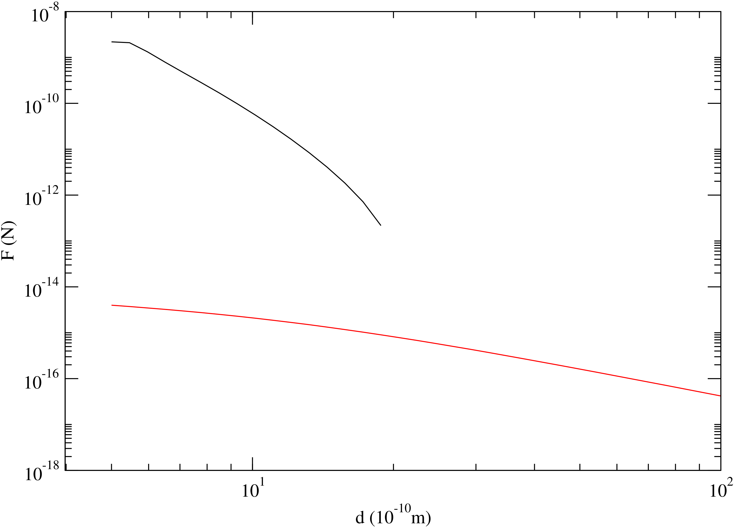
Force between two 13 × 8 armchair graphene with chemical potential biases of ±1 eV. Black: fluctuational force; red: additional force due to current (Biot-Savart law). J.-S. Wang and M. Antezza, in preparation.

Slide 14
Heat transfer in on 2D metals, super-Planckian problem
1000 K
300 K
y
x
z
d

Slide 15
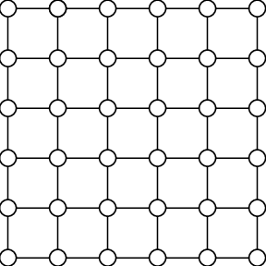
Drude model approximation to photon self-energy $Π$
$$Π_{lμ,l^{′}ν}^{r}\left(ω\right)=\frac{a^{2}e^{2}ω\left(\frac{n}{m}\right)}{2iη+ω}δ_{l,l^{′}}δ_{μ,ν}$$
$n$: electron surface density
$m:$ electron effective mass
$2η=1/τ:$ inverse relation time
$a:$ lattice constant (4 a.u.)
a

Slide 16
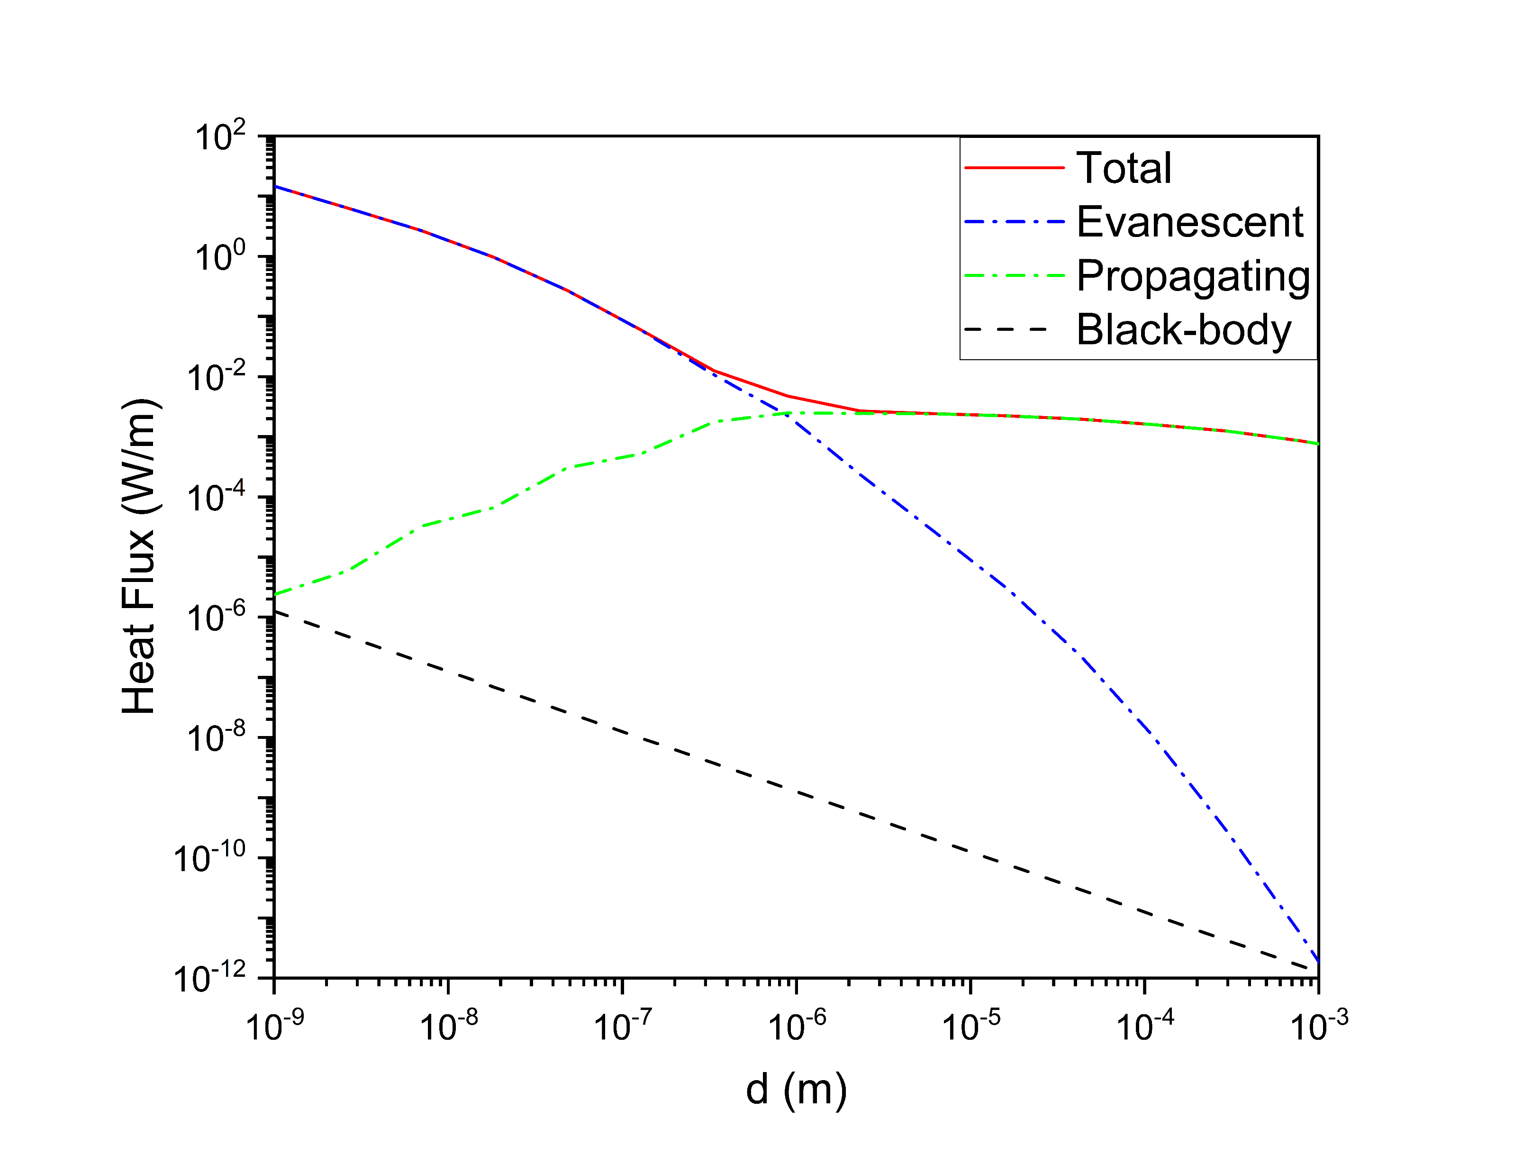
Fig. 1. Heat flux between coplanar 2D metals as a function of gap sizes. The materials properties are calculated by the Drude model. The red line is the total heat flux; the blue- and green-dotted lines are results from evanescent waves and propagating waves, respectively. The black-dashed line is the Black-body result given by the Stefan-Boltzmann law with a geometrical view factor F = a/2d, where a = 4 a.u. is the lattice constant and d is the gap size.
Some parameters:
Lx = 160, Lz = 640,
T1=1000 K, T2=300 K
w_max = 10*Kb*(T1+T2)
q_max = 5/d for total and evanescent q_max = w/c for propagating
W_n = 512
a_lat = 4 a.u.
Rcut = 1.6

Slide 17
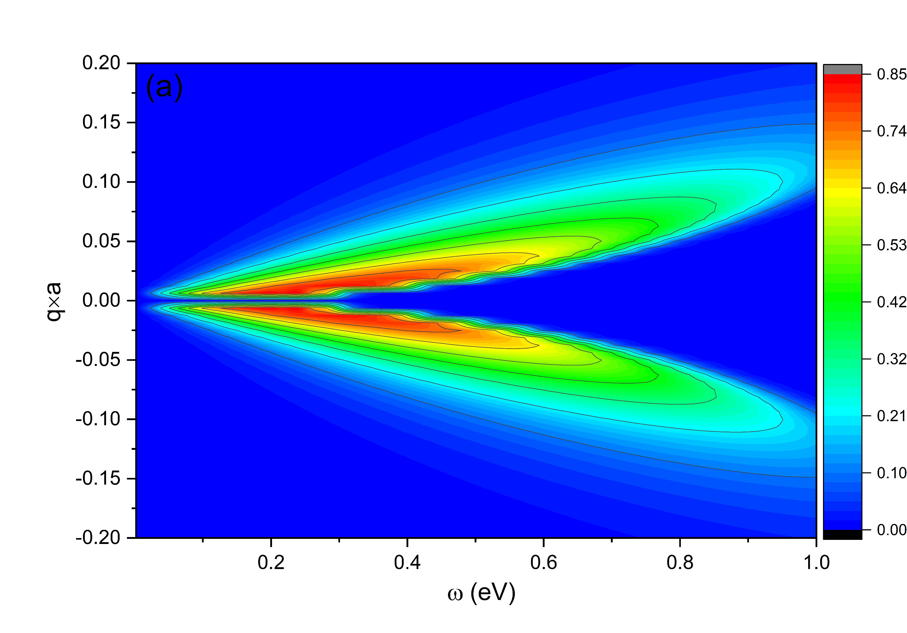
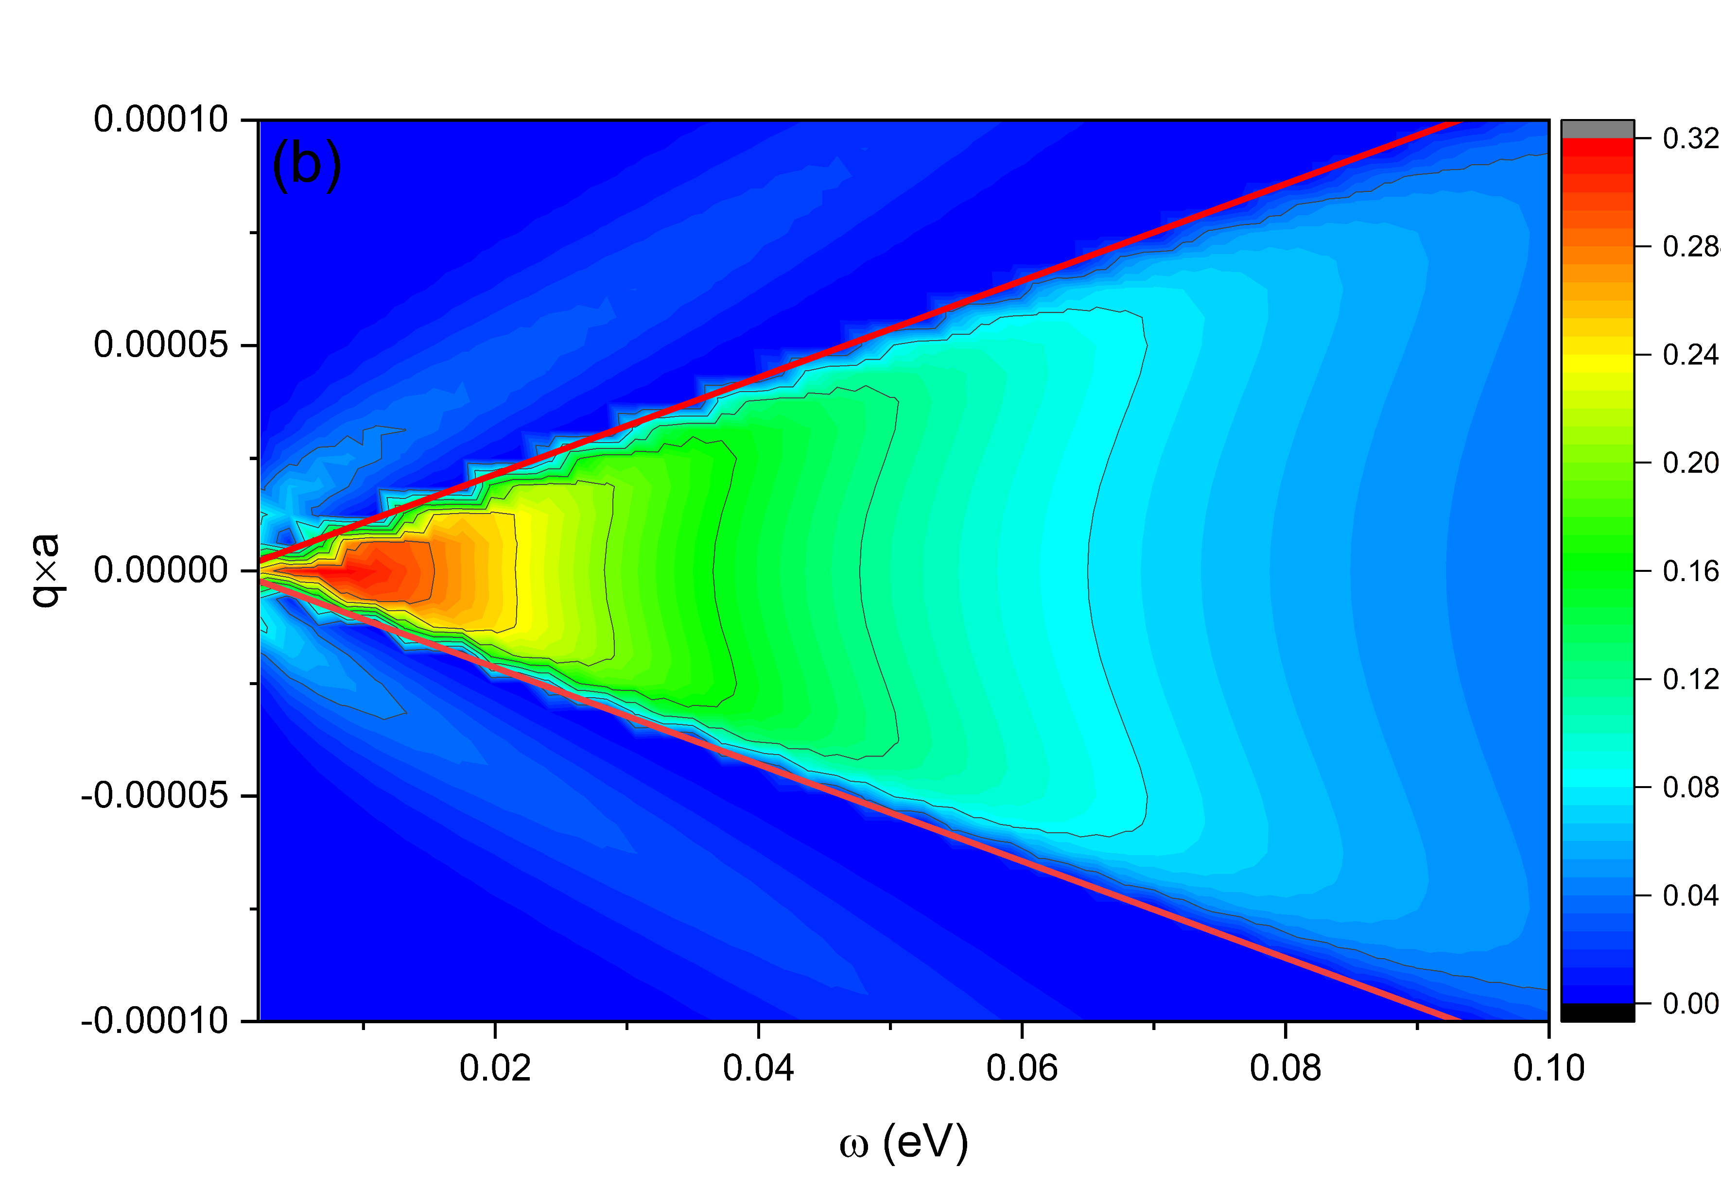
Fig. 2. Spectrum of transmission function as a function of frequency and wavevector with the gap size (a) d = 10 a.u. and (b) d = 10000 a.u. The materials properties are calculated by the Drude model. The red lines in (b) are given by $ω$/c, which represents the boundary of propagating and evanescent waves.
T. Zhu, Y.-M. Zhang, and J.-S. Wang, in preparation.

Slide 18
Acknowledgements
Tao Zhu, Tiangong University, Tianjin, China
Mauro Antezza, Univ Montpellier, CNRS

