Slide 1
Photonic Bath at Infinity
PTES/WTT Harbin, China, 12 – 17 July 2026
Jian-Sheng Wang
Department of Physics, National University of Singapore

Slide 2
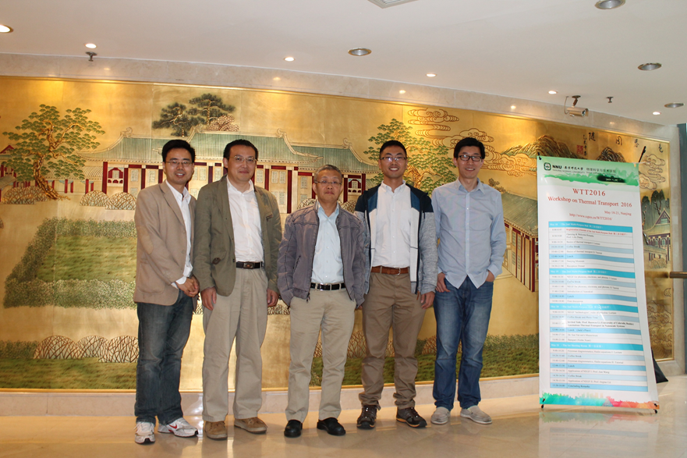
WTT2016
Notes:
Lifa Zhang, Jian Wang, Jian-Sheng Wang, Nan Zeng, Jingtao Lv on WTT2016.

Slide 3
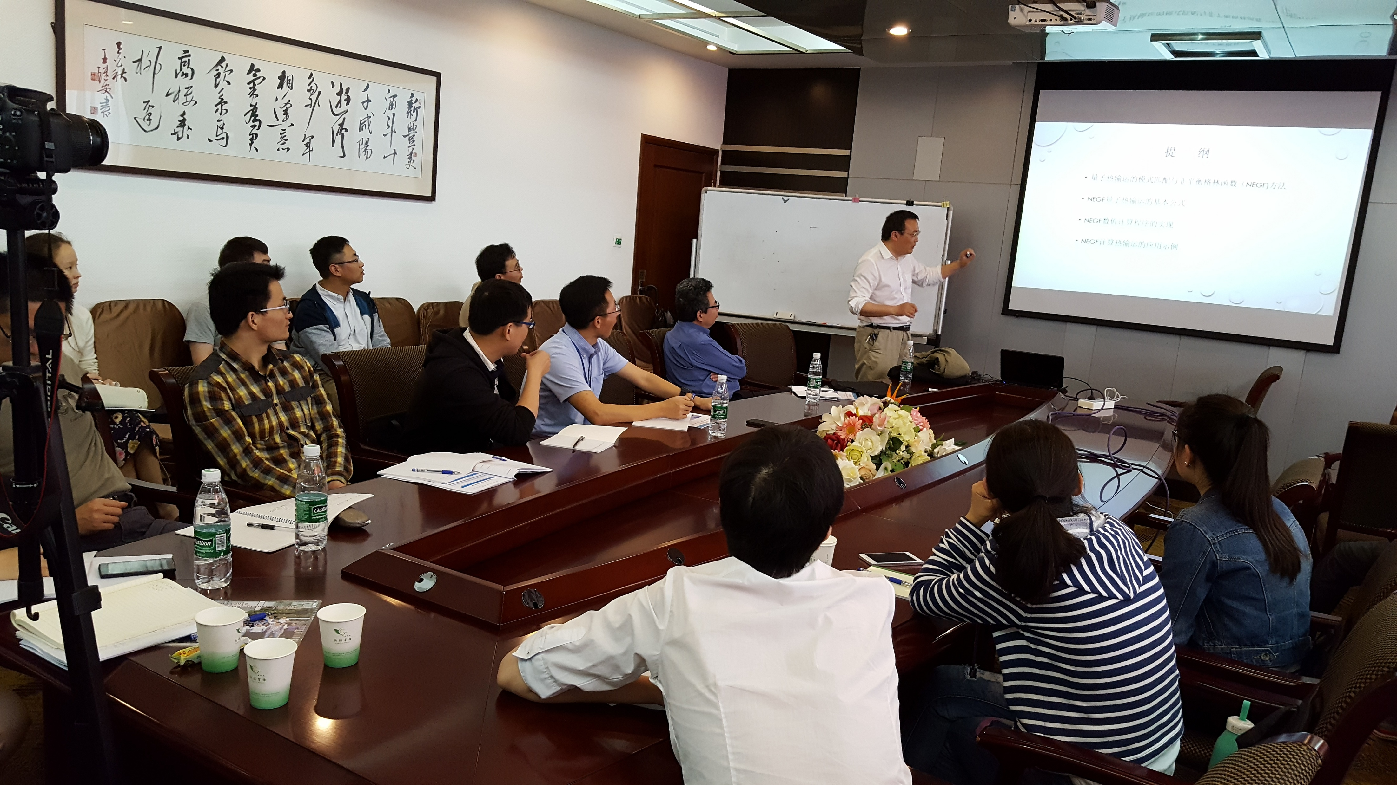
Jian Wang (Yangzhou) gave a lecture

Slide 4
Outline
Baths (or leads) in electronic and phononic transport
The dust model as a bath at infinity
Nonequilibrium Green’s function (NEGF) theory of energy transfer, the Meir-Wingreen formula
The bath at infinity for different geometries
Illustrative application
  Bath at infinity as a black body
  Far-field radiation to infinity in Floquet driving
Conclusion

Slide 5



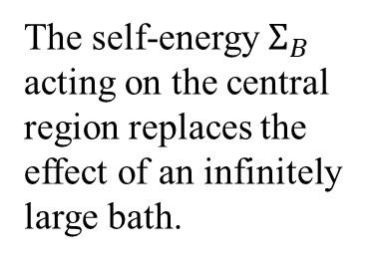
1D chain
self-energy
bath
$$→∞$$
center
$\left(\begin{matrix}{{\left(ω+iη\right)}^{2}−K}_{C} & {−K}_{CB} \\ {−K}_{BC} & {{\left(ω+iη\right)}^{2}−K}_{B}\end{matrix}\right)\left(\begin{matrix}G_{CC} & G_{CB} \\ G_{BC} & G_{BB}\end{matrix}\right)=I$
$g^{α}\left(ω\right)={\left({\left(ω+iη\right)}^{2}−K_{α}\right)}^{−1}$, $α=C, B$
$G_{CC}(ω)={\left({\left(ω+iη\right)}^{2}−K_{C}−Σ_{B}\left(ω\right)\right)}^{−1}$
The self-energy $Σ_{B}$ acting on the central region replaces the effect of an infinitely large bath.
$$Σ_{B}\left(ω\right)=K_{CB}g^{B}\left(ω\right)K_{BC}$$
Datta, “Electronic transport …’’; Wang, Wang, Lü, 2008

Slide 6

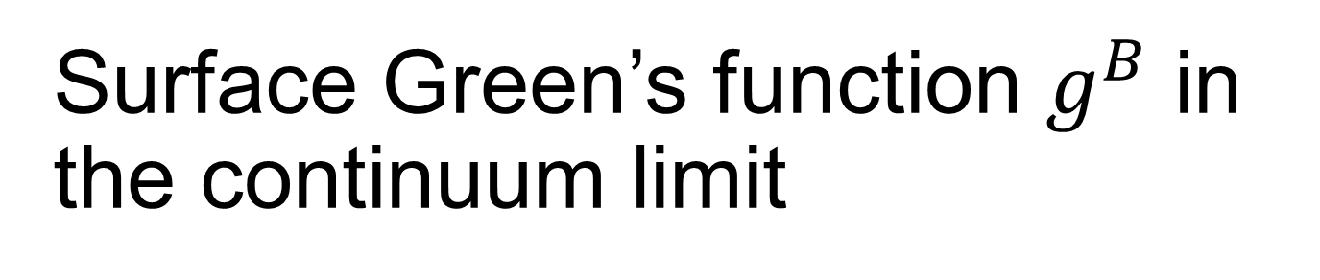
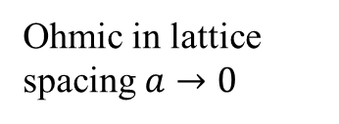

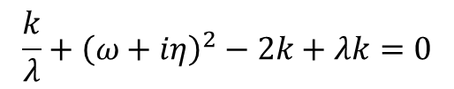
Surface Green’s function $g^{B}$ in the continuum limit
$\left[{\left(ω+iη\right)}^{2}I−\left(\begin{matrix}2k & −k & 0 & … \\ −k & 2k & −k & 0 \\ 0 & −k & 2k & −k \\ … & 0 & −k & ⋱\end{matrix}\right)\right]g^{B}=I$
$g_{j1}^{B}=−\frac{λ^{j}}{k}$, $j=1,2,⋯$
$λ∼e^{iω/\sqrt{k}}$
$$\frac{k}{λ}+{\left(ω+iη\right)}^{2}−2k+λk=0$$
$$g_{11}^{B}=const −iω k^{3/2}$$
Ohmic in lattice spacing $a→0$

Slide 7





Dust model (Eckhardt 1984) vs boundary self-energy
$$Π_{∞}$$
Integrate out the volume
$$Π_{1}$$
$$Π_{1}$$
$$R$$
$$Π_{0}$$

Slide 8

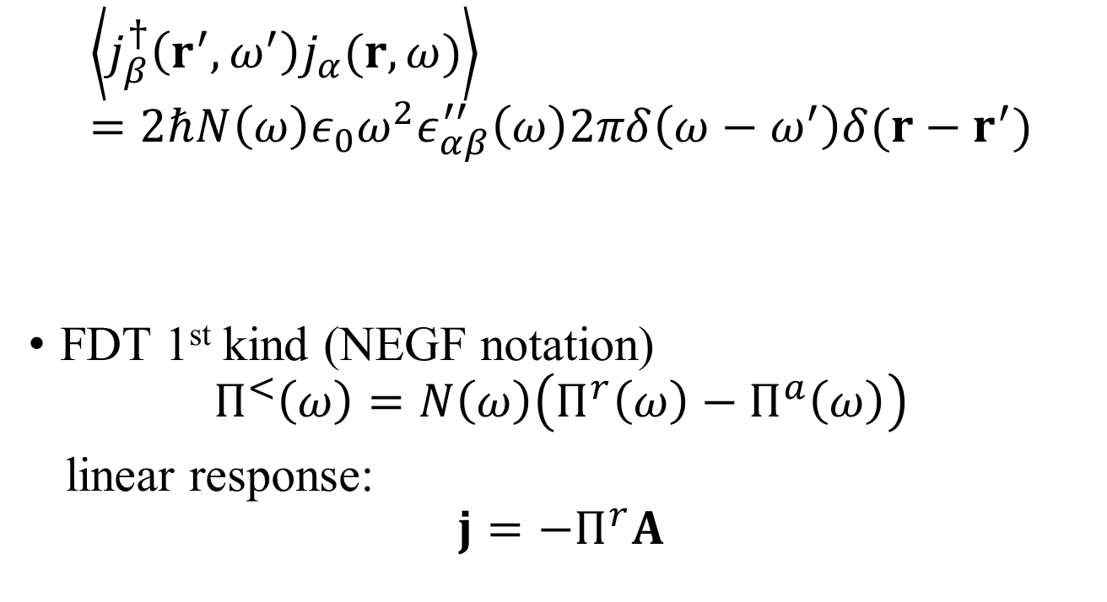
Fluctuation-dissipation theorem (2nd kind)
$$\left\langle j_{β}^{†}\left(r^{′},ω^{′}\right)j_{α}(r,ω)\right\rangle =2ℏN\left(ω\right)ε_{0}ω^{2}ε_{αβ}^{′′}\left(ω\right)2πδ\left(ω−ω^{′}\right)δ(r−r^{′})$$
FDT 1st kind (NEGF notation)
$$Π^{<}\left(ω\right)=N\left(ω\right)\left(Π^{r}\left(ω\right)−Π^{a}\left(ω\right)\right)$$
linear response:
$$j=−Π^{r}A$$
Callen and Welton 1951,
Rytov 1953, Kubo 1966,
Eckhardt 1984
permittivity
$$Π^{r}=ω^{2}ε_{0}\left(1−ε\right)=−iωσ$$
conductivity

Slide 9

NEGF, definitions
See AGD, chapter 6
Henneberger 2008
vector potential
$φ=0$ gauge
Heisenberg-Pauli 1930;
B. S. Kay 2021.
Notes:
Abrikosov, Gorkov, Dzyaloshinski

Slide 10
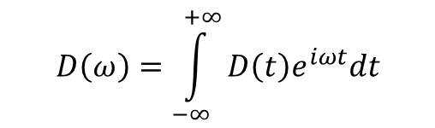

Fluctuation-dissipation theorem in thermal equilibrium
Eckhardt 1984
Agarwal 1975
Bose function
$$D\left(ω\right)=\int_{−∞}^{+∞}{D\left(t\right)e^{iωt}dt}$$
$$β=\frac{1}{k_{B}T}$$

Slide 11





Dyson equations
Haug & Jauho
$$τ$$
Keldysh eq
contour ordered
contour-time $τ$
real-time $t$
$$\underset{v^{−1}}{\underbrace{ }}$$
Two linear responses:
$$A=−D^{r}j_{ex}$$

Slide 12
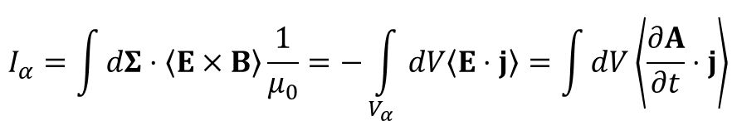
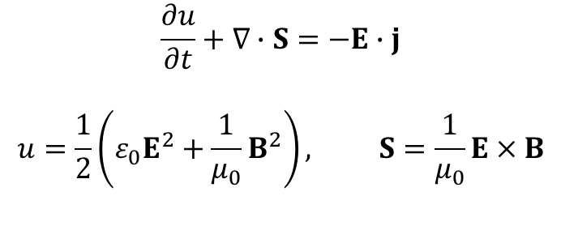
Poynting theorem and heat transfer
$$\frac{∂u}{∂t}+∇∙S=−E∙j$$
$$u=\frac{1}{2}\left(ε_{0}E^{2}+\frac{1}{μ_{0}}B^{2}\right), S=\frac{1}{μ_{0}}E×B$$
α
$$I_{α}=\int{dΣ⋅\left\langle E×B\right\rangle \frac{1}{μ_{0}}=−\int_{V_{α}}{dV\left\langle E⋅j\right\rangle }}=\int{dV\left\langle \frac{∂A}{∂t}⋅j\right\rangle }$$

Slide 13
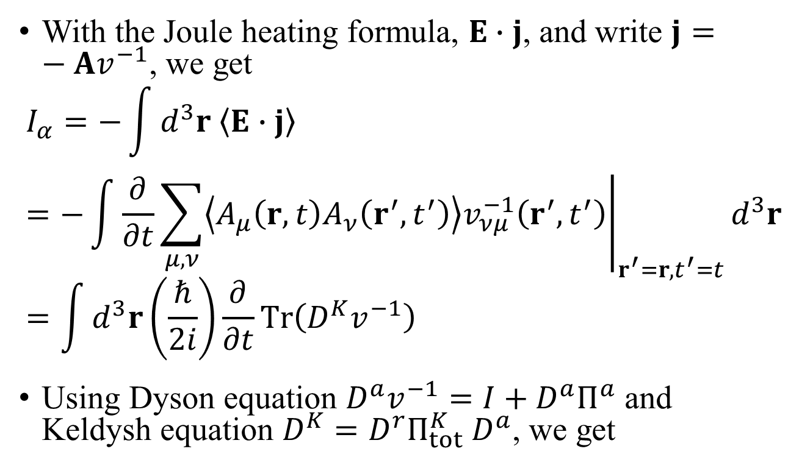
Deriving the Meir-Wingreen formula
With the Joule heating formula, $E∙j$, and write $j=−Av^{−1}$, we get
$$I_{α}=−\int{d^{3}r \left\langle E∙j\right\rangle }=−\int{{\left.\frac{∂}{∂t}\sum_{μ,ν}{\left\langle A_{μ}\left(r,t\right)A_{ν}\left(r^{′},t^{′}\right)\right\rangle v_{νμ}^{−1}\left(r^{′},t^{′}\right)}\right|}_{r^{′}=r,t^{′}=t}}d^{3}r=\int{d^{3}r\left(\frac{ℏ}{2i}\right)\frac{∂}{∂t}Tr\left(D^{K}v^{−1}\right)}$$
Using Dyson equation $D^{a}v^{−1}=I+D^{a}Π^{a}$ and Keldysh equation $D^{K}=D^{r}Π_{tot}^{K}{ D}^{a}$, we get

Slide 14
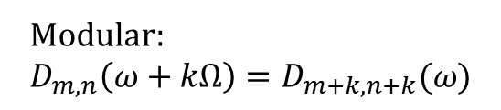
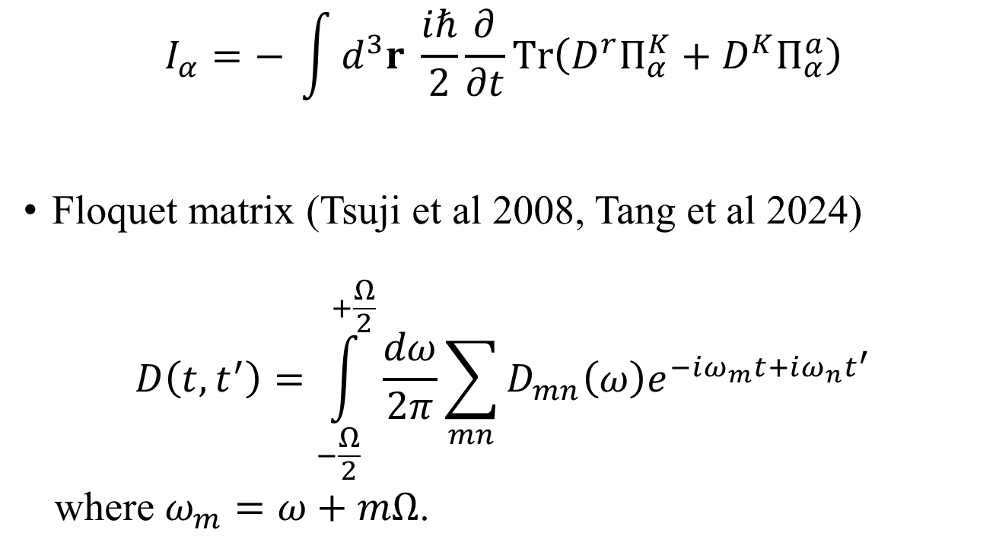
Meir-Wingreen formula
$$I_{α}=− \int{d^{3}r \frac{iℏ}{2}}\frac{∂}{∂t}Tr\left(D^{r}Π_{α}^{K}+D^{K}Π_{α}^{a}\right)$$
Floquet matrix (Tsuji et al 2008, Tang et al 2024)
$$D\left(t,t^{′}\right)=\int_{−\frac{Ω}{2}}^{+\frac{Ω}{2}}{\frac{dω}{2π}\sum_{mn}{D_{mn}\left(ω\right)e^{−iω_{m}t+iω_{n}t^{′}}}}$$
where $ω_{m}=ω+mΩ$.
Modular:
$$D_{m,n}\left(ω+kΩ\right)=D_{m+k,n+k}(ω)$$

Slide 15
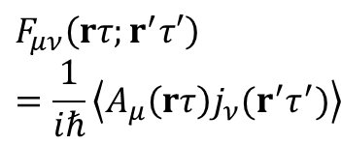
Steady-state Meir-Wingreen formula
Krüger, et al (2012); Strekha, et al (2022);
Wang, et al, Front. Phys. (2023).
$$F_{μν}\left(rτ;r^{′}τ′\right)=\frac{1}{iℏ}\left\langle A_{μ}\left(rτ\right)j_{ν}(r^{′}τ^{′})\right\rangle$$
Notes:
Levi Civita symbol

Slide 16
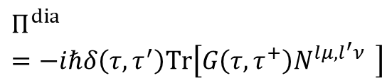

Self-energy $Π_{1}$
$$Π^{dia}=−iℏδ\left(τ, τ^{′}\right)Tr\left[G\left(τ,τ^{+}\right)N^{lμ,l^{′}ν } \right]$$
diamagnetic
RPA

Slide 17

Emission to infinity
$$T_{∞}=0$$

Slide 18
From Meir-Wingreen to Landauer
local equilibrium
No Landauer form for force and torque!

Slide 19
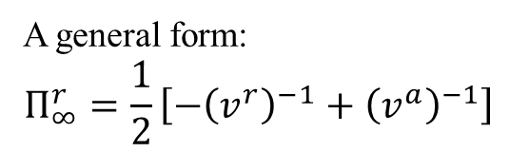

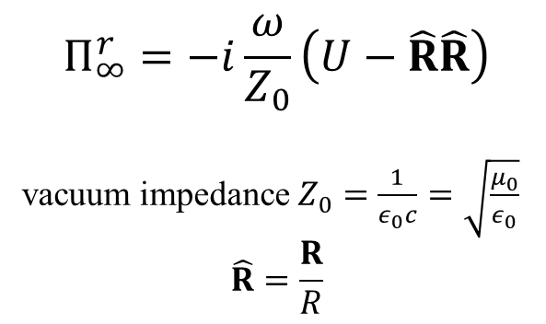
Bath at infinity
Eckhardt, PRA 29, 1991 (1984)
Krüger, et al, PRB 86, 115423 (2012)
$$Π_{∞}^{r}=−i\frac{ω}{Z_{0}}\left(U−\hat{R}\hat{R}\right)$$
vacuum impedance $Z_{0}=\frac{1}{ε_{0}c}=\sqrt{\frac{μ_{0}}{ε_{0}}}$
$$\hat{R}=\frac{R}{R}$$
$$∞$$
A general form:
$$Π_{∞}^{r}=\frac{1}{2}\left[−{\left(v^{r}\right)}^{−1}+{\left(v^{a}\right)}^{−1}\right]$$

Slide 20
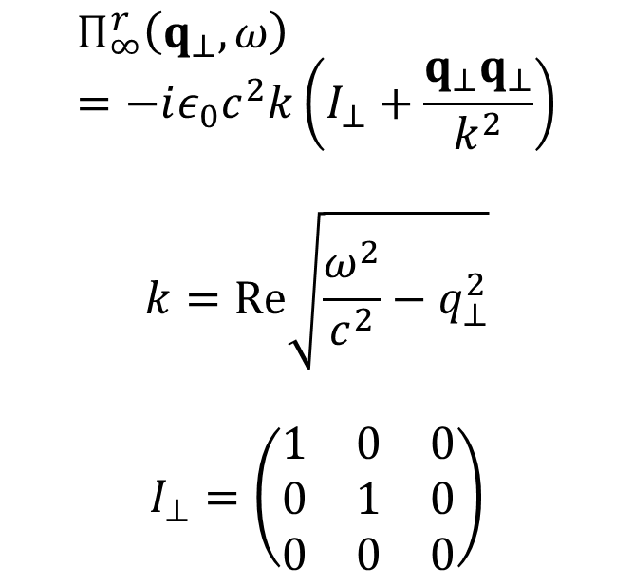



Bath at $∞, p$lanar geometry
$$Π_{∞}^{r}\left(q_{⊥},ω\right)=−iε_{0}c^{2}k\left(I_{⊥}+\frac{q_{⊥}q_{⊥}}{k^{2}}\right)$$
$$k=Re\sqrt{\frac{ω^{2}}{c^{2}}−q_{⊥}^{2}}$$
$$I_{⊥}=\left(\begin{matrix}1 & 0 & 0 \\ 0 & 1 & 0 \\ 0 & 0 & 0\end{matrix}\right)$$
$$q_{⊥}$$
z
$$Π_{∞}$$

Slide 21
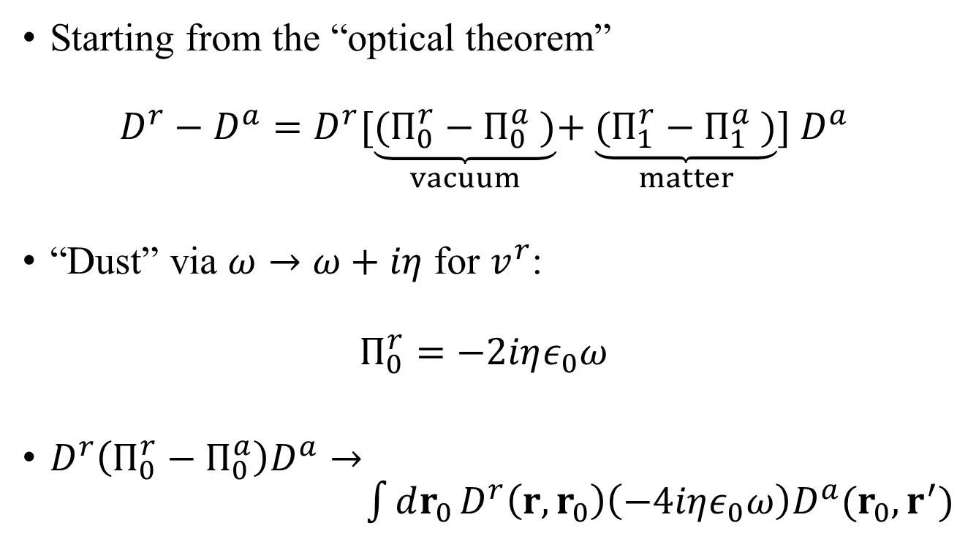
From the dust model to boundary self-energy
Tang, Ren, Wang, arXiv:2605.02265
Starting from the “optical theorem”
$$D^{r}−D^{a}=D^{r}[\underset{vacuum}{\underbrace{(Π_{0}^{r}−Π_{0}^{a} )}}+\underset{matter}{\underbrace{(Π_{1}^{r}−Π_{1}^{a} )}}{] D}^{a}$$
“Dust” via $ω→ω+iη$ for $v^{r}$:
$$Π_{0}^{r}=−2iηε_{0}ω$$
$D^{r}\left(Π_{0}^{r}−Π_{0}^{a}\right)D^{a}→ \int{dr_{0}}D^{r}\left(r,r_{0}\right)\left(−4iηε_{0}ω\right)D^{a}(r_{0},r^{′})$

Slide 22
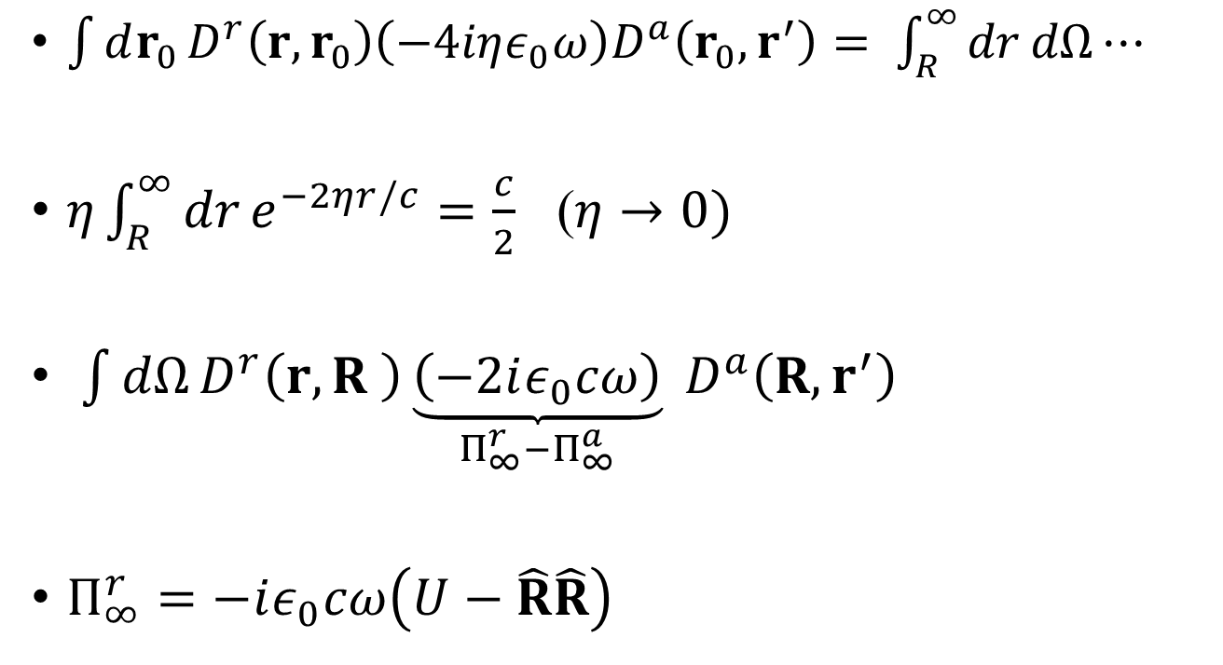

Integrating over $r$
$\int{dr_{0}}D^{r}\left(r,r_{0}\right)\left(−4iηε_{0}ω\right)D^{a}\left(r_{0},r^{′}\right)= \int_{R}^{∞}{dr}dΩ⋯$
$η\int_{R}^{∞}{dr}e^{−2ηr/c}=\frac{c}{2}$ ($η→0)$
$\int{dΩ}D^{r}\left(r,R \right)\underset{Π_{∞}^{r}−Π_{∞}^{a}}{\underbrace{\left(−2iε_{0}cω\right)}} D^{a}\left(R,r^{′}\right)$
$Π_{∞}^{r}=−iε_{0}cω\left(U−\hat{R}\hat{R}\right)$
The bath self-energy is purely transverse.

Slide 23

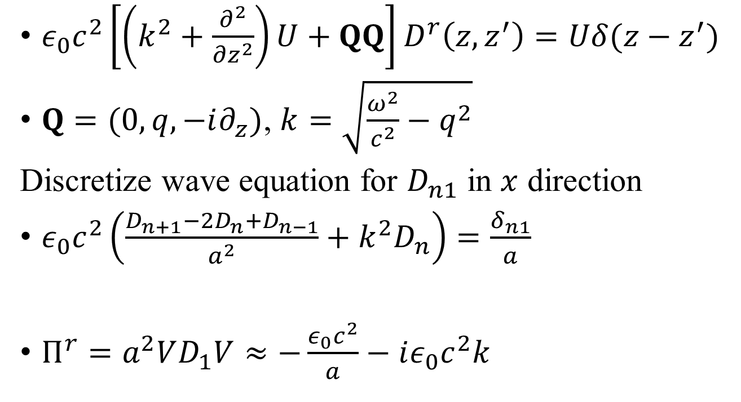
Bath at infinity: surface Green’s function approach
$ε_{0}c^{2}\left[\left(k^{2}+\frac{∂^{2}}{∂z^{2}}\right)U+QQ\right]D^{r}\left(z,z^{′}\right)=Uδ(z−z^{′})$
$Q=(0,q,−i∂_{z})$, $k=\sqrt{\frac{ω^{2}}{c^{2}}−q^{2}}$
Discretize wave equation for $D_{n1}$ in $x$ direction
$ε_{0}c^{2}\left(\frac{D_{n+1}−2D_{n}+D_{n−1}}{a^{2}}+k^{2}D_{n}\right)=\frac{δ_{n1}}{a}$
$Π^{r}=a^{2}VD_{1}V≈−\frac{ε_{0}c^{2}}{a}−iε_{0}c^{2}k$
$$V=\frac{ε_{0}c^{2}}{a^{2}}$$
Peng, et al, 2017

Slide 24

Recover the Planck law
$$T$$
R
0

Slide 25
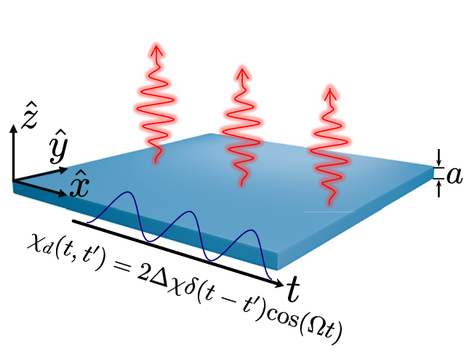
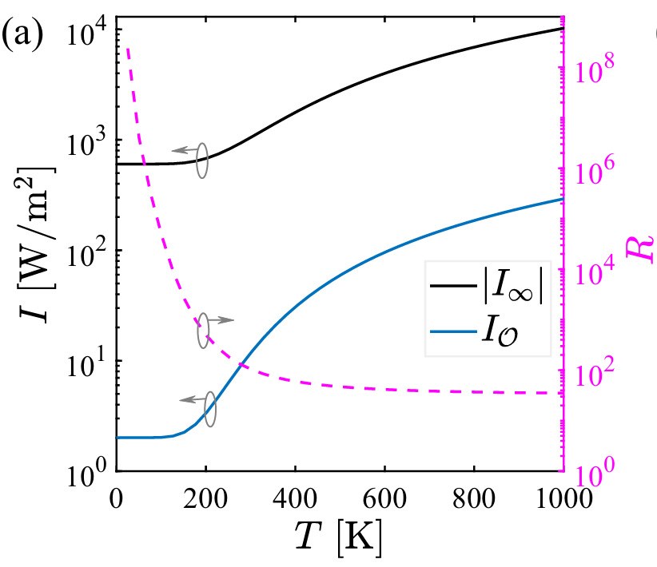
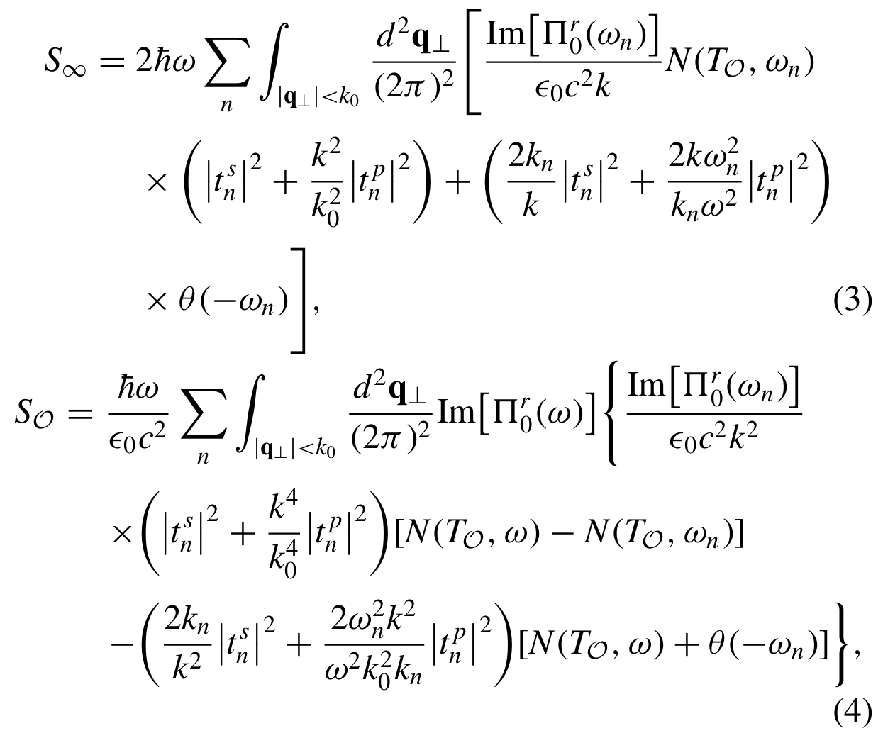


Floquet driving
SiC film $a=0.52 μ$m
Zhu, Pan, Tang, Zhang, Wang, PRB 2026
$$R=I_{∞}(Δχ=2.5)/I_{∞}(0)$$

Slide 26
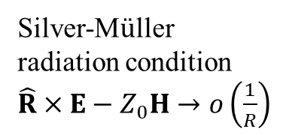
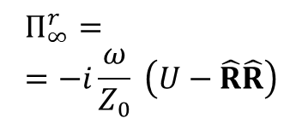
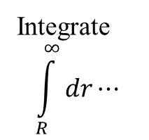
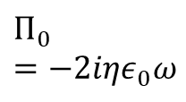
Volume dust vs boundary self-energy
$$Π_{∞}^{r}==−i\frac{ω}{Z_{0}} \left(U−\hat{R}\hat{R}\right)$$
Integrate
$$\int_{R}^{∞}{dr}⋯$$
$$Π_{1}$$
$$Π_{1}$$
$$R$$
Silver-M$ü$ller radiation condition $\hat{R}×E−Z_{0}H→o\left(\frac{1}{R}\right)$
$$Π_{0}=−2iηε_{0}ω$$

Slide 27
Conclusion
We replace the infinite volume with a boundary (surface) for the self-energy, thereby improving computational efficiency. This is analogous to the lead self-energy in electronic and phononic mesoscopic transport.
The bath at infinity behaves as a black body.
It is indispensable for energy conservation and far-field thermal radiation.

Slide 28
Acknowledgements
Gaomin Tang
Hui Pan
Yuhua Ren
Huimin Zhang
Yong-Mei Zhang
Tao Zhu
Jiebin Peng
…

